Slide 1
About This Presentation
READ THE SLIDE NOTES FOR PRESENTATION DETAIL
Author(s) | VCF Technical Marketing | VMware by Broadcom
How to use this deck | This VCF Technical Overview presentation discusses Cloud Foundation architecture, technical features and configuration detail. Use the Master Technical presentation as an appendix to the Technical Overview. This deck may be updated frequently - ensure you are using the most recent revision.
Distribution and Audience type | Internal, External, Partner, Customer. These slides are not to be redistributed outside of Broadcom. Do not send them to or include them in slide decks provided directly to customers, partners, VMUGs, etc. nor submit any part of this content to VMUGs, Explore, WWKO, etc. without the explicit permission of the author or authoring team. Check the URL below for a PDF version that may be left with customers if needed. The speaker notes are the property of Broadcom and may not be distributed in any manner. Read the speaker notes carefully before presenting this material. All content in speaker notes is provided for educational purposes only and is not intended to be disseminated widely to non-Broadcom employees. Check the documentation for the final “how to” for any feature.
Content Type | Intermediate 200-300 Level. Suitable for Infrastructure Architects, Cloud Architects, Virtualization, Storage and Networking teams
Time To Present | Can be delivered partially or in full depending on your timeframe
Last updated | First Published May, 2025
Primary Copy (PDF) | https://sales-resources.broadcom.com/group/vcf/vsphere-technical
CONTENT UPDATED REGULARLY: Please download the latest copy from the SRC prior to presenting
Notes:
Key Message:
Understand how to best use this deck.
Talk Track:
This VCF Technical Overview presentation discusses Cloud Foundation Architecture, technical features and configuration detail.
Can be delivered partially or in full depending on your timeframe (allow time for discussion and interaction).
This deck is broken up into several sections, each focused on a particular subject.
This allows you to present the material that is specific to your audience and avoid topics that may not be relevant or of interest.
Please refer to the agenda for the complete list of topics. Each slide in this deck will contain a set of speaker notes to help guide you in presenting the material.
The talk track is a guide that you can personalize to match your own presentation style.
For a full VCF Technical Deep Dive with a lot more technical detail please refer to the VCF Master Technical deck as an appendix to this presentation.
This deck is not a replacement for product documentation.
Refer to individual product resources and documentation for product specific technical details.
Notes:
From time-to-time content contained within this deck is modified and updated so please ensure you download the latest copy from the SRC prior to presenting this content.
For vendor integrated solutions of VMware Cloud Foundation some of this content may not apply. Please refer to your vendor.
Resources:
For further technical information please refer to the Cloud Foundation Documentation
https://docs.vmware.com/en/VMware-Cloud-Foundation/index.html

Slide 2
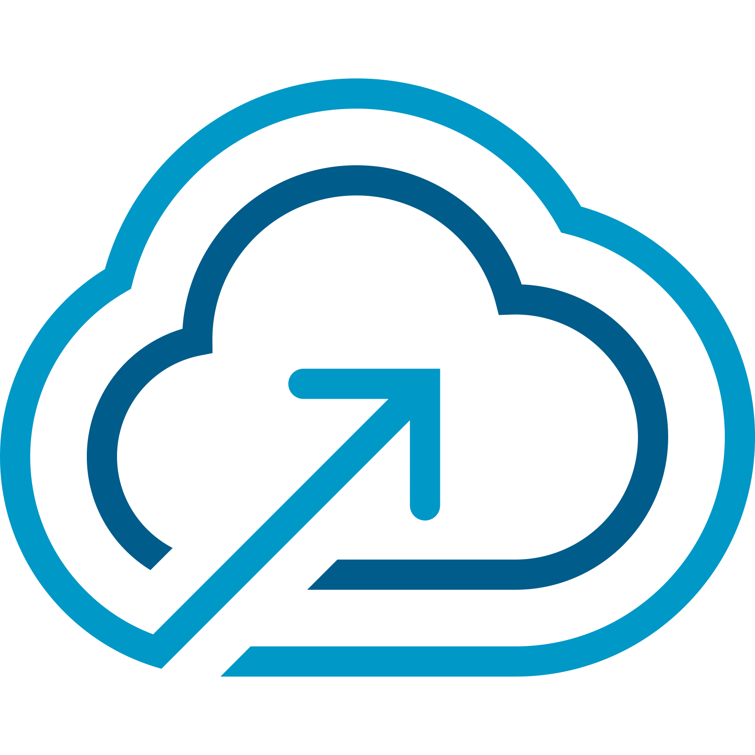
VMware Cloud Foundation 9
Technical Overview – Part 1
Notes:
Key Message:
Opening slide
Talk Track:
Welcome! My name is <name> and I work in the <name or organization> at Broadcom. Today, I want to discuss Cloud Foundation architecture, technical features and configuration detail.
Notes:
Resources:
To gain a greater understanding of VCF features, key concepts and how they are used please refer to the VCF Master Technical (Deep Div)e presentation.
VMware Cloud Foundation 9.0 Release Notes:
https://docs.vmware.com/en/VMware-Cloud-Foundation/index.html

Slide 3
01
Introducing VMware Cloud Foundation
02
Modernize Your Infrastructure
03
Deliver a Unified Cloud Experience
Agenda
04
Secure and Protect your Private Cloud
05
Add-on Services
06
Resources

Slide 4


VMware Cloud Foundation Platform for your Private Cloud
BUSINESS INFRASTRUCTURE INITIATIVES
Modern Infrastructure
Unified Cloud Experience
Secure and Resilient Platform
Build and Operate private cloud infrastructure on-premises or at the edge
Build, run and manage Kubernetes and other modern workloads
Implement Ransomware protection and recovery
PRIMARY USE CASES
Implement automated infrastructure to deliver IaaS
Build, run and manage Private AI
Implement disaster recovery
Extend data center to the cloud
Run and manage traditional workloads (e.g. ERP, Database, VDI)
Integrate security, compliance, and resilience
Notes:
Key Message:
Discussion of VCF key business and infrastructure initiatives Talk Track:
The latest release of VMware Cloud Foundation (VCF) 9 marks a significant milestone as the first major update following the Broadcom acquisition. This release underlines VMware's commitment to advancing our flagship product - VCF, with a focus on three key business and infrastructure initiatives: Modernizing Infrastructure, Cloud Experience for Developers, and Strengthening Security and Resilience.
Let’s briefly talk about how Cloud Foundation 9 accelerates these initiatives
Notes:
Resources:

Slide 5

Modernize Infrastructure
Infrastructure transformation and modernization
Build or modernize a private cloud infrastructure
Automate to provide IaaS via a self-service catalog
Extend your data center into the cloud
Broadcom Proprietary and Confidential. Copyright © 2024 Broadcom.
5
All Rights Reserved. The term “Broadcom” refers to Broadcom Inc. and/or its subsidiaries.
Notes:
Key Message:
VCF 9 has been designed to deliver a modern private cloud infrastructure
Talk Track:
VCF 9 has been designed to deliver a next-generation infrastructure that supports scalable, efficient, and agile operations. With enhanced scalability and operational efficiency, VCF provides the ability to bridge with existing VMware environments, enabling customers to leverage their current investments while taking advantage of advanced features and capabilities. These improvements are crafted to meet the demands of modern datacenters and edge locations, providing a robust foundation for IT environments.
The result? Transforming legacy systems for greater efficiency, cost reductions, and faster time to market. Enhanced scalability and performance optimize infrastructure for modern workloads and seamless migrations.
Notes:
Resources:

Slide 6
Cloud Experience for Developers
Modern application support and Private AI
Deliver Infrastructure-as-Code
Run business critical and modern workloads in production
Implement Private AI with NVIDIA (Private AI Foundation with NVIDIA)
Broadcom Proprietary and Confidential. Copyright © 2024 Broadcom.
6
All Rights Reserved. The term “Broadcom” refers to Broadcom Inc. and/or its subsidiaries.
Notes:
Key Message:
Empowering developers with a cloud-native experience is crucial in the era of digital transformation.
Talk Track:
Empowering developers with a cloud-native experience is crucial. VCF 9 offers a unified platform for both traditional and modern applications, simplifying deployment, management, and scaling across private and public clouds. New developer-friendly tools and APIs streamline the development process, enabling faster innovation and greater flexibility. Enhanced support for containerized applications and Kubernetes ensures that developers can build and deploy applications efficiently, driving business agility and competitive advantage.
Additionally, VCF 9 simplifies application deployment and management with quick start templates, easy network integration, and advanced performance insights, all helping to drive faster time to market and increased developer productivity.
Notes:
Resources:

Slide 7
Security and Resilience
Build, protect, and recover systems and data
Protect and recover from ransomware
Design and implement a disaster recovery-ready infrastructure
Build and integrate security, compliance and resilience into IT*
* Presales use case only, no discrete deliverable. Outcome leads back to cloud infrastructure capabilities relevant to security, compliance and resilience, also needs external mapping to ANS for any non-VCF Division security considerations (microseg, DFW, etc.)
Broadcom Proprietary and Confidential. Copyright © 2024 Broadcom.
7
All Rights Reserved. The term “Broadcom” refers to Broadcom Inc. and/or its subsidiaries.
Notes:
Key Message:
VCF 9 provides comprehensive security features and ensures operational resilience
Talk Track:
In today’s threat landscape, security and resilience become key to every IT budget and initiative. VCF 9 provides comprehensive security features and ensures operational resilience. Advanced security measures address data privacy and sovereignty concerns while improving threat detection and response capabilities. Unified security management and enhanced data protection safeguard critical information, ensuring compliance with regulatory requirements. The focus on minimizing downtime and maintaining a robust security posture allows organizations to operate confidently in a dynamic environment.
What customers benefit from is the ability to deliver private cloud system integrity with flexible live patching and dual DPU support. Achieving higher availability, optimized network performance, and robust data protection for resilient operations.
Notes:
Resources:

Slide 8


Deliver a Unified
Cloud
Experience
Secure
and Protect your Private Cloud
Modernize
Infrastructure
Architecture & Topologies
Deployment & Scale
Compute, Storage & Networking
Private Cloud Operations
Deliver Self-service IaaS
Migrating to VCF
Infrastructure for Kubernetes
Private AI
Operations
Infrastructure
Resiliency
Security
Notes:
Key Message:
VMware Cloud Foundation Drives Modernization, Enhances Developer Productivity and delivers a highly Secure cloud platform.
Talk Track:
VMware Cloud Foundation Drives Modernization, Enhances Developer Productivity and delivers a highly Secure cloud platform.
As we dive into VCF, we will see how VCF 9 streamlines infrastructure management and reduce complexity. How it speeds up development cycles through infrastructure that is easy to consume and update. How it delivers a Secure Infrastructure that you can continuously count on. And how it delivers faster time to value, by bringing together key stakeholders using a modern private cloud.
Notes:
Resources:

Slide 9
Modernize infrastructure
VCF Architecture & Topologies
Notes:
Key Message: Workload domains are core to VMware Cloud Foundation architecture.
Talk Track: VMware Cloud Foundation is an integration of SDDC components which come together as a full platform to provide Application-ready infrastructure. Now lets quickly take a look at the architecture.
Notes:
References:

Slide 10


Private Cloud Building Blocks
Workload Domains
VMware Cloud Foundation
Automation
Operations
Lifecycle
Compute
Storage
Networking
Notes:
Key Message:
A workload domain is best described as “Application-ready Infrastructure”. Each workload domain can be configured as self-contained capacity for customer application workloads.
Talk Track:
At the center of cloud foundation architecture is the construct of a workload domain.
Workload domains are purpose-built units of private cloud capacity. Workload domains utilize standardized repeatable infrastructure, allowing you to move away from provisioning and managing separate silos of custom infrastructure.
Workload domains are configured with dedicated resources for compute, storage, networking and security using in-built workflows. Once operational, admin staff can easily scale capacity and perform daily operations and lifecycle management of each domain as an independent unit.
Notes:
This slide introduces workload domains as a concept. More detail will come on the following slides.
Resources: Refer to the VMware Cloud Foundation Design Guide for further information on Workload Domains: https://techdocs.broadcom.com/us/en/vmware-cis/vcf.html
Refer to Getting Started Guide for further information on Getting Started with VMware Cloud Foundation: https://techdocs.broadcom.com/us/en/vmware-cis/vcf.html

Slide 11
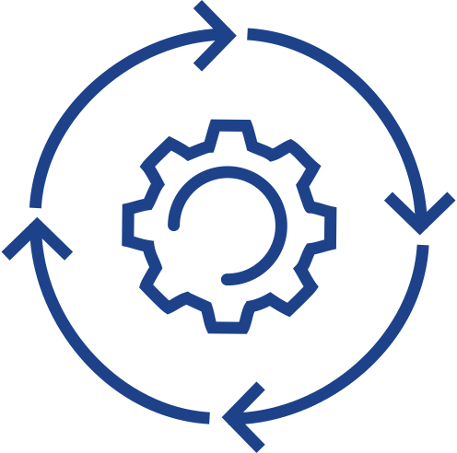

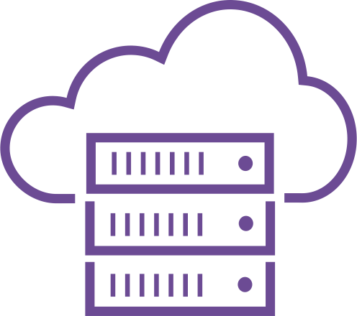

Deliver a Scalable Private Cloud
Workload Domains
VMware Cloud Foundation
Management
Production
Private AI
Kubernetes
Stretched
Data Center
Edge
Inventory
Notes:
Presenter note – this slide contains animation.
Key Message:
VCF delivers a scalable private cloud platform that lets datacenter staff manage pools of workload specific capacity in the same way public cloud providers deliver virtual datacenters. Wizard driven workflows simplify the deployment and management of application specific compute, storage and network resources.
Talk Track:
VCF delivers a scalable private cloud platform that lets datacenter staff manage pools of workload specific capacity in the same way public cloud providers deliver virtual datacenters.
For smaller environments, application workloads can be run together with management components in the management domain.
<click 1>
As your needs grow, you can provision additional workload domains using in-built workflows. Workload domains can be configured for a variety of different use cases such as traditional apps, Private AI, or modern app development.
<click 2>
When application needs grow, scaling is easy. In this example, we need to provide more capacity for a Private AI deployment.
<click 3>
The VCF admin first commissions new hosts into the Cloud Foundation inventory.
<click 4>
The new hosts are then added as capacity into the workload domain configured for Private AI. The hosts can be used to scale an existing cluster, or they can be added to create an entirely new cluster.
<click 5>
Workload domains can be deployed in a stretched configuration across two (2) data centers to support active-active availability. They can also be provisioned to support remote edge topologies.
Notes:
There are many use cases for creating a separate Workload Domain.
Workload domains can be used as a way of allocating infrastructure for different business functions, separating application types or perhaps separating licensed features.
Workload domains are the primary building blocks of VMware Cloud Foundation. They can be independently created, scaled, lifecycle managed or deleted.
Resources:
Please refer to the VCF Configmax for the minimum number of hosts required when deploying a new workload domain or cluster. https://configmax.broadcom.com/home

Slide 12
Private Cloud Constructs within VMware Cloud Foundation
VCF Private Cloud
VCF Fleet
VCF Fleet
VCF Fleet
VCF Automation
VCF Automation
VCF Automation
VCF Operations
VCF Operations
VCF Operations
VCF Instance
Management Domain
Workload Domains
VCF Fleet
One or more VCF instance
Common VCF Operations instance
Common VCF Automation Instance
VCF Private Clouds
One or more VCF Fleets
VCF Instance
VCF Instance
VCF Instance
Management Domain
Management Domain
Management Domain
vCenter
vCenter
vCenter
NSX
NSX
NSX
SDDC Manager
SDDC Manager
SDDC Manager
Clusters
Clusters
Clusters
Clusters
Core Infrastructure
Core Infrastructure
Core Infrastructure
Additional Workload Domains
Additional Workload Domains
Additional Workload Domains
vCenter
vCenter
vCenter
NSX
NSX
NSX
Clusters
Clusters
Clusters
Core Infrastructure
Core Infrastructure
Core Infrastructure
Additional VCF Instances
Additional VCF Instances
Additional VCF Instances
Notes:
Presenter Note – this slide contains animation.
Key Message: VCF Architecture can be defined following three (3) private cloud constructs. Talk Track: In order to understand the constructs of a VCF Private Cloud, you need to be familiar with VCF Instances and VCF Fleets. The first vSphere cluster of a VCF instance is configured as part of a management domain and is used to host the management components. The SDDC Manager appliance is deployed to the management domain.
<click 1>
Additional workload domains can be created to scale a deployment which are each configured with their own vCenter server and a single or shared NSX instance.
<click 2>
A VCF Fleet can be comprised of one of more VCF instances and is managed by a single set of fleet-level management components. Fleet management components comprise of a single instance of VCF Operations and a single instance of VCF Automation. The VCF Operations and VCF Automation instances can be used across all domains within a VCF instance and across one or more VCF instances. A VCF Fleet can be deployed across a single region or a dual region deployment.
<click 3>
A VCF Private Cloud is the highest level of management and consumption for the underlying software defined data center resources. A VCF Private Cloud can contain one of more VCF Fleets. Notes:
Resources:
Refer to the VMware Cloud Foundation Design Guide for further information https://techdocs.broadcom.com/us/en/vmware-cis/vcf.html

Slide 13
Workload Domain and Cluster Topologies
Management & Workload Domains
OR
Consolidated Domain
Standard Cluster
Multi-rack Cluster
Stretched Cluster
VCF Instance
VCF Instance
VCF Instance
Availability Zone 1
Availability Zone 2
Management Domain Cluster
Consolidated Management and Workload Domain Clusters
Rack
Rack
Rack
Rack
Workload Domain 1
Standard Cluster
Standard Cluster
Workload Domain 2
Standard Cluster
Workload Domain Cluster
Multi-rack Cluster
Standard Cluster
Stretched Cluster
Workload Domain 3
Storage Cluster
Compute Cluster
Storage Cluster
Compute Cluster
Notes:
Key Message:
Cloud Foundation workload domains and clusters can be deployed and configured in different ways.
Talk Track:
Cloud Foundation caters to a mix of different deployment options to support a large variety of customer scenarios.
A standardized architecture caters to customers who wish to separate their workloads from management components. Workload domains are deployed to separate hardware running their own separate vCenter server and NSX Manager instances. Workload domains are each configured with their own SSO instance. Once a domain is created vCenter Linking can later be configured from VCF Operations.
<click 1>
For smaller deployments, VCF can be deployed with just a single management domain. A consolidated deployment contains the management components and is also used to run customer workloads which can be configured on separate clusters. Resource pools are configured to separate host resources for management and customer workloads.
<click 2>
Workload domains can be deployed across one or more racks within an availability zone. Clusters can be configured as standard clusters within a single rack…
<click 3>
… or across multiple racks when layer 3 networking is in-place between the racks.
<click 4>
vSAN stretched clusters can be configured across two (2) sites for active-active availability. Availability Zones are configured as fault domains that protects VMs in a vSphere cluster leveraging vSAN replication. vSAN Stretched cluster protects VMs against partial host failures within the clusters, within a single data center and can be used to extend to multiple nearby facilities or buildings.
vSAN stretched clusters can be useful for:
Performing planned maintenance on an availability zone without any downtime. Each availability zone is configured as a fault domain. Applications can be migrated back after the maintenance is completed.
Stretching a cluster automatically initiates VM restart and recovery in the case of unplanned failures in either site.
Disaster avoidance by preventing service outages before an impending disaster.
<click 5>
vSAN Storage clusters (formerly vSAN Max) can also be used to provide highly scalable and flexible disaggregated storage for vSphere clusters, either as primary storage or to augment traditional vSAN HCI clusters. vSAN Compute clusters caan also be configured to enable vSphere clusters (including non-vSAN clusters) to consume storage resources from a remote vSAN cluster.
Notes:
Additional Information:
A Multi-Availability Zone Deployment Architecture adds additional layer of protections as hosts can stretch among multiple Availability Zone and which provides workload protection if a single Availability Zone is compromised. At the heart of the Multi Availability Zone Deployment is NSX’s ability to create distributed logical networks that seamlessly extend across AZs. By abstracting network functions from underlying hardware, NSX enables organizations to establish consistent network policies and configurations regardless of the physical infrastructure’s location. This allows for the creation of virtual network segments that span multiple AZs.
For further information on vCenter Linking please refer to Identity and Access Management section of this presentation.
vSAN Stretched Cluster will be discussed in more detail in the Stretched Cluster section of this presentation.
Resources:
Further detail on Cloud Foundation deployment options is covered in the VMware Cloud Foundation Product Documentation – VMware Cloud Foundation Administration Guide
https://docs.vmware.com/en/VMware-Cloud-Foundation/index.html
For further information on Cloud Foundation Deployment Options please refer to the VCF Design Guide
https://docs.vmware.com/en/VMware-Cloud-Foundation/index.html

Slide 14
Remote Site Topologies
Configure a Remote Workload Domain or a Remote Cluster
Provide presence for remote sites through centralized management
Place resources close to workers
Use VCF Operations to perform Fleet Management operations for each remote site
Choose the topology that best suits your requirements for:
Management
Scale
Networking
Bandwidth & latency requirements apply
VCF Operations
SDDC Manager
Workload Domain
Workload Domain
Workload Domain
Cluster
Cluster
Cluster
Cluster
Cluster
Cluster
Remote Workload Domain Example Workload Domain: 1 per site Clusters: 1 x cluster per domain
Central VCF DC Site
Remote Cluster Example Workload Domain: Per site or across sites Clusters: Multiple per domain
Notes:
Key Message:
Remote site topologies for VMware Cloud Foundation.
Talk Track:
Cloud Foundation supports the deployment of small workload domains or clusters to remote sites.
This allows customers to extend their compute processing from their centralized data center to support remote locations/offices. The management infrastructure to run these edge sites is shared and runs in the central data center.
Remote sites provide IT presence through centralized management without extra staffing. Customers can position infrastructure close to remote applications to minimize latency and overheads.
With each approach, VCF Operations is used at the central site to perform fleet management operations which includes password & certificate management and lifecycle management/upgrade and patching operations for each remote site.
<click>
Configure a Remote Workload Domain:
Initially the remote domain is composed with the vCenter Server located at the remote site. When configuring vCenter Linking the vCenter Server can be managed from the central data center. This can be handy for organizations which don’t have remote IT resources.
Each remote site is configured with a domain and a single vSphere cluster. A separate NSX instance is deployed per domain providing a full SDN solution with overlay networking.
<click>
Configure at remote Cluster. With this approach the vCenter Server is co-located with the cluster at the remote site where it can be managed remotely.
Each domain can be composed with multiple clusters per site and each domain can consist of clusters configured across multiple sites.
When configuring a remote cluster in this way vSphere Networking is used.
Additional Information:
Example use cases:
o Video Surveillance
o Point of Sales Retail
o Federal: mobile battlefield
o SLED: distributed citizen engagement
o Distributed Healthcare
o Oil and Gas Exploration
o Academic: Distributed Education and Research Computing
Notes:
Remote sites are not initially configured using VCF Operations / SDDC Manager. Follow the VCF documentation to deploy a remote cluster or workload domain.
VCF remote site topology connectivity requirements: - 10MBps min connectivity between sites - Less than 100ms latency between sites. - Two (2) connections between each site is also recommended.
- A remote cluster configured with vSAN can be configured using 3 - 16 nodes.
- A remote cluster can be configured with NFS or VMFS on FC as Principal storage with 2 - 16 nodes.
VMware Kubernetes Service (VKS) can be configured on a cluster deployed at a remote site. - vCenter Server is used to perform scaling operations for remote workload domains and remote clusters.
Customers can choose to use VCF Edge licensing with 10 or more sites.
A remote cluster or workload domain is not to be confused with VCF Edge (see appendix)
Resources:
Further detail on VCF deployment topologies and additional deployment scenarios are discussed in this whitepaper:
ttps://www.vmware.com/docs/vcf-edge-considerations-white-paper
For further information on Cloud Foundation Deployment Options please refer to the VCF Design Guide
https://docs.vmware.com/en/VMware-Cloud-Foundation/index.html
Further detail on Cloud Foundation deployment options is covered in the VMware Cloud Foundation Product Documentation – VMware Cloud Foundation Administration Guide.
https://docs.vmware.com/en/VMware-Cloud-Foundation/index.html

Slide 15
Modernize Infrastructure
VCF Deployment & Scale
Notes:
Key Message: Workload domains are core to VMware Cloud Foundation architecture.
Talk Track: VMware Cloud Foundation provides many different approaches to modernize your infrastructure. Let’s take a look at how VCF can be deployed and scaled.
Notes:
References:

Slide 16
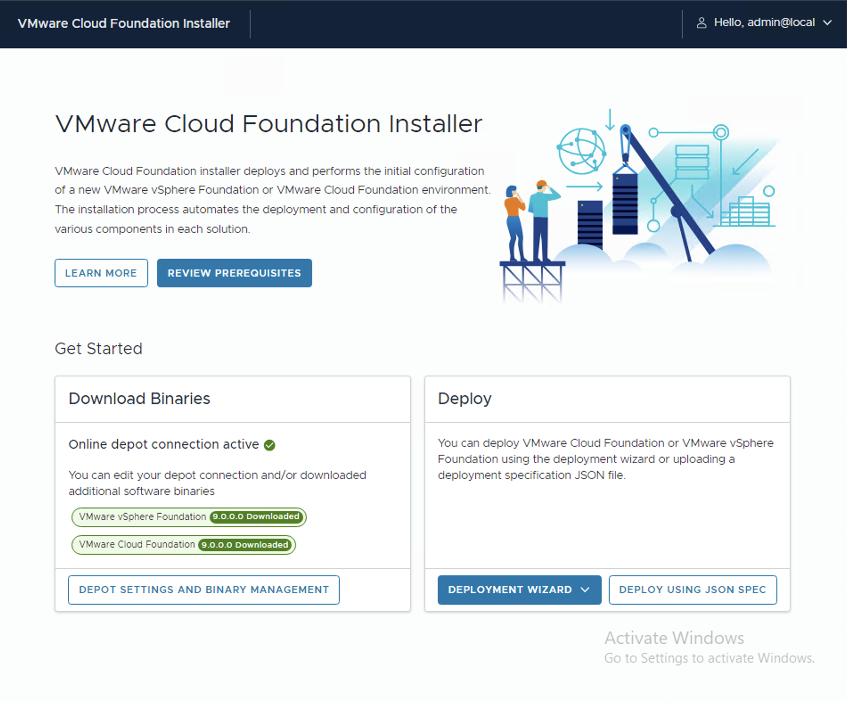



Deploying a New VCF Instance on New Hardware
VMware Cloud Foundation Installer Appliance
VMware Cloud Foundation
Customer Networking
Automation
Operations
Lifecycle
ESX Nodes
Management Network
Pre-requisites
VCF Installer ^{NEW}
Deploy to New or Existing vSphere Infrastructure
Deploy to vSphere Infrastructure
Notes:
Presenter Note: This slide contains animation
Key Message:
Cloud Foundation has a streamlined process to deploy a standardized workload-ready private cloud in a matter of hours.
The VCF Installer appliance can be used to deploy VMware Cloud Foundation in a variety of different ways to suit a variety of different customer requirements.
Talk Track:
Cloud Foundation has a streamlined process to deploy a standardized workload-ready private cloud in a matter of hours.
Here is a look at the automated deployment process when deploying a new Cloud Foundation instance to new hardware.
<click 1>
Customers can use their preferred network equipment and topology.
Just four (4) ESX hosts and a pair of TOR switches are required when deploying a new VCF instance to new hardware. Broadcom recommend that customers review the pre-deployment checklist to ensure all pre-requisites are in place (networking, customer provided DNS/NTP/DHCP services).
The VCF Installer appliance is deployed to the management network of the ESX hosts. From the VCF Installer the user initiates the download of Cloud Foundation software bundles from the Broadcom support site or their own off-line depot.
Customer-specific inputs can be entered directly into the VCF Installer appliance or a JSON spec can also be used. Inputs include appliance FQDNs, account credentials, networking, appliance sizing and HA configuration settings.
<click 2>
The VCF Installer performs a validation to test the inputs and provide recommendations on any changes which may be required before the fully automated private cloud deployment commences.
During the deployment, NSX is deployed and ready to be configured, vSphere best practice configurations are applied, and all of the Management component VMs are deployed, including VCF Operations.
Over the coming slides we will discuss some additional deployment approaches and configuration options in more detail when deploying VCF 9.
Notes:
The VCF Installer appliance in VCF 9 replaces the Cloud Builder appliance.
From VCF 9.0 Cloud Foundation can be deployed to vSAN ready nodes (recommended) or other supported storage topologies (NFS or VMFS on FC.
From VCF 9.0 VCF Operations is used to manage one or more VCF instances. SDDC Manager is also deployed.
A new VCF instance is deployed in Evaluation mode. A VCF environment is required to be licensed using a license file within the first 90 days of a deployment. VCF is fully functional while the deployment is running in Evaluation mode and allows a user to deploy additional hosts, workload domains and clusters.
Resources:
Refer to the VMware Cloud Foundation Deployment Guide for further information https://techdocs.broadcom.com/us/en/vmware-cis/vcf.html
--------------
Original Talk track
Here is a look at the different approaches which can be used to deploy VMware Cloud Foundation (VCF).
<click>
Customers can use their preferred network equipment and topology.
The Cloud Foundation deployment starts with two (2) or more ESX nodes and a pair of TOR switches. Customers can review the pre-deployment checklist to ensure all pre-requisites are in place (qualified server hardware, customer networking, customer provided DNS/NTP/DHCP services).
<click>
The next step is to deploy the VMware Installation appliance which is new to VCF 9.0.
The VCF Installer appliance is downloaded from the Broadcom Support Portal and contains all required software to perform a Cloud Foundation deployment.
The VCF Installer is installed on the VM management network and provides the user the option to deploy VMware vSphere Foundation (VVF) of VMware Cloud Foundation (VCF).
VVF or VCF can be deployed qualified hardware as a new Cloud Foundation instance. Alternatively VVF or VCF can be deployed to an existing vSphere cluster.
<click>
When deploying VCF, the user can manually enter their desired configuration inputs for their private cloud by following the in-built VCF Installer workflow.
Inputs include networking, naming conventions, account credentials and appliance sizing.
Subsequent deployments of VCF can be further streamlined by selecting the option to upload a JSON configuration file which can be easily edited.
<click>
Once the VCF Installer workflow is complete, Cloud Foundation performs a validation of the inputs and recommendations which may be required before the fully automated SDDC deployment commences.
<click>
During the deployment, a cluster is formed, NSX will be deployed and configured for use, best practice configurations are applied, and all management component VMs deployed, including VCF Operations. Customers are given the option to also deploy VCF Automation as part of the workflow.
Notes:
A new VCF instance is deployed in Evaluation mode – the environment is required to be licensed using a license file within the first 60 days of a deployment.
VCF is fully functional while the deployment is running in Evaluation mode and allows a user to deploy additional hosts, workload domains and clusters. VCF 9.0 supports a number of different storage topologies
Resources: VCF Solution Licensing: Please refer to the PnP presentation and FAQ for further information on Solution Licensing

Slide 17

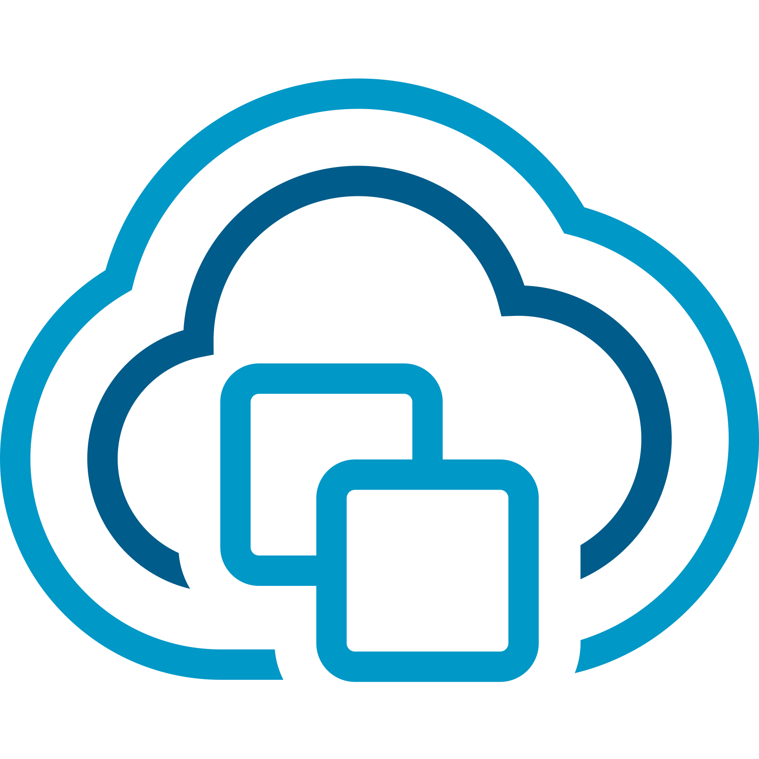
Deployment Pathways to Suit a Variety of Use Cases
VMware Cloud Foundation deployment workflows from the VCF Installer
VCF Installer Appliance:
Deploy a new VCF Fleet or Expand an existing VCF Fleet
vSphere with / without vSAN
VCF Networking (NSX)
VCF Operations
VCF Automation
Converge an existing vCenter deployment to VCF
vSphere with / without vSAN
VCF Operations
VCF Automation
V\
VCF 9.0
VMware Cloud Foundation
VCF Automation
VMware vSphere
VCF Operations
Cluster 1
Cluster 1
Cluster 2
Cluster 2
Cluster …N
Cluster …N
VCF Installer
Existing Deployment
vCenter Server
NSX Manager
Core Infrastructure
New / Expanded VCF Fleet
Notes:
Presenter Note: This slide contains animation
Key Message:
VCF 9 can be implemented into a new or existing environment in a number of different ways using user-driven UI workflows. The VCF Installer appliance provides an easier, quicker and more repeatable set of workflows for our customers to get on the pathway to VCF
Talk Track: VMware Cloud Foundation 9 is a major release which includes a number of significant new capabilities and a more integrated experience for private cloud administrators.
The VMware Cloud Foundation Installer appliance (VCF Installer) is new to VCF 9 and introduces a more flexible set of workflows for deploying VMware Cloud Foundation to suit an extended set of use cases and topology types.
<click 1>
The VCF Installer can be used to deploy a new VCF Fleet …or for customers with multiple environments they can choose to deploy another VCF instance into an existing VCF Fleet. Each VCF instance is deployed using vSphere and vCenter server, NSX, VCF Operations and VCF Automation. Configuring your VCF environment for vSAN delivers a full SDDC stack.
<click 2>
The VCF Installer appliance also contains inbuilt workflows to converge (re-use) an existing vCenter deployment (a non-VCF deployment) to a VCF management cluster.
When performing a conversion, the VCF Installer is to be deployed into the same cluster as the residing vCenter Server appliance. We support existing vCenter clusters configured for vSAN or existing clusters configured with external storage.
Once converged, the environment then becomes a fully functioning new VCF instance which is then managed, scaled and lifecycle managed as VCF. This isn’t all the VCF Installer can do. The VCF Installer workflow also provides options to converge an existing VCF Operations instance and/or an existing VCF Automation instance.
The VCF Installer appliance provides an easier, quicker and more repeatable set of workflows for our customers to get on the pathway to VCF
Notes:
- Existing vCenter deployments which can be reused (converged) and imported includes vCenter Server clusters configured as VMware vSphere Foundation (VVF).
Re-using/converging an existing vCenter deployment to VCF: - The VCF appliance workflows to re-use an existing vCenter deployment will converge the first cluster within the vCenter to a VCF management cluster. All clusters within the vCenter Server are converged into the VCF management domain. - vSphere clusters configured with/without vSAN can be used when re-using (converging) a vSphere cluster to a VCF management cluster using the VCF Installer. NSX is deployed as part of the conversion process.
Resources:

Slide 18






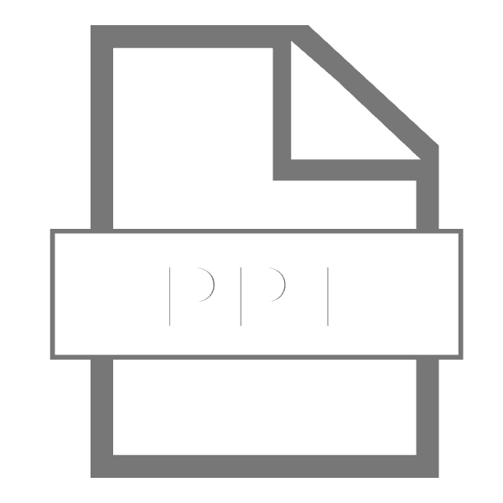

Unified Installer Streamlines Deployment
VMware Cloud Foundation Installer Appliance
VCF Installer Appliance:
Streamlines deployment of VCF or VVF from a single appliance
Inbuilt options to re-use existing vCenter, VCF Operations and VCF Automation instances
Full stack deployment and lifecycle management of compute, storage, networking, operations and automation
Generate a re-usable JSON spec which can be uploaded, reviewed and validated from the UI
VCF 5.x
VCF 9.0
Aria Operations
Aria Ops Logs
Aria Automation
Aria Ops Networks
Aria LCM
VIDM
VMware Cloud Foundation
VMware Cloud Foundation
VCF Automation
VCF Operations
SDDC Manager
vCenter Server
NSX Manager
vCenter Server
NSX Manager
Core Infrastructure
CB
XLS
The VCF Installer automates deployment of a ready-to-use Private Cloud
Cloud Builder
XLSX /JSON
VCF Import
Notes:
Presenter Note: This slide contains animation
Key Message:
Cloud Foundation introduces a more flexible process to deploy a standardized workload-ready private cloud in a matter of hours.
Talk Track: Let’s take a closer look at the VCF Installer appliance.
The VCF Installer appliance replaces the Cloud Builder appliance and further streamlines the deployment of VMware Cloud Foundation (VCF) or VMware vSphere Foundation (VVF).
It contains an inbuilt UI-driven workflow and no longer requires the use of the Deployment Parameters Workbook (MS Excel spreadsheet). The VCF Installer also includes in-built options to converge and import existing vCenter, VCF Operations and VCF Automation instances without the need for VCF Import scripts.
Prior releases of Cloud Foundation have required Aria Operations and Aria Automation to be installed and lifecycle managed as separate Day 2 operations. From VCF 9, the VCF Installer appliance is used to deploy the full VCF stack comprising of compute, storage, networking, operations and self-service automation and VCF Operations is used to lifecycle manage the full stack.
Administrators can choose to initially deploy VCF using the in-built workflows. The VCF Installer can also generate a JSON which can be re-used after uploading, reviewing and validating from the wizard driven UI.
The VCF Installer appliance provides a flexible set of options which help to further simplify the deployment of an end-to-end private cloud environment.
Notes:
The Planning and Preparation Workbook can be useful when planning a VCF 9 deployment and provides detail on the inputs required for the VCF Installer wizard driven workflow. Resources:
Refer to the VMware Cloud Foundation Planning and Preparation Workbook to help plan your deployment. https://techdocs.broadcom.com/us/en/vmware-cis/vcf.html Refer to the VMware Cloud Foundation Deployment Guide for further information https://techdocs.broadcom.com/us/en/vmware-cis/vcf.html

Slide 19
Flexible Deployment Workflows
VMware Cloud Foundation Installer Appliance
Choice of Depot:
Online or Offline depot
Choice of Deployment Method:
Wizard-driven or re-usable JSON
Choice of VCF Topology:
Deploy to a new or existing VCF Fleet
Deploy New or Existing Components:
vCenter, NSX¹, VCF Ops, VCF Automation
Choice of Appliance Model:
Simple (single node) or HA (multi-node)
¹ Existing vCenters with NSX installed are not initially supported to be converged to VCF Existing vCenters with NSX installed can be imported into VCF as Workload Domains
Notes:
Key Message:
The VCF Installer appliance can be used to deploy VMware Cloud Foundation or VMware vSphere Foundation to suit a variety of customer use cases and deployment topologies.
Talk Track:
Inbuilt into this new and very light-weight VCF Installer Appliance are a set of enhanced deployment workflows and many new configuration options.
Upon connecting to the Broadcom Support Portal, the user downloads the software binaries by connecting to the online depot. The software binaries are not included in the VCF Installer appliance.
Customers also have the option to configure their own private off-line depot which can be used by multiple VCF instances. With an offline depot, the software binaries only need to be downloaded once which is very handy when managing multiple VCF instances.
Once the software binaries have been downloaded, the appliance can be used to deploy VMware Cloud Foundation (VCF) or VMware vSphere Foundation (VVF). Deployment can be driven using the inbuild Deployment wizard or the user can generate a re-usable JSON spec which can be uploaded, reviewed and validated from the UI. A JSON spec can also be uploaded and edited in the wizard.
A VCF instance can be deployed as part of a new VCF Fleet or to an existing VCF Fleet. A VCF Fleet may consist of multiple VCF deployments which can leverage common VCF Operations and VCF Automations instances.
The VCF Installer is used to initially configure the management cluster which can be deployed in one of two ways: - New components can be deployed which include VM appliances for vCenter Server, NSX, VCF Operations and VCF Automation.
- OR…. existing appliances for vCenter Server, VCF Operations and VCF Automation can be used.
When choosing to converge (re-use) an existing vCenter Server the VCF Installer will converge an existing vSphere / vSphere with vSAN cluster to a VCF management cluster. The VCF Installer will deploy NSX as part of the conversion process.
If choosing to re-use an existing VCF Operations instance, it ,is recommended to select the vCenter server where it is deployed as the vCenter for first VCF management cluster.
The VM appliances for a new VCF Operations, VCF Automation and NSX instances can be deployed using one of two models:
A simple model will deploy a single node appliance for each component that needs to be installed.
When deployed using the High Availability model 3x NSX Manager nodes, 3x VCF Operations nodes and 3x VCF Automation nodes are deployed. Additional options are available to configure an NSX load balancer appliances for selected components.
Extended Talk Track:
Storage and compute for the management cluster can then be allocated. The number of hosts required is dependent upon the storage type selected.
NSX is deployed and ready to be configured and consumed for software defined networking. Enhanced Datapath is the default selection; switching configuration is more granular with advanced options for DVPG load balancing and uplink settings.
Prior to commencing the build, the workflow allows the user to review the deployment parameters and performs a validation to test the inputs. The VCF Installer will then provide recommendations on any changes which may be required before the fully automated private cloud deployment commences. Upon a successful deployment, the VCF Installer provides a link to launch VCF Operations which is used for management.
Notes:
An offline depot is configured at a customer site and is beneficial for VCF deployments which are not internet connected. An offline depot can also be used to service multiple VCF instances.
The Planning and Preparation Workbook can be useful when planning a VCF 9 deployment and provides detail on the inputs required for the VCF Installer wizard driven workflow.
From VCF 9 VCF Operations is used to manage one or more VCF instances. SDDC Manager 9 is installed or upgraded as a component of any VCF 9 instance. SDDC Manager will be deprecated in a future release.
From VCF 9 the management cluster can be configured using vSAN ready nodes (recommended). Qualified vSphere server hardware can be used to support NFS/VMFS on FC) storage topologies. Consult the VMware Compatibility Guide for further detail.
A new (greenfield) VCF deployment requires a minimum of 4 hosts for the management cluster which is deployed using vSAN, NFS or VMFS on FC.
A minimum number of hosts are required when re-using/converging an existing vCenter environment to VCF. (3 vSAN ready nodes or 2 vSphere hosts configured using NFS or VMFS on FC). Refer to the VCF configmax site for further detail.
A minimum number of hosts are required when importing existing vCenter environments into VCF as a workload domain. (3 vSAN ready nodes or 2 vSphere hosts configured using NFS or VMFS on FC). Refer to the VCF configmax site for further detail.
The management domain of a new (greenfield) VCF instance is configured for NSX. Each workload domain is also configured for NSX and is ready to be configured for NSX Virtual Networking (SDN).
¹ VMware supports converging (re-using) existing vSphere clusters to VCF. Existing vCenter environments to be converged can be pre-deployed with vSphere or vSphere with vSAN. Existing vCenter environments with NSX installed are not initially supported to be converged to a VCF management domain at this time. A fresh instance of NSX is installed as part of the process.
Existing vCenter environments with NSX installed can be imported as Workload Domains.
A new VCF instance is deployed in evaluation mode. VCF is fully functional while the deployment is running in evaluation mode and allows a user to deploy additional hosts, workload domains and clusters. The VCF 9 instance is required to be licensed within the first 60 days of a deployment using a license file. VCF Operations directs the user to the Broadcom Business Services Console to complete this process.
Resources:
Refer to the VMware Cloud Foundation Deployment Guide for further information https://techdocs.broadcom.com/us/en/vmware-cis/vcf.html

Slide 20
Simple vs High Availability (HA) Deployment
VMware Cloud Foundation 9 Appliance Models
V\
V\
Simple
7 required appliances
7 optional appliances
High Availability
13 required appliances
11 optional appliances
Optional
Optional
VIDB
NSX Edge
VCF Logs
VKS
VIDB
NSX Edge
VCF Logs
VKS
Required
Required
VCF Ops
VCF Ops Collector
VCF Auto
VCF Ops
VCF Ops Collector
VCF Auto
vCenter Server
SDDC Manager
NSX Manager
Fleet Management
vCenter Server
SDDC Manager
NSX Manager
Fleet Management
VCF Operations for Networks and HCX not shown for slide brevity
Notes:
Key Message: VCF 9 provides the option to deploy VCF components using one of two deployment models.
Talk Track:
Let’s take a closer look at the two appliance models available when deploying a new VCF instance.
When choosing a Simple Model a minimum of 7 appliances are required which consists of a single appliance for vCenter server, SDDC Manager and NSX Manager. VCF Operations comprises of single appliances for VCF Operations Manager, a Fleet Management appliance and a VCF Operations collector. A single appliance is also deployed for VCF Automation. A VKS appliance is deployed when the option to deploy the supervisor is selected. Additional appliances can be deployed after the initial deployment has completed which includes the option to further configure VCF Operations for Logs, configure secure connectivity with a NSX Edge cluster and configure VIDB for Identity and Access.
A High Availability Model is recommended for production environments. When deployed using the High Availability model a minimum, of 13 appliances are deployed comprising of 3x NSX Manager nodes, 3x VCF Operations nodes and 3x VCF Automation nodes. 3 appliances are also configured for VCF Operations for Logs and VKS.
Having 3 appliances provides high availability in the case of a hardware failure and also helps to minimize disruption and streamline lifecycle management, patching and upgrades
Additional options which are not shown here include the option to configure an NSX load balancer appliances for selected components.
At any point in time a customer can choose to scale additional appliances to these components as a post installation operation.
Furthermore, VCF Operations for Networks, HCX and a selection of other VCF Advanced services (Add-ons) can also be configured post deployment.
It is important to note that the deployment model that you select does not impact existing appliances that you are using in your VCF fleet or VCF instance
Notes: VCF Operations for Networks and HCX not shown for slide brevity
Resources: Refer to the VMware Cloud Foundation Design Guide for further information https://techdocs.broadcom.com/us/en/vmware-cis/vcf.html Refer to the VMware Cloud Foundation Deployment Guide for further information https://techdocs.broadcom.com/us/en/vmware-cis/vcf.html

Slide 21
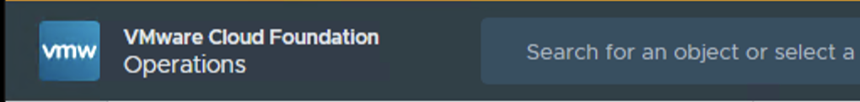

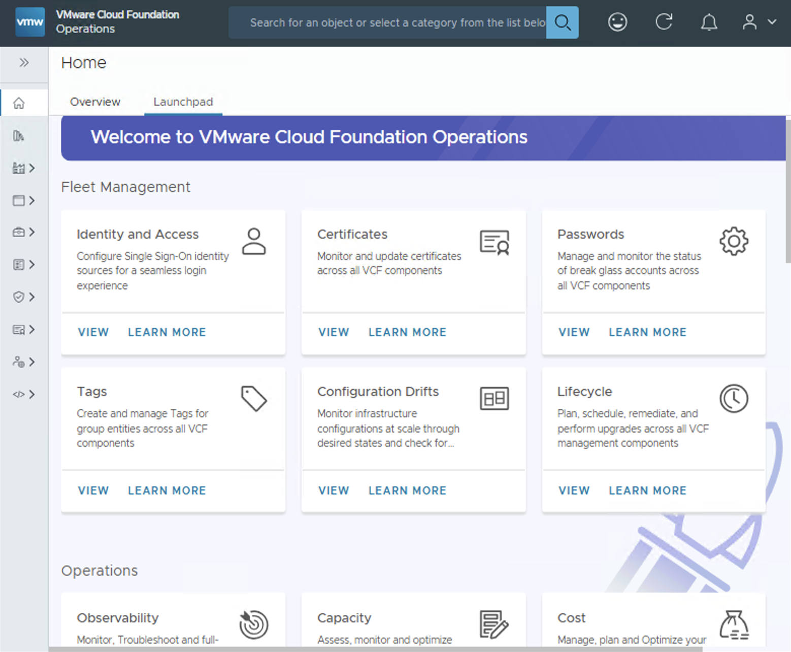

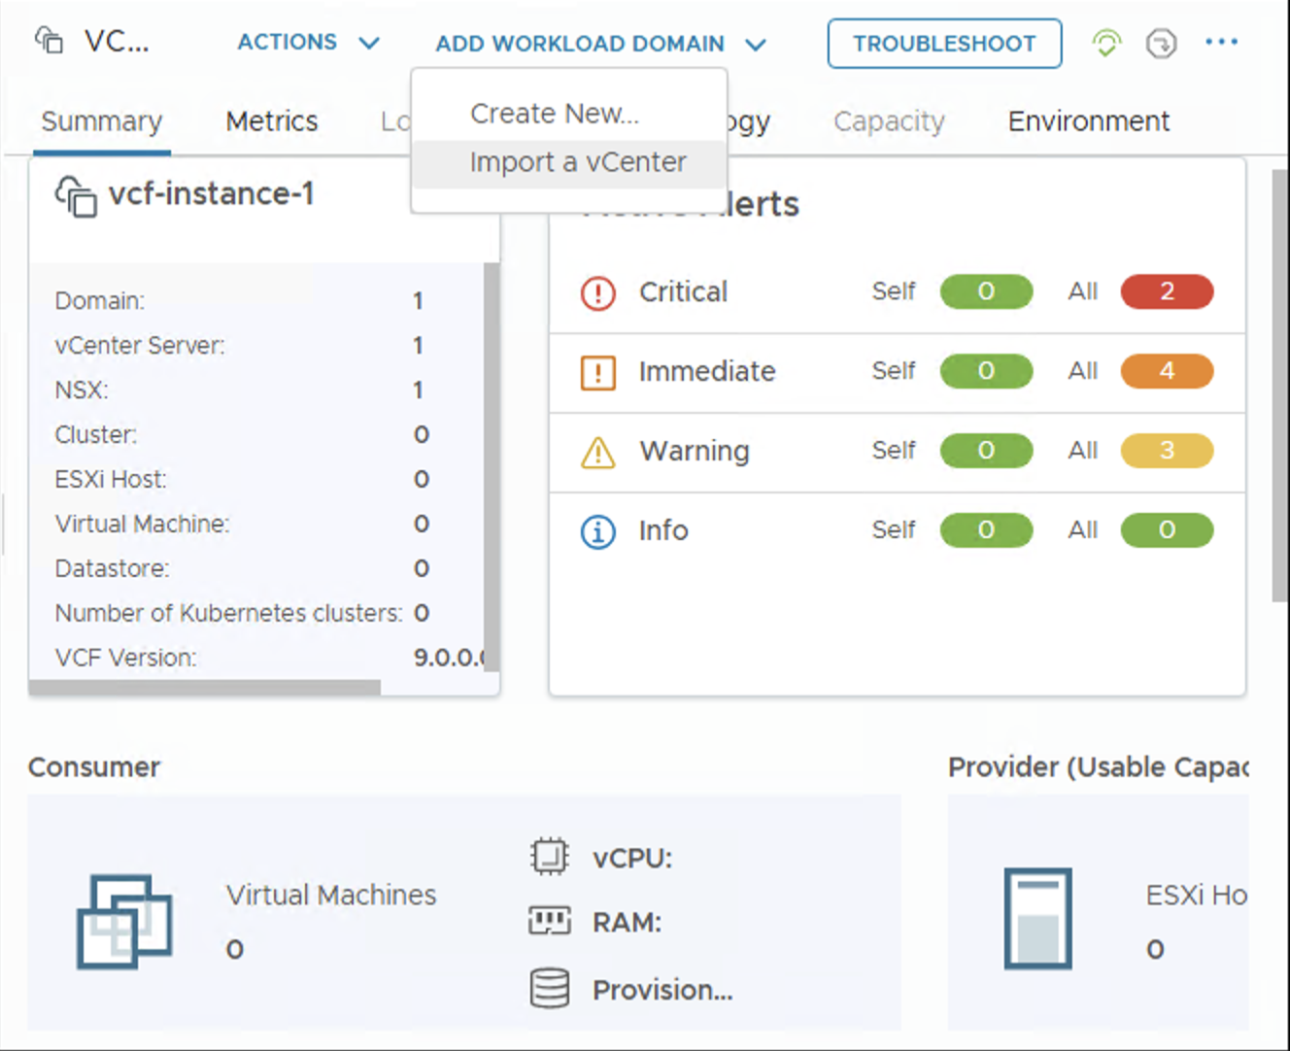
Deployment Pathways to Suit a Variety of Use Cases
VCF Operations workflows for workload domain deployment
VCF Operations:
Provides a new and integrated private cloud operations and management experience
Unified operations and management of compute, storage, networking, fleet management and lifecycle management
Inbuilt workflows to create new workload domains
External vCenter deployments can be imported into a VCF instance as workload domains for centralized management
V\
VCF 9.0
VMware Cloud Foundation
VCF Automation
VMware vSphere
Workload Domain
VCF Operations
Cluster 1
Cluster 1
Cluster 2
Cluster 2
vCenter Server
Cluster …N
NSX Manager
Cluster 1
Cluster …N
Core Infrastructure
Cluster 2
Cluster …N
External Deployment(s)
vCenter Server
NSX Manager
Core Infrastructure
Workload Domain
Cluster 1
Cluster 2
Cluster …N
vCenter Server
NSX Manager
Core Infrastructure
Notes:
Presenter Note: This slide contains animation
Key Message:
VCF 9 provides an integrated and unified operations experience (discussed in more detail later during this presentation).
VCF Operations can also be used to import pre-existing vCenter deployments into an existing VMware Cloud Foundation instance.
Talk Track:
From VCF 9 private cloud operations and management is performed using the VCF Operations Console (formerly VMware Aria Operations).
VCF Operations provides cloud administrators with a unified and feature rich operations experience which spans compute, storage, networking, fleet management and lifecycle management.
VCF Ops for VCF 9 also includes inbuilt workflows supporting an additional two VCF deployment pathways.
You can use VCF Operations to create a new workload domain or…
<click 1>
VCF Operations can also be used to import additional (existing) vCenter deployments into an existing VMware Cloud Foundation instance for centralized management and operations.
<click 2>
In this instance each vCenter deployment is imported into the VCF Inventory as a workload domain.
VCF Operations will be discussed in more detail later in this presentation.
Notes: Importing additional vCenter deployments into VCF:
- When importing a vCenter deployment into a VCF instance all clusters within the vCenter server are imported and configured as part of a workload domain. - vSphere clusters configured with/without vSAN, vSphere clusters configured with/without NSX and any combination of the 3 software components can be used when importing a vSphere cluster to an existing VCF instance from VCF Operations. NSX is deployed as part of the process if it is not already present. The SDDC Manager appliance is still present and can be used with VCF 9. SDDC Manager will be deprecated in a future release. Resources:

Slide 22
Centralize Management of External vCenter Deployments
Importing an existing vCenter deployment into VCF with VCF Operations
Import externally managed vCenter environments into VCF using VCF Operations
Eases private cloud adoption by centralizing management and operations which can reduce costs across disparate environments
Inbuilt workflows negate the need for workload migrations
Combinations of vSphere, vSAN and NSX can be imported
NSX is deployed as part of the process if it is not already present.
Import a vCenter
Notes:
Presenter Note: This slide contains animation
Key Message:
VCF 9 makes it easy to import existing infrastructure directly into Cloud Foundation.
Talk Track:
Let’s take a closer look at the options available within VCF Operations to centralize management of external vCenter deployments.
VCF Operations makes it easy to add existing vSphere, vSAN and NSX infrastructure into an existing VCF instance. VCF Operations provides guided workflows for importing pre-existing vSphere infrastructure into a VCF instance as workload domains.
The ability to import pre-existing infrastructure into VCF expedites the path to VCF by allowing customers to leverage existing investments while simultaneously reducing costs. In addition, with this capability customers no longer need to be concerned with having to migrate existing workloads from existing infrastructure to VCF.
When importing a vCenter deployment into a VCF instance all clusters within the vCenter server are imported and configured as part of a workload domain. vSphere clusters configured with/without vSAN, vSphere clusters configured with/without NSX and any combination of the 3 software components can be used when importing a vSphere cluster to an existing VCF instance from VCF Operations.
NSX is deployed as part of the conversion process if it is not already present.
Notes:
The VCF Import Tool was used in VCF 5.2.x to converge an existing vSphere cluster to a VCF management domain. It was also used to import a vSphere cluster into an existing VCF instance.
VCF Operations is used to import an existing vSphere cluster into an existing VCF 9.0 instance From the Inventory Menu > select your VCF instance > Add Workload Domain > Import a vCenter
Once complete the admin can then go in to enable VCF Ops Data Collection for the domain.
vSAN: The VCF Operations workflow to “Import a vCenter” in VCF 9 supports multiple vSAN deployment types
Single site cluster
Disaggregated storage clusters
Stretched clusters
2-Node clusters
Resources:

Slide 23
Supported Configurations for VCF Import
Import existing vCenter deployments into VCF using VCF Operations
Imports
V\
V\
Before:
After VCF Import:
VMware vSphere
Imports all clusters in an existing vCenter into the VCF Inventory
Host Interoperability:
Hosts with single pNICs
Clusters with LACP enabled
Single node clusters & standalone hosts
Storage Interoperability:
vSAN: 2-node, HCI mesh, storage clusters, stretched clusters
NFS, VMFS on FC, iSCSI
Networking Interoperability:
vCenter with or without NSX
Cluster 1
VCF Instance
Cluster 2
Cluster …N
VMware vSphere
Cluster 1
Cluster 2
Workload Domain
Workload Domain
Cluster …N
VMware vSphere
Cluster 1
Cluster 2
Cluster …N
Multiple disparate infrastructure silos
Complex to manage
Expensive to maintain
Standardized with Centralized operations
Easier to manage, lifecycle and scale
Manage with less resources reduces costs
These configurations apply to VCF Import only and do not apply when deploying new clusters or workload domains
Notes:
Key Message:
VCF 9 supports the import of existing infrastructure into VCF.
Talk Track:
When importing a vCenter deployment into a VCF instance, all clusters within the vCenter server are imported and configured as part of a workload domain.
The VCF Operations workflow caters to a broad variety of cluster configurations which typically exist in existing vSphere environments. Host Interoperability
hosts configured with single pNICs and clusters configured with LACP enabled
single node clusters and standalone hosts
Storage Interoperability:
2-node vSAN clusters, HCI mesh, vSAN storage clusters, vSAN stretched clusters can be imported
Clusters configured using external storage using NFS, VMFS on FC, iSCSI can also be imported
Networking Interoperability:
vCenter Server deployments configured with or without NSX can be imported
Notes:
Its important to note that these configurations apply when using VCF Import only. These configurations do not apply when deploying new clusters or workload domains.
Resources: Refer to the VMware Configuration Maximums tool for further detail on supported configurations for compute, storage and networking: https://configmax.broadcom.com/home

Slide 24
Cloud Foundation Deployment and Scale
Deployment and scale workflows
Cloud Foundation Administrator
Operations Team
Expand a cluster
Scale an existing Cloud Foundation deployment
Configure Network Pools
Commission Hosts
Add a new cluster
1
2
3
Create a new NSX Edge
Create a new workload domain
Existing Deployment
Prepare the Infrastructure
Scale Options
Cloud Admin
Operations
Notes:
Presenter note – this slide contains animation
Key Message:
Once Bring-up has completed, a VCF instance can be scaled quickly and easily.
Talk Track:
Cloud Foundation includes in-built workflows to deploy and scale private cloud infrastructure.
Once Bring-up has completed, a VCF instance can be scaled quickly and easily.
ESX hosts can be added into the Cloud Foundation inventory by a Cloud Admin from the vSphere client – allowing the VCF deployment to easily scale. We call this process Host Commissioning.
Network Pools need to be configured prior to commissioning a host. They are used to store IP addresses that can be used for vMotion and Storage during automation tasks.
Once hosts are commissioned, they can be seen within the Cloud Foundation inventory and can be used to:
Expand an existing cluster,
Or create a new cluster within an existing domain.
The vSphere client also contains workflows to set up network connectivity to ensure that your workload is connected and protected and appropriately configured to available networking services. NSX can be leveraged to activate networking services such as DHCP, NAT, Layer 3 Services, External IP and Network Monitoring and Logging.
VCF Operations contains streamlined workflows to create new workload domains. Each workload domain can be configured using its own software defined infrastructure which allows them to be individually managed, scaled, lifecycle managed, patched and upgraded independently.
Notes:
The vSphere client is used to commission new hosts into the VCF inventory, add hosts to an existing cluster or to add a new cluster. It can also be used to configured centralized network connectivity (using an NSX Edge cluster) or distributed networking connectivity.
VCF Operations is used to create new workload domains.
Continue using SDDC Manager for Day N workflows. SDDC Manager will be deprecated in a future release.
References:
Refer to the VMware Configuration Maximums tool for further detail on supported configurations for compute, storage and networking: https://configmax.broadcom.com/home

Slide 25
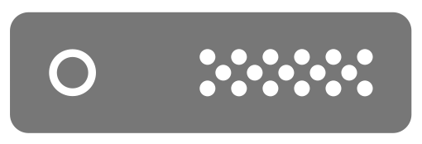
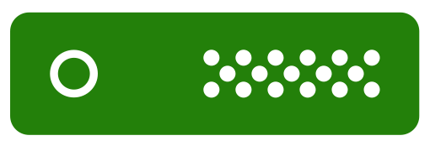
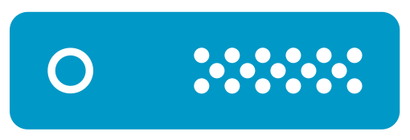
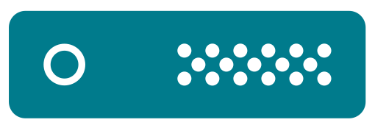
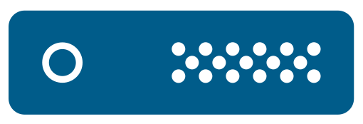
Easily Scale Private Cloud Infrastructure
Host Commissioning, Adding Clusters and Creating Workload Domains
Use the familiar vSphere client to scale your private cloud
Commission hosts in bulk or individually to the Inventory
Network Pools configured for vMotion and Storage
Add unassigned hosts to new clusters or scale existing clusters
Create new workload domains using VCF Operations
Continue using SDDC Manager for Day N workflows
V\
Management Domain
VCF Automation
Workload Domain
Management Domain
VCF Operations
VCF Operations
VCF Automation
Cluster N
VCF Operations
Cluster 2
Cluster 1
Cluster…
Cluster 1
NSX Manager
vCenter Server
NSX Manager
vCenter Server
vCenter Server
vCenter Server
NSX Manager
Core Infrastructure
ESX Hosts
Core Infrastructure
Core Infrastructure
Global Inventory
Notes:
Presenter Note: This slide contains animation
Key Message:​
The vSphere client is used to commission new hosts, add new clusters and scale clusters. VCF Operations can be used to deploy new workload domains.
Talk Track:
Scaling private cloud infrastructure is easy in VCF 9.
Utilize familiar workflows within the vSphere client to commission new ESX hosts into the Global inventory.
<click 1>
New hosts can be commissioned individually or in bulk using FQDN. Hosts can be commissioned into predefined network pools for vMotion and storage. Admins can select to commission hosts for a number of different storage types – vSAN, NFS and VMFS on FC. Each host is validated by confirming their fingerprint.
<click 2>
Commissioned hosts will be visible as unassigned hosts in the global inventory and can be used to create new clusters or scale existing clusters. Multiple host and cluster deployment and scaling operations can be performed in parallel to save time. Each cluster is deployed using a vSphere Lifecycle Manager image (vLCM image).
<click 3> VCF Operations contains streamlined workflows to create new workload domains. Each workload domain can be configured using its own software defined infrastructure which allows them to be individually managed, scaled, lifecycle managed, patched and upgraded independently.
<click 4> Continue using SDDC Manager for Day N workflows.
Notes: vSAN
vSAN is recommended when configuring a new cluster as it is flexible, quick to configure, easy to change and removes the need for manual configuration and potential disruption when storage changes or maintenance needed.
vSAN ESA and OSA architectures are supported.
ESX: - A new workload domain is deployed using dedicated ESX hosts configured in one or more clusters managed with it’s own vCenter server. Clusters can be configured with a choice of supported storage types.
NSX:
- Each host is deployed for virtual networking using NSX. Administrators can also configure advanced networking to best suit the needs of their applications by creating switch profiles, multiple Virtual Distributed Switches (which are prepared for NSX) and multiple pNICs.
The first workload domain is configured with a separate NSX instance to the management domain. Additional workload domains (2nd and so on) can be configured to use a new NSX instance or the NSX instance of an existing workload domain.
Infrastructure Management and Operations:
- VCF Operations contains in-built workflows to create new workload domains pre-configured with the vSphere Supervisor to support the configuration of Kubernetes workloads.
The vSphere client is used to commission new hosts into the VCF inventory, add hosts to an existing cluster or to add a new cluster. It can also be used to configured centralized network connectivity (using an NSX Edge cluster) or distributed networking connectivity.
- SDDC Manager is deprecated in VCF 9 and will not be available in a future release.
Resources:
Refer to the VMware Configuration Maximums tool for further detail on supported configurations for compute, storage and networking: https://configmax.broadcom.com/home

Slide 26
Modernize Infrastructure
Compute
Notes:
Key Message:
Talk Track:
Now, we will examine the primary components of VCF that enable a modern private cloud.
Notes:
Resources:

Slide 27
The Compute Engine of VMware Cloud Foundation
Modern Workloads
Security and Compliance
Compute Infrastructure
Notes:
Presenter Note: This slide contains animation
Key Message:
VMware vSphere provides the essential, robust, and versatile compute engine for VMware Cloud Foundation, enabling both traditional and containerized workloads while facilitating seamless integration across the entire private cloud platform.
Talk Track:
Think of vSphere as the core engine for compute within VMware Cloud Foundation (VCF). It's the leading technology that takes your physical server resources and pools them together, creating a flexible base for your applications. Within VCF, vSphere provides the essential layer for virtual machines and even modern containerized applications using Kubernetes. It includes the hypervisor that runs directly on servers and vCenter Server for central management, helping VCF efficiently use compute resources for optimal application speed and scalability. Importantly, vSphere works seamlessly with VCF's storage and networking, allowing for automated management of your entire infrastructure. In short, vSphere is the proven, reliable foundation powering VCF's compute, making running your most demanding workloads more straightforward.
Notes:
Resources:

Slide 28
The Evolution from vSphere to Full-stack Private Cloud
Introduction of HCI
EVO:RAIL was VMware’s hyperconverged solution for simplifying the deployment and management of virtual environments.
Latest version of VCF
VMware Cloud Foundation unifies compute, networking, storage, operations, automation, and security while supporting the import of existing infrastructure for added flexibility.
vSphere
Integrates vCenter and ESX into a unified cloud platform that features live migration, resource pooling, and high availability.
VMware vSAN
VMware’s 2014 HCI solution, vSAN, integrates storage with the hypervisor to streamline management and lower costs.
2009
2012
2014
2017
2025
Software-defined Data Center (SDDC) Vision
Paul Maritz served as VMware's CEO from 2008 to 2012, during which the SDDC vision was announced. Pat Gelsinger was named his successor at VMworld 2012 and took over as CEO in September.
VMware Cloud on AWS
VMware partnered with AWS to launch VMware Cloud on AWS, which extends on-premises environments to the public cloud.
NSX (Nicira) Acquisition
VMware's acquisition of Nicira accelerated its networking innovations, resulting in the creation of NSX.
VMware Cloud Foundation (VCF) version 2.0
VCF 2.0 integrates vSphere, vSAN, NSX, and the vRealize Suite into a unified platform for compute, storage, networking, and cloud management.
Notes:
Key Message:
VMware vSphere has evolved from a foundational virtualization platform to the central compute engine within VMware Cloud Foundation with features like automated migration, embedded storage, virtualized networking, robust security, and simplified operations.
Talk Track:
vSphere's evolution is a testament to VMware's commitment to continuous innovation, culminating in its pivotal role within VMware Cloud Foundation. From its foundational beginnings to its current state, vSphere has consistently pushed the boundaries of virtualization, enabling increasingly agile and scalable IT environments.
vSphere unifies core virtualization technologies with features like automated live migrations, resource pooling, and high availability, establishing a robust and resilient infrastructure foundation. In 2012, VMware articulated the Software-Defined Data Center vision, aiming to virtualize all data center elements. This vision, championed by Paul Maritz and later by Pat Gelsinger, set the stage for deeper integration and automation.
2014 saw significant strides with the introduction of vSAN, which embedded storage into the hypervisor, and the collaboration with EMC on EVO: RAIL, simplifying hyperconverged infrastructure deployments. These advancements further solidified vSphere’s role within integrated infrastructure.
The cloud era accelerated in 2017 with VMware Cloud on AWS, seamlessly extending on-premises vSphere environments to the public cloud. Concurrently, VMware Cloud Foundation 2.0 was released, integrating vSphere, vSAN, NSX, and the vRealize Suite to offer a unified experience.
Today, with the latest release of VMware Cloud Foundation, vSphere remains the core compute engine within a fully integrated platform that includes networking, storage, management, and security. Notably, importing existing infrastructures into VCF significantly enhances its versatility and simplifies migration. vSphere's evolution reflects VMware's ongoing commitment to delivering a comprehensive, future-proof private cloud.
Notes:
Resources:

Slide 29
Modernize Infrastructure
Storage
Notes:
Key Message:
Talk Track:
Now, let’s take a look at how storage is configured and utilized within VMware Cloud Foundation.
Notes:
Resources:

Slide 30
VMware Cloud Foundation Storage
Flexible Storage Options when deploying a new VCF instance
Principal storage options for the Management Domain of a new VCF instance
IP or FC Network
Switches
vSAN HCI (ESA/OSA)
NFS
FC
Principal storage options when creating a Workload Domain or Cluster (configured per-cluster)
vSAN HCI (ESA/OSA)
vSAN HCI Storage Clusters
vSAN Remote Datastores
NFS
FC
Supplemental storage – Used to add capacity to any domain
vSAN HCI
Storage Clusters
vSAN Remote Datastores
NFS*
FC
iSCSI
NVMe
/FC
NVMe
/TCP
*LCM, patching, and upgrades of Supplemental Storage is not managed by VCF Operations
Notes:
Presenter note – this slide contains animation
Key Message:
VMware Cloud Foundation defines two (2) categories of storage - Principal storage and Supplemental storage.
Talk Track:
VMware Cloud Foundation provides flexible storage support for Workload Domains to satisfy a broad range of customer application requirements.
Cloud Foundation defines two (2) categories of storage.
Principal storage is the storage type selected when creating a new domain
During the initial deployment of a new Cloud Foundation instance, the management domain is configured using one of three storage types. vSAN HCI is recommended for use in the management domain. Alternatively NFS or VMFS on FC can be used.
<click>
When an additional workload domain or cluster is created, the customer is given several additional storage options to choose from. Again, vSAN is recommended. vSAN can be deployed as hyperconverged (vSAN HCI), disaggregated (using vSAN storage clusters) or as remote vSAN datastore.
Workload domains can also configured using NFS or VMFS on FC.
Having the flexibility to choose from a selection of different storage types allows customers to leverage their existing investments in storage hardware while also providing an easy on-ramp to move their workloads and applications to vSAN when they are ready.
<click>
Supplemental storage is the second storage type defined by Cloud Foundation.
Whilst Principal Storage is used when configuring a workload domain or cluster, Supplemental Storage can be used to add storage capacity to any domain or cluster, including the management domain.
Supplemental storage options include:
vSAN Storage Clusters, vSAN remote datastores, NFS options NFSv3 and NFSv4.1 as well as VMFS on FC, VMFS on iSCSI, NVMe/FC, and now NVMe/TCP.
It is important to point out that adding and scaling any storage type other than vSAN is a manual process… just as it would be in a traditional environment using hardware-based storage solutions.
When vSAN is not used, the customer is responsible for maintaining server firmware/drivers and plug-ins in accordance with the VMware Compatibility Guide. If a customer is using VMFS on FC it is important that they also check HCL for FC array & HBA compatibility.
Notes:
Principal Storage:
Provisioning is automated in VCF Operations when creating Workload Domain(s).
Supplemental Storage:
Targets:
Data protection (File/Image backups).
Data at rest (templates, backups, archives).
Migration to a full SDDC.
Connect/mount:
Use vSphere web client to connect storage to workload domains.
vSAN Storage:
VCF provides support for clusters configured using vSAN Original Storage Architecture (vSAN OSA) and vSAN Express Storage Architecture (vSAN ESA).
vSAN can be configured as local or remote. vSAN local storage is a principal storage option which leverages local storage from the hosts configured as part of the cluster.
NVMeof/TCP:
VMware Cloud Foundation includes added supplemental storage support for NVMe-TCP. Cloud Administrators can utilize the benefits of using NVMeoF storage in a standard ethernet-based networking environment. The use of NVMe/TCP is more cost efficient and negates the need to deploy a fibre channel fabric. NVMe Storage an be added by creating a new VMFS datastore which can be done quickly by following the steps in the VMware vSphere Product Documentation.
iSCSI:
VMware Cloud Foundation supports the use of iSCSI when for supplemental storage in any domain. Admins can register a VASA provider to configure iSCSI using APIs provided by the storage vendor. For a list of supported VASA providers please check the VMware Compatibility Guide. Once the VASA provider is configured, the user can then create a Network pool from the vSphere client to provide IP addresses for the VASA endpoints.
vSAN Storage Clusters (formerly vSAN Max):
vSAN 8 U3 also brings support of vSAN Storage Clusters (formerly known as vSAN Max) as principal storage in VMware Cloud Foundation 5.2. vSAN Storage Clusters leverages vSAN ESA architecture providing a disaggregated HCI solution that allows for the independent scaling of storage resources from compute resources. It enables businesses to adapt to changing needs quickly, ensuring storage capabilities align precisely with demand. This adaptability supports dynamic workloads and growth, significantly enhancing IT infrastructure’s flexibility and scalability
VCF Import:
If you use the VCF Operations to converge an existing vSphere environment to a VCF management domain, that management domain can use VMFS-FC and NFS v3 as principal storage, in addition to vSAN
Virtual Volumes (vVols) vVols will be deprecated beginning with VVF/VCF 9.0 and will be fully disabled in in an upcoming release of VVF and VCF.
Limited time support for customers in 9.0 may be considered on a case-by-case basis under TQR/RPQ until vVol capabilities are fully disabled.
Resources:
For further information on Cloud Foundation storage please consult the Cloud Foundation Operations and Administration Guide.
https://docs.vmware.com/en/VMware-Cloud-Foundation/index.html
VMware Compatibility Guide: https://www.vmware.com/resources/compatibility/search.php
VMware vSphere Product Documentation:
https://docs.vmware.com/en/VMware-vSphere/index.html

Slide 31
Cloud Foundation Storage Options
Storage Options and Capabilities
Provides a Full SDDC Solution
Storage Policy Based Management
Automated Deployment and Scale
Automated LCM, Patching, Upgrades
Stretched Clusters
Remote Clusters
Compute Only Clusters
vSAN HCI
vSAN Storage Clusters
VMFS on FC
NFS
Notes:
Key Message:
Summary of different storage options within VCF and their capabilities.
Talk Track:
What we can see here are the different storage options available within a VCF deployment…and their capabilities.
Using vSAN provides the customer with a full software defined solution. It is flexible, it’s quick to configure and easy to manage and change at a per workload-level with storage policy-based management.
vSAN can be configured for aggregated storage (using vSAN HCI) and disaggregated storage using vSAN Storage Clusters (formerly known as vSAN Max).
Storage Policy-based Management (SPBM) removes the need for manual hardware configuration and potential disruption when inevitable changes are needed later down the track. vSAN is also very easy to scale, allowing you to add compute and storage together when it is needed without the need to plan up-front for growth capacity. vSAN is also fully lifecycle managed, patched and upgraded which is completely automated when used with Cloud Foundation.
Cloud Foundation supports stretched clusters when using vSAN (both vSAN OSA and vSAN ESA).
Administrators can also configure multiple remote clusters using vSAN, NFS, VMFS on FC
It’s for these reasons why VMware recommends using vSAN with Cloud Foundation.
Notes:
- It is important to point out that adding and scaling any storage type other than vSAN is a manual process… just as it would be in a traditional environment which uses hardware-based storage solutions.
- When vSAN isn’t used, the customer is responsible for maintaining server Firmware/Drivers and plug-ins in accordance with the VMware Compatibility Guide.
If a customer is using VMFS on FC it is important that they also check HCL for FC array & HBA compatibility.
Resources:
VMware Compatibility Guide:
https://www.vmware.com/resources/compatibility/search.php
(ESX Host, vSAN, storage compatibility and more)

Slide 32
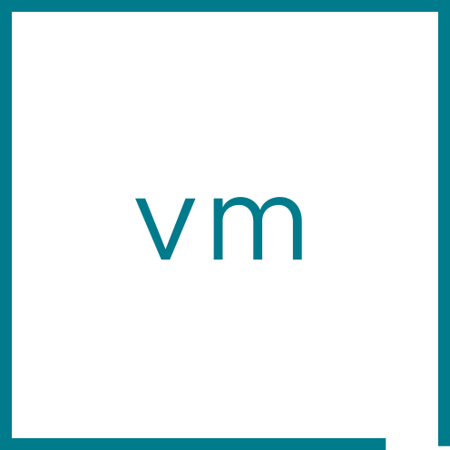
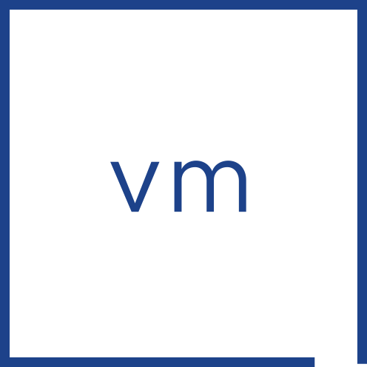
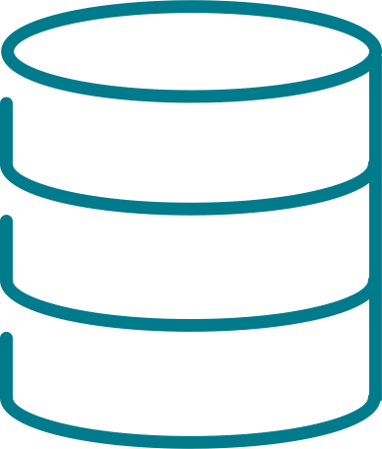

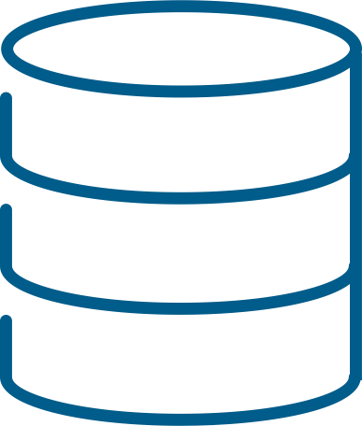
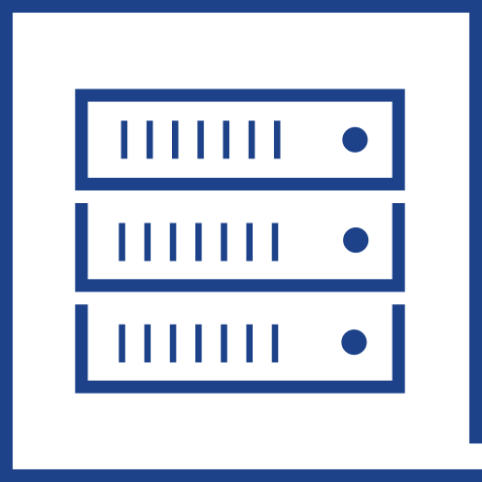
Evolving your Platform for the Demands of Today and Tomorrow
Remove hardware dependencies, decrease TCO, increase agility
Legacy Three-Tier
Hyperconverged
Proprietary storage hardware
Limited scalability
Siloed management
Inflexible
Commodity server hardware
Distributed scale-out storage
Common management
Highly flexible
Aggregated Resources
Compute & storage
Compute only
vSAN
Or…
Compute only
Storage array
Disaggregated Resources
Scale out
Scale out
Storage only
vSAN
Notes:
Key Message/Talk track:
Traditional three-tier architectures have been powering data centers for many years, but have been hampered by fundamental limitations, including the use of proprietary hardware, and the need for special teams to manage specific aspects of the architecture. A hyper-converged architecture can remove dependencies from hardware feature sets. By abstracting these features away from underlying hardware, you can address and apply the RIGHT settings in the RIGHT way for each workload running in a data center. As organizations are looking for interoperability with other public or private cloud environments, being able to apply these settings in a granular way, using software, is quickly turning into a requirement.
----------------------------------
Overview:
Remove dependencies from hardware feature sets
Simplified management drives down TCO, and increases agility
Deliver to apps based on what is actually needed
Apply same principles used for compute requirements to storage
A necessity for SDDC!
----------------------------------
Details:
Traditional architectures are typically associated with the following traits.
Managed in silos
New features dependent on hardware vendor’s equipment upgrade cycles
Difficult to scale
Difficult to accommodate growth
Inability to deliver the right SLA
“One size fits all” approach for application requirements

Slide 33
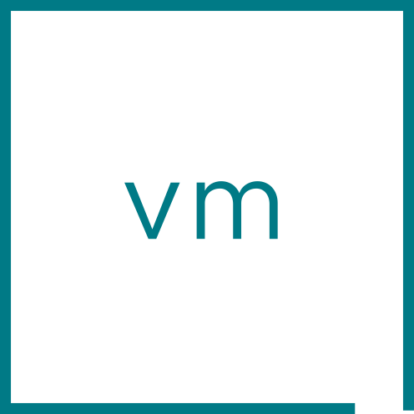




Next Generation Architecture built into vSAN
vSAN Express Storage Architecture™ (ESA) in vSAN
Next generation storage architecture for the workloads of today and tomorrow
Optional, alternative architecture to the vSAN original storage architecture
Available when running on qualified hardware in ESA approved vSAN ReadyNodes
Powers aggregated vSAN HCI clusters and disaggregated vSAN storage clusters
vSphere
vSphere
Compute only
vSphere
vSAN ESA
Powered by
vSAN ESA
vSAN ESA
Compute & storage
Storage only
vSAN HCI cluster
vSAN
vSAN storage cluster
Express Storage Architecture™
vSAN HCI Clusters Aggregated resources
vSAN Storage Clusters Disaggregated resources
Notes:
Key Message/Talk track:
vSAN 8 introduced the revolutionary Express Storage Architecture (ESA). This is our next generation storage architecture, written specifically for modern high-performance hardware that not only delivers unprecedented levels of performance and efficiency, but allows us to introduce new capabilities not previously possible. With vSAN ESA, you can easily choose by one of two deployment options. Aggregated vSAN HCI clusters, or disaggregated vSAN Storage Clusters. No matter what you choose, The vSAN Express Storage Architecture unlocks the capabilities of modern hardware to allow the workloads of today and tomorrow perform as the hardware allows.
----------------------------------
Overview:
Next generation storage architecture for the workloads of today and tomorrow
Optional, alternative architecture to the vSAN original storage architecture
Available when running on qualified hardware in ESA approved vSAN ReadyNodes
Powers aggregated vSAN HCI Clusters and disaggregated vSAN Storage Clusters
----------------------------------
Details:
N/A
Positioning
We want to make it very clear that while this new, optional architecture within vSAN introduces new patented technologies offering unprecedented new capabilities, vSAN was not “rewritten.” In fact, you’ll find many aspect of vSAN, such as the Distributed Object Manager (DOM), the Cluster Level Object Manager (CLOM) and the Cluster Management and Monitoring Directory Service (CMMDS) in place just like past editions, as it solves many of the great challenges of a distributed storage system. The new architecture simply helps address our ability to capitalize on the capabilities of this latest generation of high-performance hardware.
The vSAN ESA is not a “replacement” architecture, but an alternative architecture optimized for high performing, modern hardware. vSAN remains as a single product, but now includes the architectural capability to accommodate for these next generation hardware devices. It should not be positioned as a “rewrite” or a replacement in any way.
Do not reference the ESA and vSAN’s original storage architecture as “new” and “old” or any variation of that, as this can have a negative connotation toward previous editions of vSAN. While the vSAN ESA is the storage architecture where all future development efforts will be focused on, VMware is committing to ongoing support of the original storage architecture for many years to come. The official naming reference for the original storage architecture should be “Original Storage Architecture” abbreviated to OSA only when absolutely necessary.”
The internal name for our durable log-structured file system is “zDOM.” This is an engineering-centric name, and not intended as a public reference. One can refer to it as the “vSAN log-structured file system” or vSAN LFS when necessary.
Note that the references to “log-structured file system” do not refer in any way to a traditional file system such as NTFS, ext4, etc. It is a common industry reference to a method of how data and metadata are written to a circular log buffer and persisted to the storage subsystem.
Please note: Specific terms and details not readily available in the UI or KB articles, deemed as intellectual property, or sensitive have been obfuscated. Even the information here should be treated as sensitive, and should not necessarily be shared with external audiences. There is generally no need to use the terms CMMDS, CLOM, DOM, and LSOM with customers verbally, in correspondence, or in any published material. These are internal terms that are provided to help you better understand how vSAN works. Generalized terms such as “vSAN’s object manager…” will suffice in most cases.
The vSAN ESA is not a “replacement” architecture, but an alternative architecture optimized for high performing, modern hardware. vSAN remains as a single product, but now includes the architectural capability to accommodate for these next generation hardware devices. It should NOT be positioned as a “rewrite” or a replacement in any way.
Do not reference the ESA and vSAN’s classic architecture as “new” and “old” or any variation of that, as this can have a negative connotation toward previous editions of vSAN. While the vSAN ESA is the storage architecture where all future development efforts will be focused on, VMware is committing to ongoing support of the classic architecture for many years to come.
The internal name for our durable log-structured file system is “zDOM.” This is an engineering-centric name, and not intended as a public reference. One can refer to it as the “vSAN log-structured file system” or “vSAN LFS” when necessary.
Note that the references to “log-structured file system” do not refer in any way to a traditional file system such as NTFS, ext4, etc. It is a common industry reference to a method of how data and metadata are written to a circular log buffer and persisted to the storage subsystem.
Please note: Specific terms and details not readily available in the UI or KB articles, deemed as intellectual property, or sensitive have been obfuscated. Even the information here should be treated as sensitive, and should not necessarily be shared with external audiences. There is generally no need to use the terms CMMDS, CLOM, DOM, and LSOM with customers verbally, in correspondence, or in any published material. These are internal terms that are provided to help you better understand how vSAN works. Generalized terms such as “vSAN’s object manager…” will suffice in most cases.
----------------------------------
Additional Information:
Blog: https://blogs.vmware.com/cloud-foundation/2022/08/30/an-introduction-to-the-vsan-express-storage-architecture/

Slide 34
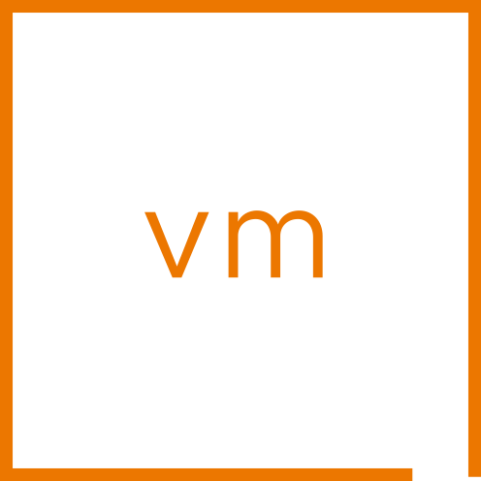

The vSAN Difference
Scale UP and OUT for maximum agility
Run more VMs per host
Add capacity the way you want
Scale UP by adding drives
Scale OUT by adding hosts
Agile, cost-effective cluster designs
vSphere
vSAN
vSphere
vSAN
vSphere
vSAN
Scale Up
vSAN Datastore
Scale Out
Notes:
Key Message/Talk track:
The tremendous efficiency of vSAN means that it can run more VMs per host than other HCI systems not integrated into the hypervisor. And not only that, but do with much more consistent levels of performance and tighter integration. This ability to scale up and out – often not possible in the same way when using storage arrays - means that users can strategically design their vSAN powered cluster to accommodate growth that best reflects the needs of their organization.
----------------------------------
Overview:
Add capacity the way you want
Scale UP by adding drives
Scale OUT by adding hosts
Agile, cost-effective cluster designs
----------------------------------
Details:
The difference in VM per host density is NOT a trivial amount. Actual real world environments have suggested competing solutions can only get ½ to 1/3rd the number of VMs per host, and lacking the consistency in performance that an in-kernel solution like vSAN has.
Designing vSAN hosts for future “scale up” expansion is an extremely powerful message that resonates with customers (e.g. Add capacity without any new hosts or licensing). See “Options in Scalability” that provides details and illustrations on how scale up expansion works. VirtualBlocks blog post at: https://blogs.vmware.com/virtualblocks/2016/09/15/options-scalability-virtual-san/
Some current scaling limits PER cluster are current set to:
Max cluster size: 64 hosts
Max stretched cluster size: 15 hosts + 15 hosts + 1 witness host
Max components: 9,000 per ESX host
Max witness components: 45,000 per ESX host
Max VMDK size: 62TB
6,400 VMs per cluster (limitation of vSphere HA)
A full listing of vSAN Limits and design considerations can be found here: https://storagehub.vmware.com/t/vmware-vsan/vmware-r-vsan-tm-design-and-sizing-guide/ as well as common FAQs found at: https://storagehub.vmware.com/t/vmware-vsan/vsan-frequently-asked-questions-faq/architecture/
----------------------------------
Additional Information:
TBD

Slide 35

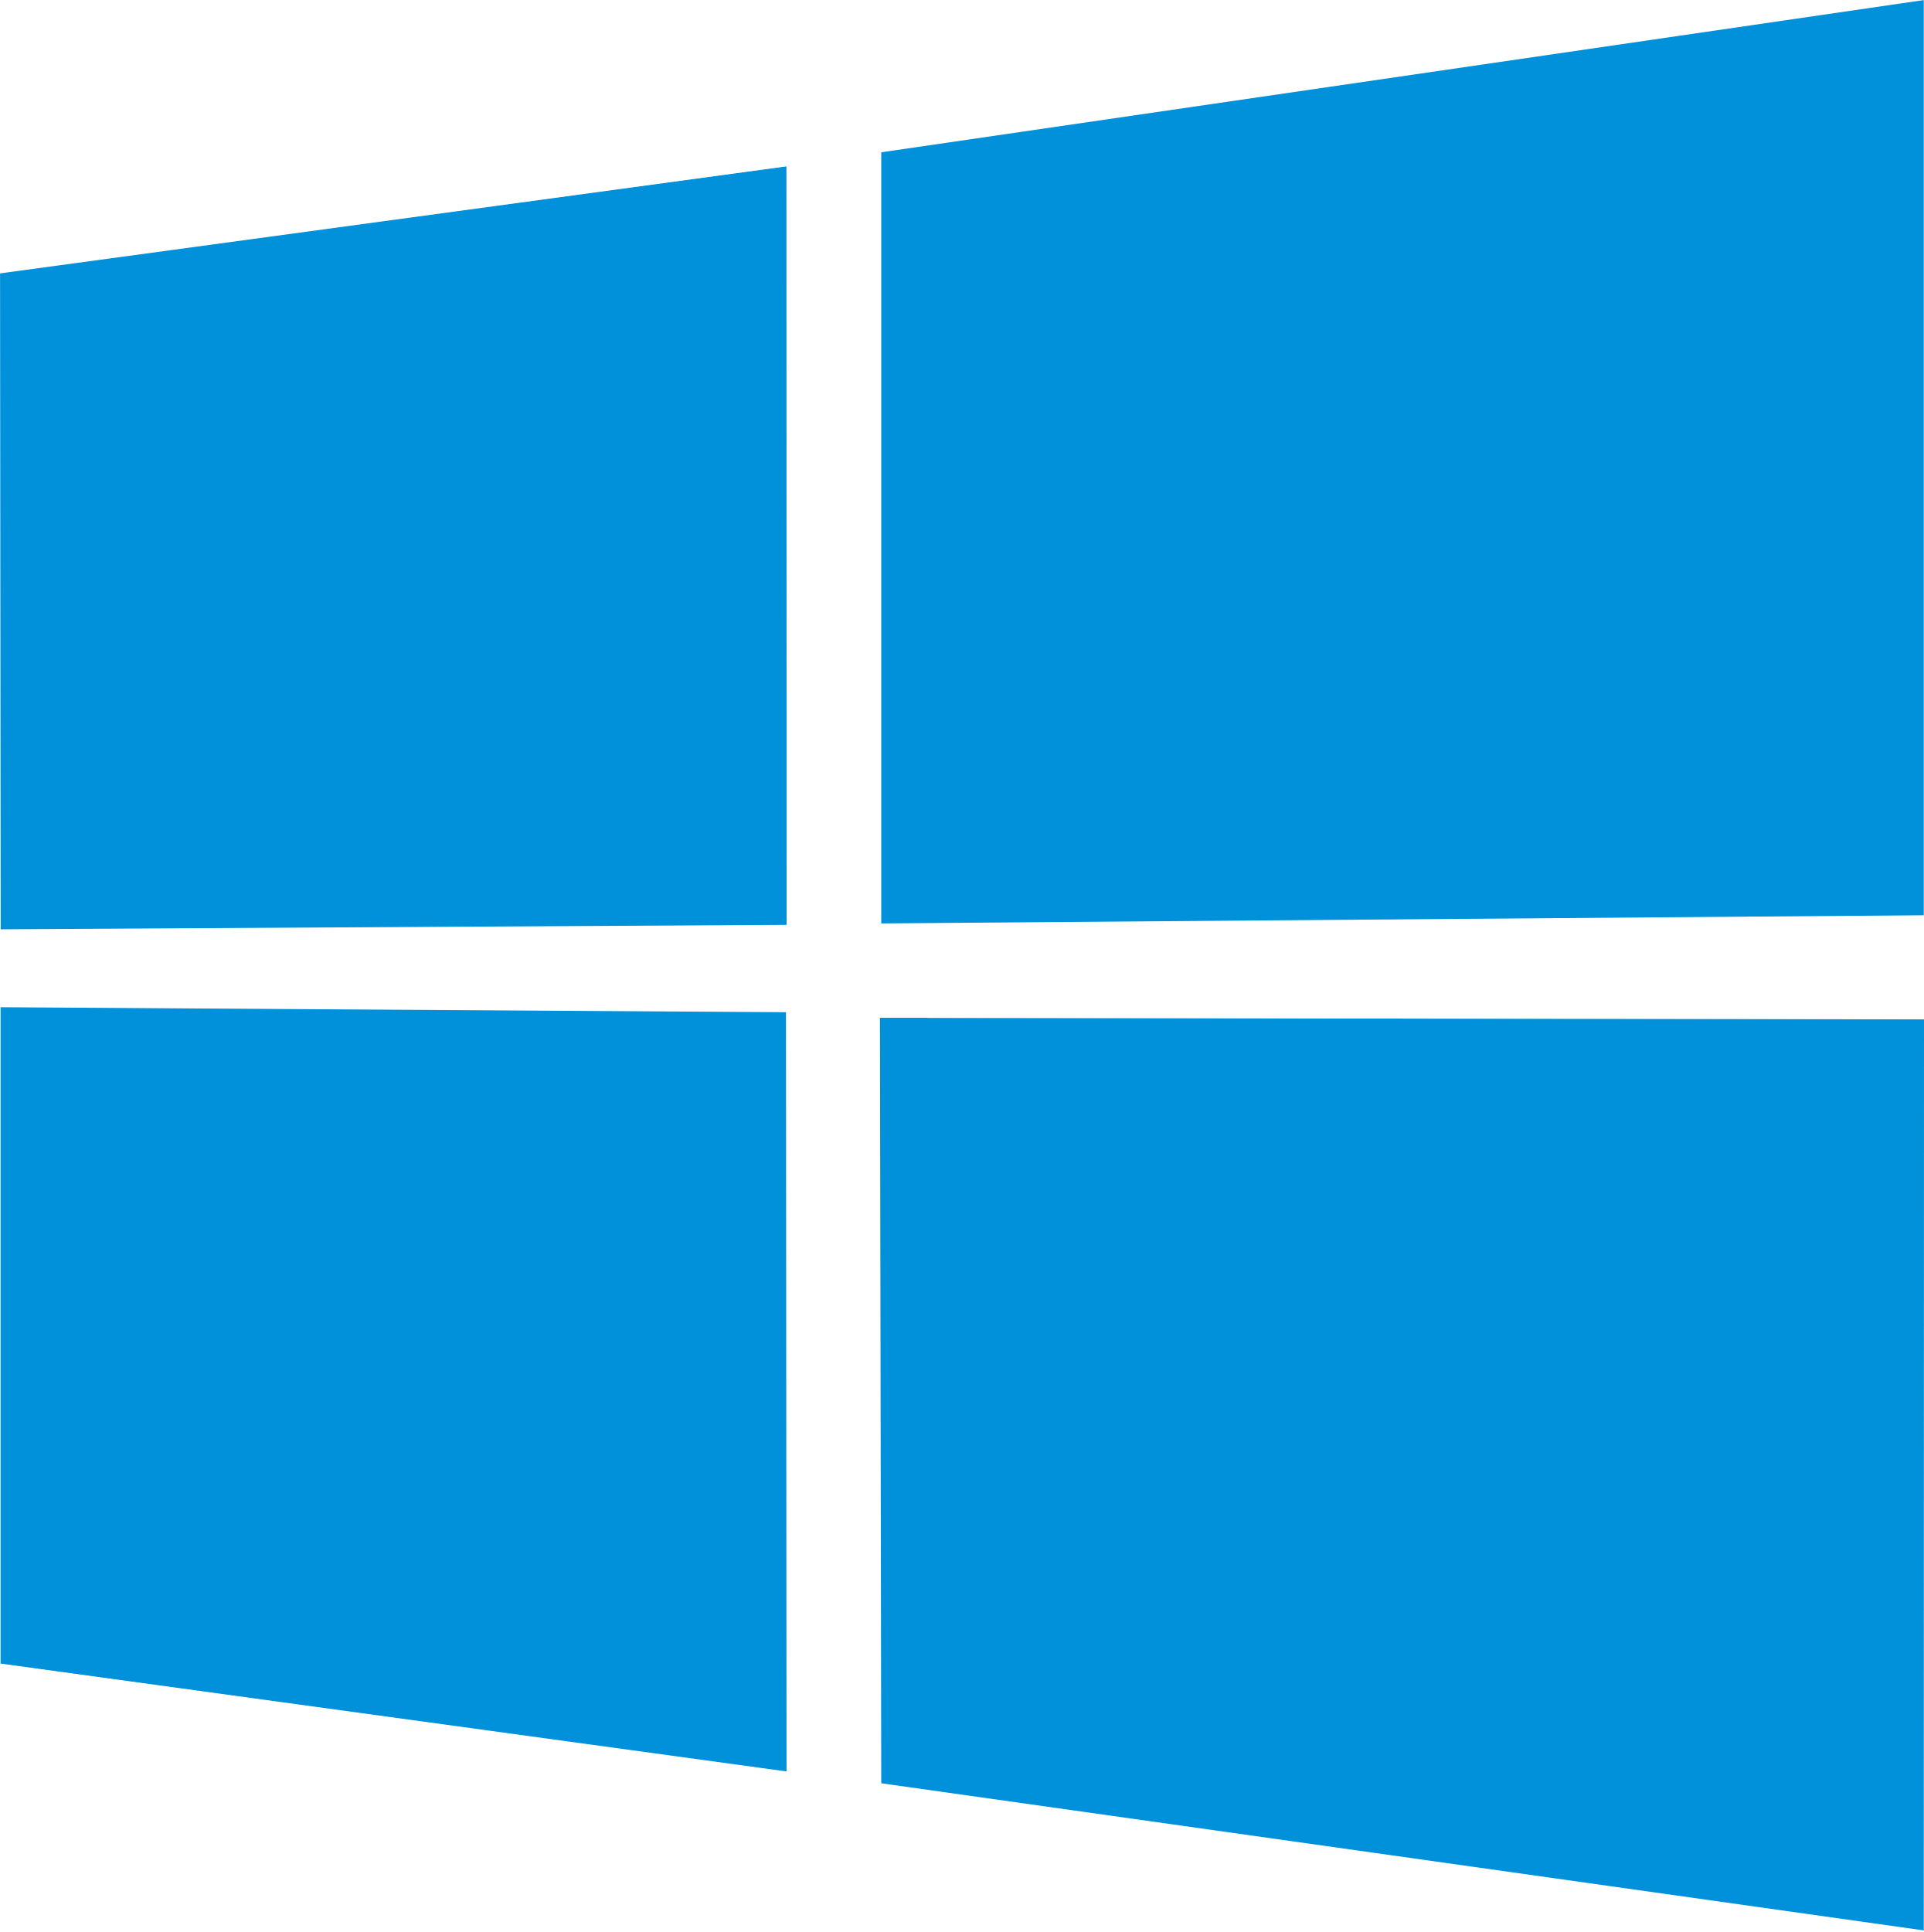






Additional Data Services to Meet your Business Requirements
Easily tailor unique data services on a per cluster basis
vSAN iSCSI target service
vSAN File Services
S3 compatible object storage*
Extend vSAN beyond native VM storage
Enable/disable based on organizational needs
SMB and NFS file services
iSCSI block access for legacy workloads
S3 compatible object storage*
Provide FIPS validated data-at-rest and data-in-transit encryption
Physical
Virtual
App
Windows clients
Linux clients
Container PVs
Cloud native applications
iSCSI Network
vSphere
vSAN
DiT
Data-at-Rest Encryption
Data-in-Transit Encryption
vSAN Datastore
*When using a 3rd party certified solution through VMware vSAN Data Persistence platform
Notes:
Key Message/Talk track:
vSAN offers a number of data services to help you address your organization’s unique needs. While vSAN can run hundreds of VMs per host in a vSAN cluster, additional data services are available to extend the functionality of vSAN. Take for example the vSAN iSCSI target service, where you can create an iSCSI target on vSAN so that a legacy physical server running an application can mount that iSCSI volume. Or perhaps your organization needs file services. vSAN File Services offers the ability to create SMB and NFS shares to work with both traditional and cloud native workloads. vSAN also offers native S3 compatible object storage. This comes through the use of 3rd party certified solutions as a part of the VMware vSAN Data Persistence platform, or DPp. And finally, vSAN offers the ability to ensure the highest levels of security through data-at-rest encryption and data-in-transit encryption offerings. All of this adds up to a highly flexible, robust, and secure storage solution.
----------------------------------
Overview:
Extend vSAN beyond native VM storage
Enable/disable based on organizational needs
SMB and NFS file services
iSCSI block access for legacy workloads
S3 compatible object storage*
Provide FIPS validated data-at-rest and data-in-transit encryption
----------------------------------
Details:
Some features subject to licensing requirements, and depend on the architecture used. (OSA versus ESA)
----------------------------------
Additional Information:
TBD

Slide 36


Simple, Insightful Cluster Health Status and Troubleshooting
Skyline Health intelligent cluster health scoring, diagnostics and remediation
vCenter
Provides cluster health score for at-a-glance condition of cluster
Prioritizes identified issues to help address most important condition first
Weighs issues using common Administrator responsibilities
Data availability
Performance
Capacity utilization
Efficiency & Compliance
Take action on the most important issue, first
Summary
Monitor
Configure
Permissions
Skyline Health
Cluster health score
Health score trend
Weighted
score & history
92
92
52
Attention
Healthy
Health Findings
UNHEALTHY (2)
HEALTHY (49)
INFO (2)
SILENCED (1)
Prioritized issues with remedies
vSAN object health
Impact -40
Availability
Performance
Impact area:
Availability
Capacity
Compliance
Calculates Impact
Relationships
Category
Priority
Analyzes Conditions
vSAN
Notes:
Key Message/Talk track:
Administrators responsible for the health and well-being of an environment have a lot to think about. In vSAN 8 U1, VMware has developed an all-new cluster health status and troubleshooting dashboard. It helps answer the basic questions of, “Is my cluster and the workloads it serves in a health state?” and if not, how sever is the condition? …and should the issue be resolved? It provides that information that traditional health alerts alone cannot. For each vSAN cluster, the Skyline Health for vSAN will provide a quick at-a-glance score of the condition of a cluster so an administrator can easily determine if all is good, and if not, how impactful any identified issues are. The new mechanism used a sophisticated method of weighing triggered health checks, and aligns them with common pillars of responsibility. It will then provide the most important, impactful triggered health findings in an order of priority so that an administrator can resolve issues quickly and easily.
----------------------------------
Overview:
Provides cluster health score for at-a-glance condition of cluster
Prioritizes identified issues to help address most important condition first
Weighs issues using common Administrator responsibilities
Data availability
Performance
Capacity utilization
Efficiency & Compliance
Take action on the most important issue, first
----------------------------------
Details:
The Skyline Health checks for vSAN allows administrators to verify the status of well over a hundred discrete health checks. While this can be useful, it lacks in its usefulness to administrators in the following ways:
Does not convey health condition in a way that is in alignment with common administrative pillars of responsibility (e.g. Availability of data and services, Performance SLAs, etc.)
Does not convey health severity. What type of impact the triggered health check(s) may have on a cluster
Does not provide a correlation of triggered health checks and their relationship to one another. (until vSAN 7 U3)
It presents triggered health checks in arbitrary form, visually presenting a more benign triggered health check with a more important triggered health check equally – which can be misleading in terms of what to address first.
More health checks added to a list exacerbates the problem of which triggered health check to address first.
Methods and order of remediation were unclear for many users.
vSAN 8 U1 introduces an all-new simplified way understand the health or status of a cluster, and remediate issues in a prioritized way.
Quickly identify the status of a cluster (e.g. “Do I need to address an issue now, or is it just a small matter that can wait?”)
Provides a summed, weighted value of triggered health checks to indicate severity, and priority.
Understand how any triggered health checks are impacting core administrator responsibilities
Gives a priority of remediation for triggered health checks.
Simplified steps for remediation in UI (manual or automated depending on the circumstances)
Provides a historical view of this cluster health score.
The new cluster health score and troubleshooting framework in vSAN uses a sophisticated algorithm to determine the score of a cluster so that triggered checks are accounted for with the appropriate level of severity. It does so through the following ways:
Category Factor. All health checks fall into one of 4 general categories. They are “Availability,” “Performance,” “Capacity Utilization” and “Efficiency and Compliance.” These categories are weighted to align with typical administrator pillars of responsibility. (Example. Efficiency and compliance isn’t important if none of the data is available in the first place). Some categories like “Availability” have an additional level of distinction between data availability, and infrastructure availability to be more accurate in its scoring.
Priority factor. This helps give a weight to a triggered heath check within a category, aggregating the weight of the triggered health checks.
The cluster score ranges from 0-100, with 100 being a perfectly healthy cluster based on the condition of the health checks.
Triggered alerts that are silenced will still be deducted from the total score.
The cluster score dial has line breaks that denote three general states of the cluster. This mimics, but in a much more accurate way, a common task administrators perform in quickly opening up vCenter server and randomly checking health checks, but in an arbitrary way.
81-100. On Target/Healthy - No attention required
61-80. Degraded health - Attention suggested.
0-60. Unhealthy - Attention required
Given the defined categories, one will find that if there are any triggered issues regarding “availability” (where data is unavailable, and not just degraded in prescribed resilience) it will always reduce the total cluster health score enough to where the scoring will be in the “Unhealthy – Attention required” range.
This capability is designed to prevent false positives from operational tasks, or the designed behavior of vSAN in how the types of conditions of alerts are weighted. The Skyline health checks for vSAN can distinguish between data unavailability versus data still available but degraded in its level of prescribed resilience. For example, a triggered health check of “vSAN Object Health” will impact a health score much more so if it is unavailable, than if it is available, but degraded due to a “reduced level of resilience” condition that could have been invoked by a planned EMM event using the “ensure accessibility” option. It methodology is also applicable to device and host failures.
The “Capacity Utilization” and the “Efficiency and Compliance” categories attempt to convey to the administrator if they are utilizing their purchased resources optimally. Anything that subtracts from the aggregate sum of resources could be deemed a reduction in efficiency because the cost of providing the services was increased relative to the loss of resources.
Rendering a cluster health score sets the stage for the other aspect of this feature: The prioritized order of remediation of outstanding issues, with improved guidance for the triggered issues.
The UX deemphasizes the simple enumeration of green health checks for the reasons described in bullet point #1, and prioritizes triggered health checks in priority of 1.) Level of impact on the cluster, and 2.) the hierarchal relationship that the triggered health checks have to each other.
“Health Findings” will be presented in a list below the cluster health score and score timeline. It will be sorted by a “recommend” (e.g. “root cause”) order of remediation.
The triggered health findings will always be sorted by “root cause” by default. It can also be sorted by:
Occurred on
Status
Score
Category
Impact area
The remediation will always surface the root cause of the issue. For example, in the event of a data availability issue, there may be an “object health” warning that is most certainly important, but this in many ways is a symptom-based health check. There may also be a “network partition” alert associated with this issue, where it is a symptom of the related issue. Skyline health will recognize this, and present the “root cause” alert “e.g. “vSAN vmknic is not configured” as the first order of resolving the issue.
The dashboard deemphasizes an enumerated list of health checks that have passed, as the details of passed health checks have limited relevance. They are however visible by selecting the “Healthy” tab in the “Health Findings” of the Cluster dashboard.
The guidance in many of the triggered health checks have improved. While we aim to have semi-automated “fix issue” workflows in place, enhancements in the guidance should help customers resolve issues more quickly.
This new capability builds off of the Skyline Health Check correlation capability introduced in vSAN 7 U3. This health check correlation capability introduced the ability for various health checks to understand the relationship of one health check to another for improved levels of troubleshooting. These relationship mapping of the health checks grows more sophisticated with each release, and plays a critical role in helping the administrator address the root cause of a triggered issue.
At this time, the majority of the checks in the vSAN health check engine are focused availability. As a result, the cluster scoring, identification of issues, and direct paths for remediation are the strongest with availability concerns. As our health check engine continues to add more checks for performance, capacity utilization, and efficiency, it will become more effective and important to the understanding of the conditions of cluster health in those areas, and offer more sophisticated methods for remediation.
A cross-BG effort has transitioned the “health Check” terminology across vCenter Server to “Health Findings.” They mean the same thing, but for all future UI references, you will see the term “health findings” used.
Note that for all time based-metrics, the formatting of dates across a time-line can be adjusted to suit a country of origin. Clicking on the “My Preferences” will provide a time format and language selection that can either be set for the browser default, or to a specific language.
Positioning
The Cluster health scoring mechanism mimics an approach often practiced by seasoned administrators, where issues are identified, weighted, and steps for remediation are prioritized. However, Skyline Health for vSAN in vSAN 8 U1 is able to achieve these practices in a similar way for all customers, regardless of skillset.
----------------------------------
Additional Information:
TBD

Slide 37
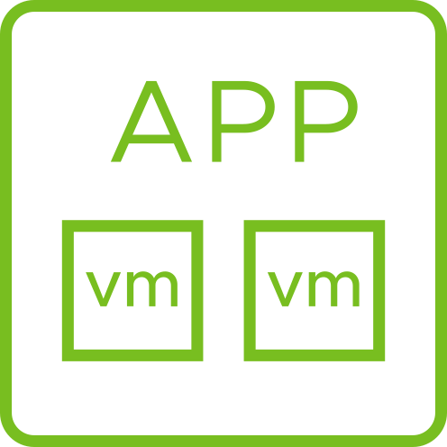
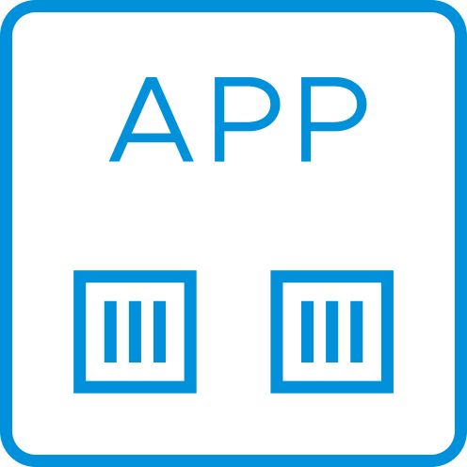






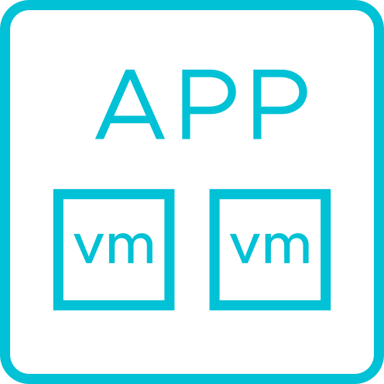
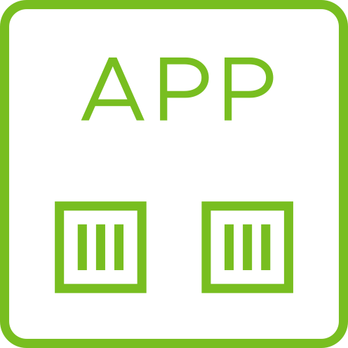
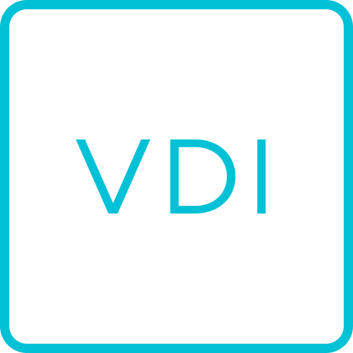

Run Multiple Workloads and Topologies Simultaneously
Provides flexibility in powering many types of workloads across different environments
Edge
Edge
Power multiple application types using vSAN
Business Critical Apps (BCA)
Cloud Native Apps (CNA)
IT Core Infrastructure svcs.
Virtual desktops (VDI)
Edge (2-Node Clusters)
Easily adapt configuration to evolving needs
Use multiple topologies across environment
Manage through single interface
vCenter Server
vSAN
vSAN
Edge / Branch Offices
Business Critical Apps (BCA)
VDI
CNA
IT
Stretched Cluster
vSAN
vSAN
vSAN
Co-Lo
Primary Data center
Notes:
Key Message/Talk track:
vSAN supports all different types of workloads and topologies. Run business critical applications along-side other applications or carve out clusters focused on specific application requirements. Whether they be VDI workloads, business critical workloads, cloud native applications, or common IT service workloads, not only can you easily meet the needs of the application, but the flexibility of the architecture allows you to deliver those services in many different ways. House them in a central data center, or perhaps a stretched cluster that spans two physical sites. Maybe an organization has several branch offices, or perhaps they want the flexibility to expand resources by using the cloud. vSAN can meet all of these demands, and more, all by using a single management plane: vCenter Server.
----------------------------------
Overview:
Power multiple application types using vSAN
Business Critical Apps (BCA)
Cloud Native Apps (CNA)
IT Core Infrastructure svcs.
Virtual desktops (VDI)
Edge (2-Node Clusters)
Easily adapt configuration to evolving needs
Use multiple topologies across environment
Manage through single interface
----------------------------------
Details:
Flexibility in topologies could include, but are not limited to:
Standard clusters carved up to meet specific business needs
Standard clusters using explicit fault domains
Standard clusters using HCI-Mesh
Hybrid-cloud configurations using a blend of hardware on premises and in the cloud
Stretched clusters
2-Node clusters
Clusters connected to DRaaS
The emphasis of this slide is focused on traditional application. Cloud native apps can be intermingled in this, but it is not shown for clarity.
----------------------------------
Additional Information:
Use case: vSAN in Industrial Environments: https://blogs.vmware.com/cloud-foundation/2021/03/26/vsan-in-industrial-environments/
Use case: vSAN in Healthcare: https://blogs.vmware.com/cloud-foundation/2021/06/16/vsan-in-healthcare/
Use case: vSAN Powering Biotech: https://blogs.vmware.com/cloud-foundation/2021/04/07/vsan-powering-biotech/
Use case: Multitenancy in vSAN: https://blogs.vmware.com/cloud-foundation/2022/09/23/multitenancy-in-vsan/

Slide 38
One Solution – Multiple Deployment Options
Aggregated resources using vSAN HCI or disaggregated resources using vSAN storage clusters
Unified lifecycle management of storage and compute resources
Symmetrical scaling of storage and compute resources
Treats storage as a resource of the cluster
Compute & storage
vSAN HCI
vSAN HCI
Compute only
Independent lifecycle management of storage and compute resources
Asymmetrical scaling of storage and compute resources
Extreme capacity can serve many clusters
Decoupled vSphere clusters can be sized to optimize application licensing
Scale out
Scale out
Storage only
vSAN storage cluster
vSAN Storage Cluster
Powered by vSAN ESA
Centralized Management
Storage integrated into hypervisor
Notes:
Key Message/Talk track:
Which one is right for you? The circumstances or requirements you have in your environment may favor one deployment option over the other, but in most cases, it does not mean that a specific deployment option should be excluded from consideration. The decision may come down to a unique set of considerations, or personal preference. Regardless, the vSAN Express Storage Architecture powers all deployment options, giving you the performance, resilience, and scalability that is synonymous with the ESA. Some of the key considerations come down to overall capacity needs, asymmetry of growth for compute resources versus storage resources, requirements of storage for existing clusters, and topology constraints. Whatever is chosen, vSAN HCI clusters can happily coexist with vSAN storage clusters, as they are all managed in the very same way, using the very same software.
----------------------------------
Overview:
vSAN HCI
Unified lifecycle management of storage and compute resources
Symmetrical scaling of storage and compute resources
Treats storage as a resource of the cluster
vSAN Storage Clusters
Independent lifecycle management of storage and compute resources
Asymmetrical scaling of storage and compute resources
Extreme capacity can serve many clusters
Decoupled vSphere clusters can be sized to optimize application licensing
----------------------------------
Details:
See the document referenced below
----------------------------------
Additional Information:
Asset detailing this decision making process: https://blogs.vmware.com/cloud-foundation/2024/01/22/vsan-hci-or-storage-clusters-which-deployment-option-is-right-for-you/

Slide 39
A New Way to Process and Store Data Efficiently
vSAN Express Storage Architecture
Fast & efficient data path
Native scalable snapshots
Simplified Administration
vSphere
vSAN ESA
Efficient and resilient data structure
Single tier
Single tier
Single tier
vSAN ESA Datastore
Performance
Efficiency
New Capabilities
More data on less hardware
Fewer hosts to process data
More capacity on less hardware
Fewer hosts to process data
vSAN Data Protection vSAN storage clusters, etc.
Notes:
Key Message/Talk track:
What makes the vSAN Express Storage Architecture found in vSAN 8 unique? We’ll be looking at that in more detail throughout this presentation, but its capabilities are best captured by a quick summary of benefits it provides our customers. The vSAN ESA provides a new way for vSAN to process and store data efficiently. A new fast and efficient data path paired with an efficient and resilient data structure give our users the ability store and access data fast and efficiently. The Express Storage Architecture also provides an all-new snapshot engine that is meets high levels of performance and scalability while remaining fully compatible for use with our ISV partners who provide backup solutions. And finally, the vSAN Express Storage Architecture makes administering an environment simpler by improving how devices contribute as a storage resource to the cluster. Does this mean that vSAN was re-written? No! As we’ll see in the following slides, VMware was able to introduce some new technologies into this optional architecture, but that optional architecture is built within vSAN – the same software you already know.
----------------------------------
Overview:
Highly adaptable to the hardware of today and tomorrow
Stores data efficiently while meeting performance requirements
Higher levels of resilience without compromise
Native, scalable snapshots
Simplifies administration and serviceability
----------------------------------
Details:
Technical details provided in the subsequent slides.
Positioning
The vSAN ESA is not a “replacement” architecture, but an alternative architecture optimized for high performing, modern hardware. vSAN remains as a single product, but now includes the architectural capability to accommodate for these next generation hardware devices. It should NOT be positioned as a “rewrite” or a replacement in any way.
Do not reference the ESA and vSAN’s original storage architecture as “new” and “old” or any variation of that, as this can have a negative connotation toward previous editions of vSAN. While the vSAN ESA is the storage architecture where all future development efforts will be focused on, VMware is committing to ongoing support of the original storage architecture for many years to come. The official naming reference for the original storage architecture should be “Original Storage Architecture” abbreviated to OSA only when absolutely necessary.”
----------------------------------
Additional Information:
Blog: https://blogs.vmware.com/cloud-foundation/2022/08/30/an-introduction-to-the-vsan-express-storage-architecture/

Slide 40

Do More with What You Already Have to Reduce TCO
Rapid innovation with vSAN Express Storage Architecture™
Greater Performance & Scalability
Supreme Resource & Space Efficiency
Store data using RAID-6 at the performance of RAID-1
Consistent and scalable performance
Adaptive write path for maximum throughput
Snapshots with minimal performance impact
vSAN storage clusters
Lower CPU usage per I/O processed
Up to 70% more usable capacity
Up to 500 VMs per host
Non-invasive, more efficient compression
Combination of efficiencies dramatically reduce TCO
Better Resilience
Easier to Use
Reduced failure domains improve availability upon device failure
All new native, scalable snapshots and data protection
Durable data during planned and unplanned events
Unique protection against device errors
Simplified storage device provisioning and servicing
Auto-policy management for set-it-and forget it resilience
Improved storage policies for simplified operations
Proactive Insights detects anomalies to prevent potential issues
Notes:
Key Message/Talk track:
The Express Storage Architecture allows customers to provide a platform that serves and stores data faster and more efficiently than ever before. But of course, it is not just about performance and efficiency. It is about having a platform that demonstrates the agility needed to support a variety of use cases, while making sure that it is easy, and intuitive to deploy, operate, and optimize.
----------------------------------
Overview:
Better Performance & Scalability
Store data using RAID-6 at the performance of RAID-1
Consistent and scalable performance
Snapshots with minimal performance impact
Improved scalability supporting up to 500 VMs per host
vSAN storage clusters
Supreme Resource & Space Efficiency
Improved CPU efficiency – lower CPU usage per I/O processed
Up to 70% more usable capacity
Adaptive RAID-5 erasure coding
Non-invasive, more efficient compression
Combination of efficiencies dramatically reduce TCO
Better Resilience
Reduced failure domains improve availability upon device failure
All new native, scalable snapshots
Durable data during planned and unplanned events
Unique protection against device errors
Easier to Use
Simplified storage device provisioning and servicing
Auto-policy management for set-it-and forget it resilience
Improved storage policies for simplified operations
Proactive Insights detects anomalies to prevent potential issues
----------------------------------
Details:
The performance claims are generalized in this presentation. Additional material will be provided that will demonstrate referenceable and quantifiable improvements when compared to vSAN using the original storage architecture. As with any performance and efficiency claims, it is subject to several environmental conditions, such as hardware, workload characteristics, data services used, etc.
Positioning
The Express Storage Architecture has numerous architectural details that provide several positive benefits to the customer, but many of them (especially performance and efficiency improvements) are implementation details that will be transparent to the administrator. They are, however, important to the concept of doing more with less to drive down costs.
----------------------------------
Additional Information:
TBD

Slide 41
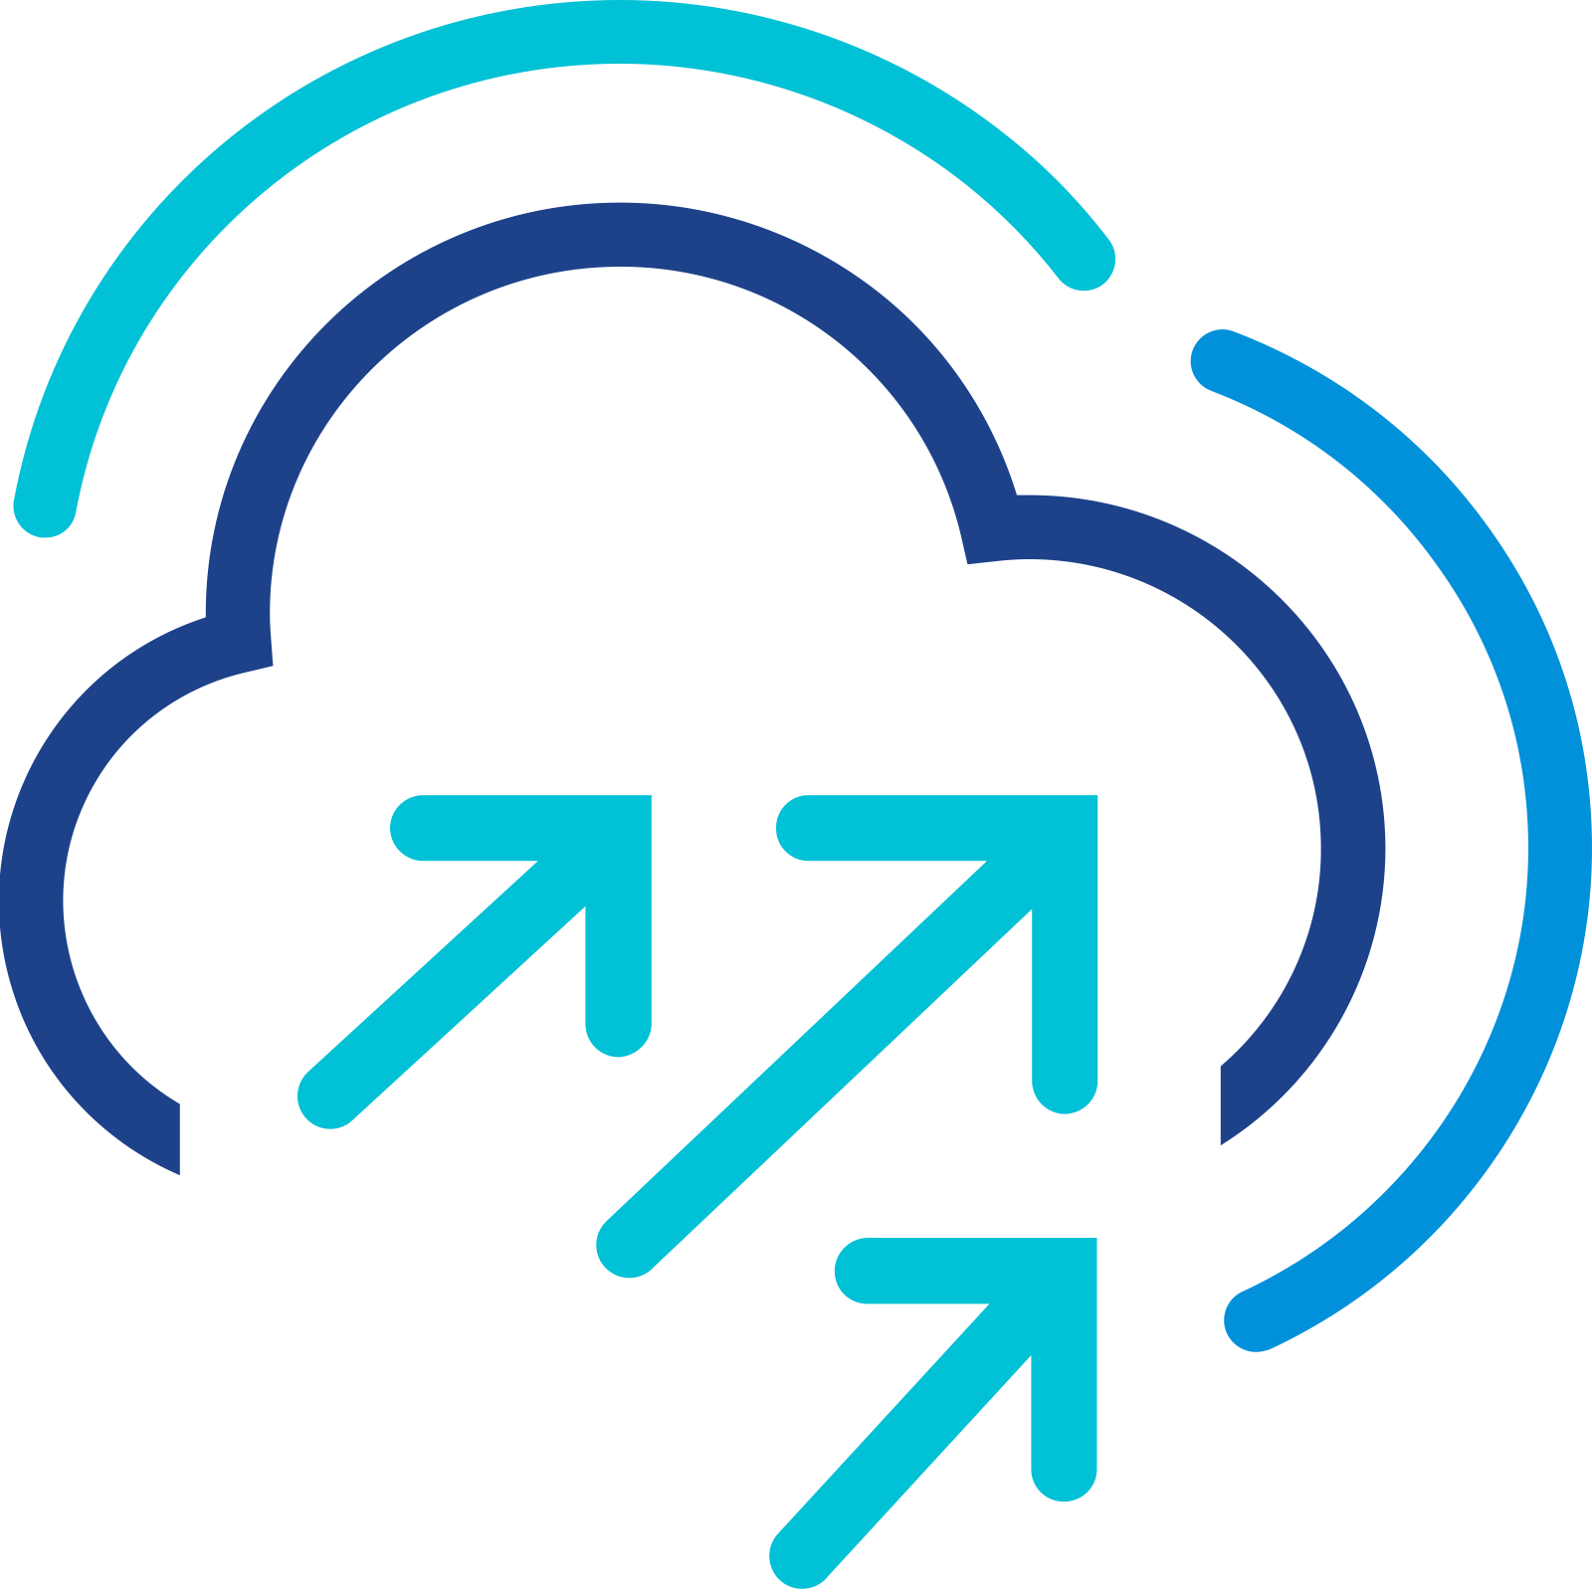
vSAN - The premier storage for VMware Cloud Foundation
You’ve trusted the hypervisor to manage your workloads. Why not let it manage your storage?
vSAN is a part of the hypervisor and licensing. Why not use it?
vSAN HCI
vSAN storage clusters
VMware Cloud Foundation
Manage and protect your workloads at the VM level for unprecedented levels of control, visibility, and protection
Notes:
Key Message/Talk track:
There you have it! With all of the new capabilities and integration into VCF, it is clear that vSAN is the premier storage platform for VMware Cloud Foundation. Ask yourself the questions: “You’ve trusted the hypervisor to manage your workloads. Why not let it manage your storage?” “vSAN is a part of the hypervisor and licensing. Why not use it? vSAN allows you to manage and protect your workloads at the VM level for unprecedented levels of control, visibility, and protection.

Slide 42
Modernize Infrastructure
Networking - NSX
Notes:
Key Message:
Networking is a core component of Cloud Foundation's software defined capabilities.
Talk Track: (50)
The public cloud (as we know it) is built upon and heavily leverages software defined networking. VMware NSX is an inherent part of Cloud Foundation and allows IT teams to deliver similar cloud-like capabilities into the data center.
Software Defined Networking and Security with NSX removes the need to individually configure networking and security components manually. Switched and routed networks can be provisioned and managed with ease to support the changing needs of your applications. It removes the complexities associated with provisioning and managing traditional networking infrastructure allowing you to build and scale it in software using automation.
SDDC Manager takes NSX even further adding automation capabilities. Administrators can build, scale and lifecycle manage networking and security as part of the full platform stack.
Notes:
Cloud Foundation delivers a complete SDDC platform where all elements of infrastructure (compute, storage, networking, security and lifecycle management) are virtualized and abstracted from the underlying hardware. Having these capabilities allows IT Teams to deliver an unprecedented level of flexibility within the data center allowing them to best service the needs of their applications and services without disruption and in less time.
References:

Slide 43


Network Virtualization is Required to Deliver a Modern Private Cloud
Network Virtualization
Modern Apps Networking
Network Visibility and Troubleshooting
Workload
Mobility
Lateral
Security*
Integrated
SDN
Simplified K8s Networking
Powerful Monitoring
Large-scale
Mobility
E-W Traffic
Protection
Self-service networks with Virtual Private Cloud
Comprehensive network
policy model
Pre-deployment assessment
Any-to-any vSphere version
Stateful L7
Distributed FW
Virtual distributed switching & routing
K8s platform agnostic
Application discovery
Zero-downtime migration
ATP with IDS/IPS, Network Sandbox, NTA/NDR
Consistent networking policies across sites
Integration with NSX offers a single pane of glass
Network topology and metrics visualization
Various migration modes
Security analytics and rule recommendations
*Add-on advanced services not included with VCF
Notes:
Presenter Note: This slide contains animation.
Key Message:
VMware NSX revolutionizes private cloud networking by abstracting network services, enabling seamless container integration, enhancing network visibility, facilitating workload mobility, and bolstering security through vDefend add-on services such as distributed firewalls and advanced threat protection. Thus, it delivers the agility, efficiency, and security essential for modern applications and workloads.
Talk Track:
Traditional physical networks hinder agility and scalability, which are essential for modern private clouds. VMware NSX addresses this by abstracting network services from hardware and creating a software-defined network. This allows provisioning and managing network services such as routing, switching, load balancing, and firewalls through software. This abstraction offers the flexibility and automation needed to adapt to workload demands, transforming network operations within the private cloud.
<click 1>
Modern applications utilize container workloads. VMware NSX integrates with container orchestration platforms like Kubernetes, offering networking capabilities for containerized environments. This includes features such as container network interface plugins, which facilitate the provisioning of network resources and security policies for container communication. By extending network virtualization to containers, NSX ensures consistent networking and security policies across virtual machines and containers, simplifying the management of hybrid application architectures.
<click 2>
Network visibility is crucial for troubleshooting and optimizing performance. VMware NSX provides insights into network traffic flows, allowing administrators to monitor and analyze network performance in real time. This includes insights into network traffic patterns, micro-segmentation policies, and distributed firewall rules. With NSX, administrators can pinpoint bottlenecks, troubleshoot network issues, and understand network behavior, improving operational efficiency and reducing downtime.
<click 3>
Workload mobility is essential for modern private clouds. VMware NSX enables workload mobility across various environments, including on-premises data centers and public clouds. Consistent network and security policies facilitate this process, allowing workloads to migrate without the need for reconfiguration. NSX also simplifies hybrid cloud connectivity, ensuring secure and efficient communication between on-premises and cloud resources. This helps guarantee consistent application performance and security, regardless of the workload's location.
<click 4>
Advanced add-on services such as VMware vDefend solutions provide a defense architecture that integrates a distributed firewall, gateway firewall, intrusion detection, sandboxing, and network threat analytics for VMware Cloud Foundation. Utilizing a software-defined distributed architecture with hypervisor integration and AI/ML-powered threat intelligence, vDefend minimizes the attack surface, eliminates blind spots, and offers threat campaign identification and remediation while providing lateral security for applications and data.
Notes:
Advanced Threat Protection (ATP) refers to a collection of security solutions and practices aimed at detecting, preventing, and responding to complex and sophisticated cyber threats—particularly those that traditional tools often overlook, such as zero-day exploits, fileless malware, and advanced persistent threats (APTs).
An Intrusion Detection System (IDS) is a security tool that monitors network or system activity to detect malicious behavior, policy violations, or unauthorized access. It analyzes traffic or logs and raises alerts when it detects suspicious patterns, often based on known threat signatures or behavioral rules.
An Intrusion Prevention System (IPS) is an inline security tool that monitors, detects, and actively blocks malicious or unwanted traffic in real time. It builds on the functionality of an Intrusion Detection System (IDS) by identifying threats and taking immediate action to stop them, such as dropping packets, resetting connections, or blocking IP addresses.
Network Traffic Analysis (NTA) is a cybersecurity technique for monitoring, inspecting, and analyzing network traffic to detect suspicious behavior, threats, or policy violations. It involves collecting and analyzing packet data, flow data (like NetFlow or IPFIX), and metadata to gain visibility into everything happening across the network.
Network Detection and Response (NDR) is a cybersecurity solution that uses advanced analytics, machine learning, and behavioral modeling to detect, investigate, and respond to threats based on network traffic. It’s an evolution of Network Traffic Analysis (NTA), adding automated response and deeper threat intelligence capabilities.
Resources:

Slide 44
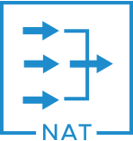

Software Defined Networking in VMware Cloud Foundation
Networking has changed…
Software-Defined Networking is Built for the Application
Applications in Focus
Building a repeatable infrastructure for applications
Abstracts the hardware layer and virtualizes network resources
Application Layer
Hosted on VMS
Centrally Controlled and Deployed
SDN Layer
Operations
Policy-based enforcement based on application behavior
Enforcement at application level and not at multiple points in the infrastructure
Switching
Routing
Stateful Firewalling
LB
NAT
VPN
Physical Infrastructure as Transport
Infrastructure Layer
Notes:
Presenter Note: This slide contains animation.
Key Message:
Introduce the concept of SDN in VMware Cloud Foundation.
Talk Track:
The new era of networking isn’t about hardware configuration anymore—it's centered around the application.
VCF delivers SDN through NSX and its add-ons, allowing you to visualize your application, network, and security topology, apply automated security policy recommendations, and monitor traffic continuously.
<click 1>
The core idea of software-defined networking is to build a standardized, repeatable infrastructure by abstracting away the complexity of physical networking.
And because SDN is policy-driven, compliance is easier to maintain and enforce, tailored to each application's requirements. From an operational standpoint, enforcement is centralized and applied at the VM level, instead of relying on multiple touchpoints across the infrastructure.
<click 2>
Hardware configuration becomes simpler and more consistent—focused primarily on providing redundancy and high availability. The physical layer remains, but it simply serves as the transport foundation for the software-defined network.
Notes:
* Security features are consumed as an add-on NSX license (VMware vDefend).
Other advantages of software-defined networking as expressed as part of VMware Cloud Foundation:
1.) Abstraction through encapsulation – traffic can now simply transit (bypass) over the hardware layer by making use of encapsulation technologies.
2.) Integrated networking across application frameworks (this means that routing and switching policies can be applied at application-level and across the entire SDDC)
3.) Integrated security throughout the data center by introducing the concept of micro-segmentation (application-focused firewalling)
4.) Single pane of glass for troubleshooting
Resources:
For further information on Cloud Foundation networking please refer to the VCF Design Guide

Slide 45
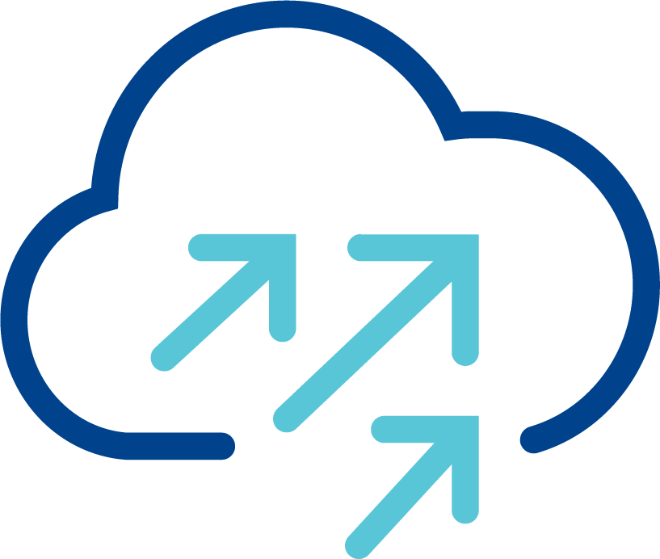
VCF with Physical Networking
IP Fabric with service appliances
Vendor #1 configuration/API
Switching
Vendor #2 configuration/API
Routing/NAT
VLAN z
VLAN y
VLAN x
VCF with vSphere Networking
Vendor #3 configuration/API
Load Balancing
ESX
ESX
ESX
Vendor #4 configuration/API
Firewall, IDS/IPS, ATP
DvPG x
DvPG y
DvPG z
DvPG x
DvPG y
DvPG z
Vendor #5 configuration/API
Monitoring and Analytics
Monitoring and Analytics
Vmware Cloud Foundation
Notes:
Presenter Note: This slide contains animation.
Key Message:
Using vSphere networking with VCF requires tight coordination with physical infrastructure, creating delays and making full automation complex and often unfeasible.
Talk Track:
When VCF uses vSphere networking, coordination with the physical network is essential.
For example, deploying a new application involves attaching its VMs or containers to dvportgroups
<click 1>
Those dvportgroups must then be mapped to corresponding VLANs in the physical fabric.
Even with advanced technologies like EVPN, coordination between application and network teams remains necessary.
<click 2>
Beyond Layer 2, deployments may require changes to routing, load balancing, security, and more—often involving multiple teams.
In many organizations, these interactions rely on ticketing systems, introducing delays that can span weeks.
Furthermore, the sheer number of independent configuration touchpoints makes end-to-end automation extremely difficult, if not impossible.
Notes:
Resources:

Slide 46
VCF with NSX Virtual Networking
Independent of the physical infrastructure
IP Fabric with service appliances
Tunnels over physical infrastructure
VCF with NSX Virtual Networking
ESX
ESX
ESX
Virtual Network z
Virtual Network y
Virtual Network x
Vmware Cloud Foundation
Notes:
Presenter Note: This slide contains animation.
Key Message:
NSX enables seamless, scalable virtual networking over existing IP infrastructure, with no physical network changes required.
Talk Track:
VCF includes NSX virtual networking. With NSX, workloads can be connected to virtual networks that are completely independent of the physical infrastructure.
<click 1>
For example, here we create virtual network X using NSX. The VMs attached to this network immediately get Layer 2 connectivity—no additional configuration is needed anywhere else.
How is this achieved?
<click 2>
NSX automatically establishes tunnels between the hosts. No user intervention is required.
<click 3>
When traffic for a virtual network needs to be carried between hosts, NSX encapsulates it and sends it over the physical infrastructure.
The physical network only sees standard IP traffic between hosts—it’s unaware of the underlying virtual segment, which exists entirely within NSX.
<click 4>
This allows NSX to instantiate any number of virtual networks over the same set of tunnels, without requiring any configuration on the physical network side.
Notes:
Resources:

Slide 47
VCF with NSX Networking
The whole networking stack is virtualized
IP Fabric with service appliances
GENERIC IP FABRIC
Switching
Routing/NAT
VCF with NSX Virtual Networking
Load Balancing
ESX
ESX
ESX
Firewall, IDS/IPS, ATP
Virtual Network z
Virtual Network y
NSX REST API
Automation
Virtual Network x
Monitoring and Analytics
Vmware Cloud Foundation
Notes:
Presenter Note: This slide contains animation.
Key Message:
NSX delivers a full virtual networking stack with centralized, API-driven control—enabling cloud-like automation and simplicity on a standard IP fabric.
Talk Track:
Of course, NSX offers much more than just virtual Layer 2 networking. In fact, NSX builds a complete virtual networking stack on top of those virtual networks.
<click 1>
There’s no need to manage complex, costly service appliances in the physical network. With NSX, all you need is a simple IP fabric.
Application deployment now only involves configuring virtual components.
<click 2>
And because all those components are managed by NSX, you can deploy your application through a single configuration point.
Thanks to NSX’s intent-based model, multiple networking features can even be configured in a single REST API call. This architecture also makes automation straightforward.
These benefits are well established in the public cloud—and with VCF, which integrates compute, storage, and virtual networking—you now get that same experience in your private cloud.
Notes:
Resources:

Slide 48

Some Additional Uses Cases for VCF with NSX
VM Mobility
L2 DC Extension
Rack 1
Rack 2
Rack 3
DC1
DC2
Disaster Recovery
Multi-Site
DC1
DC2
London
Paris
DC1
Notes:
Presenter Note: This slide contains animation.
Key Message:
NSX enables flexible, location-independent networking that supports workload mobility, simplified disaster recovery, and scalable multi-site deployments—all over standard IP infrastructure.
Talk Track:
NSX virtual networking unlocks several additional use cases. In traditional data centers using physical appliances, workloads are often tied to specific locations—creating silos and limiting flexibility.
<click 1>
With virtualized networking, workloads become mobile. VMs can move freely across the data center, enabling optimal compute utilization and better redundancy.
<click 2>
Because NSX virtual networks operate over basic IP connectivity, they can be extended across racks—or even between data centers—without requiring complex overlays deployed throughout the physical infrastructure.
<click 3>
This flexibility also forms the foundation for simplified disaster recovery.
<click 4>
When a site fails, its networking environment can be instantly re-created at the backup site, supporting redeployed—or even pre-existing—workloads.
<click 5>
More advanced multi-site deployments are also possible. NSX allows dynamic extension and instantiation of networking infrastructure, all managed from a central control point.
Notes:
Resources:

Slide 49
NSX Components
Physical Network Infrastructure
VM Management Network
NSX Overlay network
/Edge Overlay Network
ESX
ESX
ESX
Edge node VM1
Edge node VM2
vCenter
NSX manager
TEP
TEP
TEP
TEP
TEP
TEP
TEP
TEP
TEP
TEP
Edge Cluster
Vmware Cloud Foundation
Configured by VCF Operations
Deployed from vCenter (optional)
Deployed by VCF Operations
Notes:
Presenter Note: This slide contains animation.
Key Message:
NSX is automatically deployed in VCF, with NSX Manager, host TEPs, and optional edge nodes providing a fully integrated virtual networking stack over a shared IP fabric.
Talk Track:
NSX is integrated into VCF and automatically deployed through VCF operations. At the core of NSX is the NSX Manager, which handles both the control and management planes. In smaller environments, it can run as a single VM protected by vSphere HA. More commonly, it runs as a cluster of three VMs for scale and redundancy. NSX Manager is tightly coupled with vCenter, which acts as the compute manager. Both components connect to a shared “VM Management Network” within VCF.
<click 1>
Each ESX host is automatically configured by VCF with Tunnel Endpoints, or TEPs. These TEPs enable virtual network traffic and act as interfaces on the “NSX Overlay Network.”
<click 2>
NSX can also use edge node VMs to provide network services that require centralized processing. Those are optionally deployed from vCenter.
On the top of the “VM Management Network”, these edge VMs have their own TEPs, connected to either the “NSX Overlay Network” or the “Edge Overlay Network.”
Which one is used isn’t critical—what matters is that all TEPs, whether on hosts or edge nodes, have IP connectivity with one another.
Notes:
Resources:

Slide 50
NSX Components
Physical Network Infrastructure
BGP peering with physical routers
VM Management Network
NSX Overlay network
/Edge Overlay Network
ESX
ESX
Tier0
Gateway
vCenter
NSX manager
TEP
TEP
ESX
Edge node VM1
Edge node VM2
TEP
TEP
TEP
TEP
TEP
TEP
TEP
TEP
Edge Cluster
Vmware Cloud Foundation
Configured by VCF Operations
Deployed from vCenter (optional)
Deployed by VCF Operations
Notes:
Key Message:
The Tier-0 Gateway, deployed from vCenter on NSX edge nodes, enables dynamic BGP routing between NSX and the physical network.
Talk Track:
A key service that runs on NSX edge node VMs is the Tier-0 Gateway.
This is a virtual router that connects the NSX environment to the physical network.
Peering with external routers via BGP allows NSX to dynamically advertise newly created networks and receive traffic destined for them.
The deployment of edge node VMs, as well as the creation and basic BGP configuration of the Tier-0 Gateway, can all be done directly from vCenter.
Notes:
Resources:

Slide 51
Major NSX features
Distributed or centralized on edge nodes
ESX
ESX
ESX
Edge node VM1
Edge node VM2
Edge Cluster
Features distributed across ESX hosts
Features requiring NSX edge nodes
Distributed routing and switching
Distributed routing to physical infrastructure
1:1 NAT
Distributed DHCP
QoS
Routing and bridging to physical infrastructure
BGP, multicast routing, VPN, EVPN
NAT
DHCP
Gateway QoS
Load balancing
Distributed firewall, IDS/IPS, ATP*
Gateway firewall*
*requires vDefend add-on
Notes:
Key Message:
NSX’s virtual networking stack includes centralized services on edge nodes and can be extended with advanced security features.
Talk Track:
Here’s a selection of key features offered by the NSX virtual networking stack.
Stateful services typically run on edge nodes, which act as centralized appliances.
And while NSX includes core networking capabilities out of the box, advanced security features are available as add-ons.
Notes:
Resources:

Slide 52


Simple Networking with Virtual Private Clouds (VPCs)
Consistent implementation of Virtual Private Clouds (VPCs) across the platform
PHYSICAL NETWORK
Resources pre-provisioning
VCF with NSX
Required Networking Expertise
Clear role definition allows self-service networking
Enterprise Admin:
Owns the physical infrastructure
Project Admin:
A tenant
No direct access to physical network
VPC Admin:
End user
Simple, self-service networking
IP blocks/quotas
Configures N/S connectivity
Creates projects, external IP blocks
Assigns IP blocks and quotas to projects
Enterprise Admin
advanced
Project
Creates VPCs
Assigns IP blocks and quotas to VPCs
Project Admin
basic
VPC
VPC
Required Networking Expertise
Creates subnets from pre-allocated IP blocks
Attach VMs
VPC Admin
minimal
subnet
subnet
Self-service resources consumption
Notes:
Presenter Note: This slide contains animation.
Key Message:
Virtual Private Cloud configuration is split into multiple roles, matching the different responsibilities required in a multi-tenant environment.
One of the main benefit of this model is that it shields VPC admin (a VI admin for example) from complex networking configurations that are pre-configured by the upper tiers (enterprise admin/project admin.)
Talk Track:
A Virtual Private Cloud, or VPC, is a logically isolated, tenant-specific virtual network that provides dedicated routing, switching, and security services.
In VCF 9.0, VPCs are implemented consistently across the entire platform—not just within NSX.
This model defines clear roles to support multi-tenancy and enables self-service capabilities for end users.
The first role is the Enterprise Admin, who owns the VCF infrastructure and manages the connection to the physical network.
<click 1>
The Enterprise Admin is responsible for coordinating with the physical network to ensure proper connectivity.
They also create "projects," which represent the first level of tenancy, and define external IP blocks that allow communication between the virtual and physical networks.
These external IP blocks are then distributed to the individual projects, and quotas can be applied as needed. Importantly, the Enterprise Admin maintains full control over all networking resources.
<click 2>
Next, the Project Admin steps in to manage the resources delegated by the Enterprise Admin, but without direct access to the physical infrastructure.
<click 3>
The Project Admin is responsible for creating and managing VPCs, which represent the second level of tenancy.
They also allocate resources, such as IP pools, and apply quotas to individual VPCs.
<click 4>
Finally, we have the VPC Admin, who acts as the end user in this model.
The VPC Admin can independently create virtual networks—called subnets—
and easily attach workloads to these networks.
<click 5>
A key benefit of this model is that the VPC Admin can fully leverage networking services without requiring in-depth networking expertise.
This is possible because the Enterprise and Project Admins pre-configure the underlying network and resource allocations, enabling true self-service with minimal need for additional support.
Notes:
Resources:

Slide 53
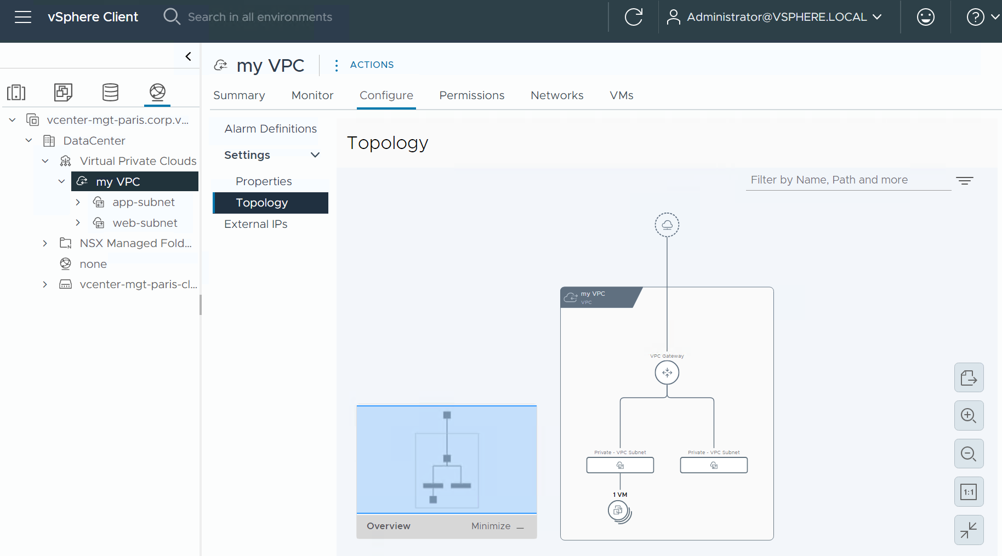
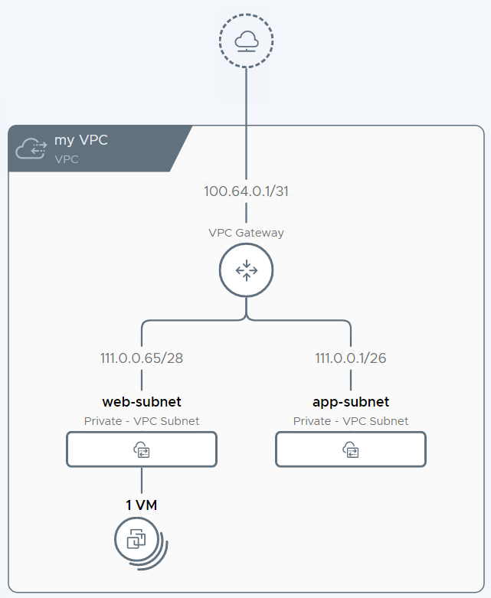
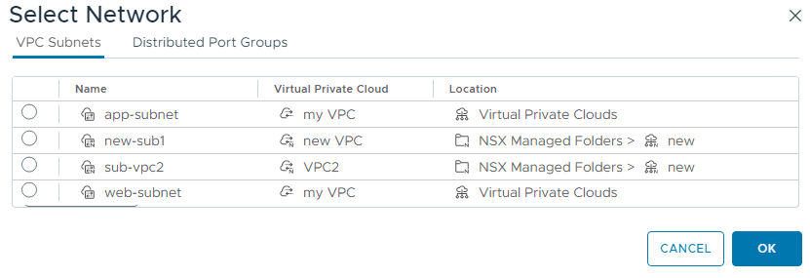
Consume VPCs in vCenter and VCF Automation
Consistent implementation of Virtual Private Clouds (VPCs) across the platform
VPCs can be configured directly from vCenter and VCF Automation
VPCs and subnets are first-class objects
Attaching a VM to a subnet is straightforward
Notes:
Presenter Note: This slide contains animation.
Key Message:
With VCF 9.0, VPCs are fully integrated across the platform, exposed as first-class objects in vCenter where the default project is fully configurable by the vCenter Admin, who can easily connect VMs to subnets or DVPGs directly from the UI.
Talk Track:
The VPC concept has long existed within NSX, but with VCF 9.0, it is now fully integrated and consumable across other components of the platform.
VCF automation leverages VPC objects, and VPCs are now exposed as first-class objects directly within vCenter.
By default, NSX creates a default project that is fully configurable by the vCenter Admin, who in this case serves as the Enterprise Admin, Project Admin, and VPC Admin all at once.
Other, non-default projects appear in vCenter as read-only and cannot be modified from there.
<click 1>
vCenter also displays subnets directly in the UI, allowing you to easily connect a VM to a subnet, similar to how you would attach a VM to a DVPG.
In fact, both options are available side by side in the interface.
Notes:
Resources:

Slide 54
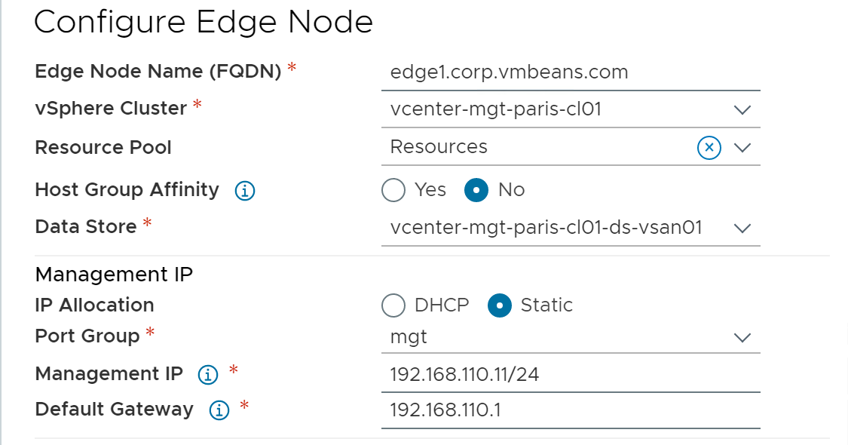
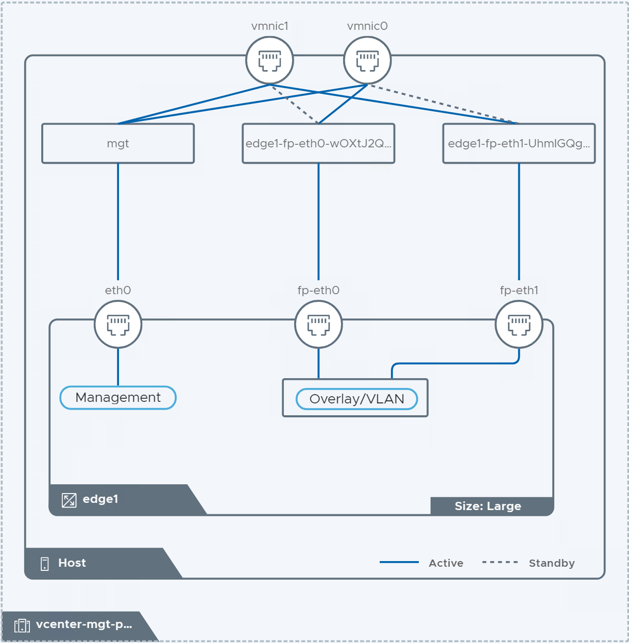
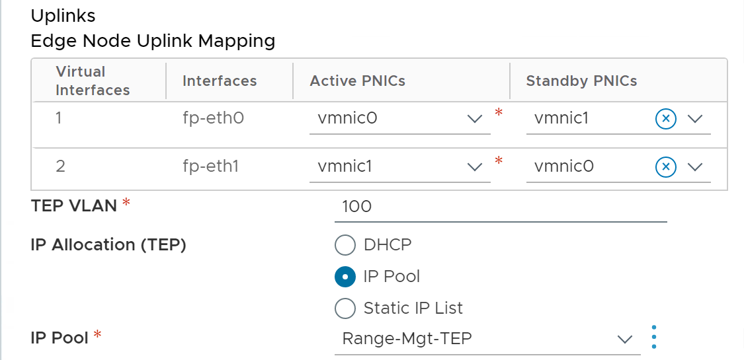
Deploy NSX Edges Easily
Guided edge deployment workflow available in vCenter
Edges are deployed with a simple vCenter UI workflow in VCF 9.0:
the user is guided through entering the required parameters
and a graphical representation is generated in real time
Notes:
Key Message:
The new vCenter-integrated workflow simplifies NSX Edge deployment by guiding users through input, automating vSphere and NSX object mapping, and visually displaying configurations, reducing complexity for non-expert users.
Talk Track:
NSX Edges are essential service appliances within the NSX architecture.
Their deployment requires careful alignment between dvPortGroups and VDS uplinks on ESX hosts and NSX Edge fast-path interfaces—an often complex task for less experienced users.
A new deployment workflow, now integrated into the vCenter UI, simplifies this process by guiding users through the necessary inputs, automatically mapping vSphere and NSX objects, and providing a real-time visual representation of the configuration.
This significantly streamlines the deployment of Edge VMs, a critical component of NSX.
Notes:
Resources:

Slide 55
Independent Connectivity Options for Each Tier
Introducing the transit gateway and VPC gateway
PHYSICAL NETWORK
The enterprise admin creates external connections
They represent connectivity to the physical network
Can be a centralized or distributed (resp. Tier0 or VLAN)
The transit gateway (TGW)
Owned by the project admin
One per project today
Can be centralized or distributed, based on the external connection selected by the project admin for N/S connectivity
The Virtual Private Cloud gateway (VPC GW)
Local to a VPC
The transit gateway interconnects the VPC gateways within a project
Tier0
Gateway
VLAN
External Connection
Project
Transit
Gateway
VPC
VPC
VPC Gateway
subnet
subnet
Notes:
Presenter Note: This slide contains animation.
Key Message:
The multi-tier gateway model enables Enterprise, Project, and VPC Admins to make independent connectivity decisions, with Project Admins using transit gateways to connect projects to external networks, and VPC Admins leveraging VPC gateways to connect subnets within each VPC.
Talk Track:
We’ve seen that the VPC model defines three distinct roles, each with clear responsibilities.
Now, let’s look at how these roles work together to establish connectivity, and the key objects involved in making that happen.
The Enterprise Admin manages interactions with the physical network and provides connectivity options to Project Admins by defining "external connections."
These external connections are profiles that describe how access to the physical network is delivered.
<click 1>
An external connection can represent either a connection centralized through a Tier-0 gateway on an edge node or distributed direct access via a VLAN.
<click 2>
The Project Admin, who has no direct access to the physical infrastructure, manages a new type of gateway called the transit gateway.
By attaching the transit gateway to an external connection exposed by the Enterprise Admin, the Project Admin defines how the project connects to the external network.
The choice of external connection also determines whether the transit gateway will function in a distributed or centralized mode.
<click 3>
Finally, within each VPC, a VPC gateway is deployed.
The VPC gateway connects internal subnets and provides external connectivity by routing through the transit gateway.
Notes:
Resources:

Slide 56
External Connectivity with Centralized Services
Centralized Transit Gateway
PHYSICAL NETWORK
When attached to a centralized external connection, the transit gateway has a component running on an NSX edge.
NSX edges required for:
NAT
DHCP
QoS profiles
Gateway firewall (with license)
Supervisor cluster and VCF automation modern experience
Tier0
Gateway
Centralized External Connection
Transit
Gateway
VPC Gateway
NSX Edge
NSX Edge
ESX
ESX
ESX
ESX
Vmware Cloud Foundation
Notes:
Presenter Note: This slide contains animation.
Key Message:
When attaching to a centralized external connection, the transit gateway is implemented as a Tier0 VRF.
Based on the Tier0, it can offer stateful services.
This is the most traditional connectivity model offered by NSX. It requires NSX edges.
Talk Track:
When attached to a centralized external connection, the transit gateway is associated with a Tier-0 gateway on an Edge node—effectively acting as a VRF of the Tier-0 for those familiar with NSX.
This tight integration means that all north-south traffic through the transit gateway also flows through the Tier-0 gateway and inherits its redundancy model, whether active/active or active/standby.
This has direct implications on the services the transit gateway can deliver: stateful services are not supported when operating in active/active mode.
<click 1>
Similarly, VPC gateways also require a centralized component on an Edge node to run stateful services.
However, VPC gateways can be assigned Edge resources independently of those used by the transit gateway in a centralized external connection setup.
Services such as SNAT/DNAT, DHCP, QoS, Gateway Firewall, Supervisor Cluster integration, and VCF automation with the modern UI all rely on Edge nodes.
Notes:
Resources:

Slide 57
External Connectivity without NSX Edges
Distributed Transit Gateway
PHYSICAL NETWORK
VLAN
The transit gateway can attach to a distributed external connection.
In that case, it has no centralized component:
NSX edges are not required
All ESX hosts must be connected to a VLAN providing an IP block for external addresses used by VMs
Distributed services:
1:1 NAT and
distributed DHCP
Distributed External Connection
Transit
Gateway
Transit
Gateway
Transit
Gateway
Transit
Gateway
ESX
ESX
ESX
ESX
Vmware Cloud Foundation
Notes:
Key Message:
VCF 9.0 simplifies VPC deployment by removing the need for NSX Edge appliances, allowing ESX hosts to route external traffic directly via a distributed external connection.
This reduces complexity but limits services to reflexive NAT and distributed DHCP, while requiring a shared Layer 2 VLAN across all hosts.
Talk Track:
VCF 9.0 introduces the capability to deploy VPCs without requiring NSX Edge appliances, significantly simplifying one of the most complex tasks in NSX.
By attaching a transit gateway to a distributed external connection, each ESX host can independently route VM traffic to external destinations.
However, this model comes with trade-offs:
only basic services like reflexive (1:1) NAT and distributed DHCP are available,
and the physical network must provide a shared Layer 2 domain across all ESX hosts. Unlike traditional NSX overlay networking, this approach requires external VLANs to be extended to each host.
Notes:
Resources:

Slide 58



High Performance Switching out of the box
Enhanced Data Path (EDP) Standard as a default
Enhanced Data Path (EDP) standard is enabled by default for new VCF 9.0 deployments
Does not require tuning
50-70% increased performance (for both bandwidth and packets per second)
EDP driver with improved pNIC queue distribution (pooling and allocations)
EDP dedicated mode can also be configured, as well as the original “standard” VDS mode.
vmknic
VM vmxnet3
VM e1000
Optimized Packet Processing
Fast Path
Slow Path IOChain
Optimized Packet Data Structure
EDP Standard vSwitch
EDP Driver
ESX Host with EDP
Vmware Cloud Foundation
Notes:
Presenter Note: This slide contains animation.
Key Message:
The enhanced data path VDS is an improvement over the “legacy” VDS in every respect.
It’s been available for several years and VCF 9.0 makes it now the default for new VDS deployments.
VDS that are imported into VCF 9.0 (via import, convert, upgrade for example) are left unchanged.
Talk Track:
Enhanced Data Path (EDP) is a high-performance virtual switch with two modes of operation: standard and dedicated.
By default, new VCF 9.0 deployments run EDP standard mode on the VDS, while upgrading to VCF 9.0 will not change the VDS mode.
Like the legacy VDS, the EDP VDS is interrupt-driven and uses CPU cores on demand.
<click 1>
However, with its DPDK-based operations and packet data structure, it offers higher performance across all workloads without tuning.
<click 2>
EDP delivers a 50-70% increase in performance, improving both bandwidth for large-flow workloads and packets per second for workloads exchanging a high rate of small packets.
<click 3>
EDP drivers optimize pNIC performance.
Even for older pNICs with limited features will see an improvement compared to legacy standard VDS.
<click 4>
The dedicated mode assigns specific CPU cores for packet processing, offering even better performance for specialized workloads.
It requires tuning based on careful consideration of traffic type and average packet size and is typically used in Telco environments.
The legacy standard, non-EDP, VDS mode remains available.
Notes: - In VCF 9 EDP is the default choice when configuring a Virtual Distributed switch.
Resources: For further detail on configuring EDP please refer to :
https://techdocs.broadcom.com/us/en/vmware-cis/nsx/vmware-nsx/4-2/installation-guide/transport-zones-and-transport-nodes/enhanced-datapath-1.html

Slide 59
Modernize Infrastructure Private Cloud Operations
Fleet Management
Notes:
Key Message:
Talk Track:
Let's take a look at fleet management in VCF Operations.
Unified Operations Experience
Centralized Fleet Lifecycle Management
Non-disruptive Upgrades
Single Sign-on for Administrator Access
Centralized Certificate Management
Centralized Password Management
Configuration Drift Management and Assessment
Unified Tag Management
VCF Download Tool for Disconnected Sites
Notes:
Resources:

Slide 60











Unified Operations Experience
VCF Operations and VCF Fleet Management
VCF Fleet
VCF Operations
VCF Automation
VCF Fleet Management
VCF Health & Diagnostics
(formerly Aria Skyline)
VCF Operations
Identity & Access
Integrated Log Operations
VMware Cloud Foundation Instance
Certificate Management
Integrated Network Operations
vCenter Server
NSX Manager
Password Management
Integrated Storage Operations
Tag Management
Core Infrastructure
Integrated Troubleshooting & Observability
Configuration Drift
Security Operations
Lifecycle Management
.
Additional VCF Instances
Notes:
Presenter Note: This slide contains animation
Key Message: From VCF 9 private cloud operations and management is performed using the VCF Operations Console.
VCF Operations provides Administrators with a unified and feature rich operations experience for fleet management which spans identity and access management, certificate management, password management, tag management, configuration drift and lifecycle management.
Talk Track:
VMware Cloud Foundation provides IT Teams with everything they need to build, deploy and operate a vSphere-based on-premises private cloud infrastructure. <click 1> VCF Operations provides admins with a unified and feature rich operations experience which expands upon the familiar capacity management and performance monitoring capabilities included in prior versions of Aria Operations. VCF Health and diagnostics has also been adapted from Skyline and is has now also been integrated.
<click 2>
From VCF 9, private cloud operations and management traditionally serviced from SDDC Manager is now also performed using the VCF Operations Console as part of Fleet Management.
Noting that Host and cluster infrastructure-level configuration is now managed from the vSphere client.
VCF Operations Fleet management provides Admins with a unified and feature rich operations experience. This single console spans workload domain deployment, the ability to perform an import of an existing vCenter environment into VCF, identity and access management, certificate management, password management, tag management, configuration management & drift assessment, licensing and lifecycle management of the full VCF stack.
<click 3>
Keeping in mind what we discussed earlier - that a VCF Fleet can consist of multiple VCF deployments which can leverage common VCF Operations and VCF Automations instances.
<click 4> Let’s take a closer look at the components of VCF Fleet Management
Notes:
From VCF 9 VCF Operations is used to manage one or more VCF instances.
A VCF Fleet may consist of multiple VCF deployments which can leverage common VCF Operations and VCF Automations instances.
SDDC Manager 9 is installed or upgraded as a component of any VCF 9 instance. SDDC Manager will be deprecated in a future release.
Resources:

Slide 61
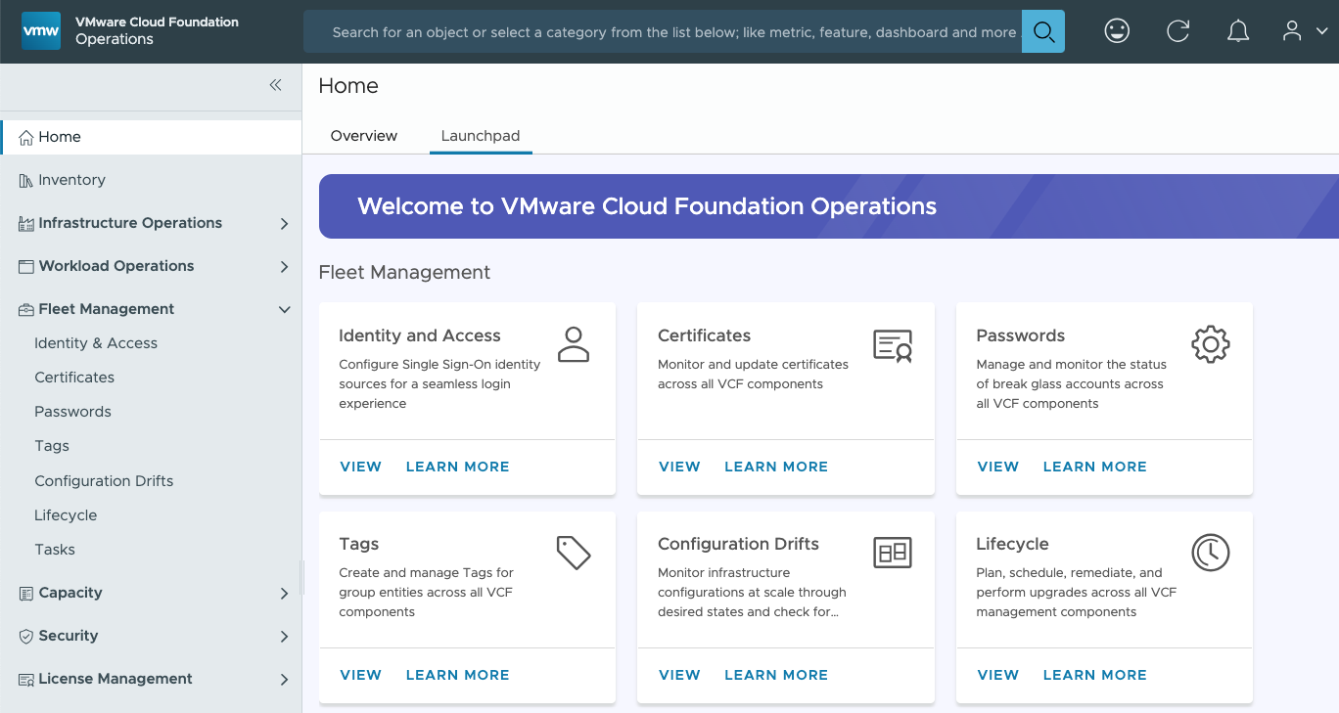
Fleet Management – Consolidating Related Activities
Quickly access common fleet management tasks in VCF Operations
Fleet Management is a new section in VCF Operations
It consolidates access to essential administrative tasks for the infrastructure and management components
Now, related activities such as setting up VCF SSO and managing certificates and passwords are all in one central place
Notes:
Key Message:
VCF 9 adds an entire new section to the VCF Operations interface to consolidate fleet management activities
Talk Track:
Now that VCF Operations is the primary administrative console that administrators use to manage the underlying VCF infrastructure and management components, a new section called “Fleet Management” conveniently groups related activities for quick access.
In this section, administrators will find important configuration interfaces for essential tasks such as:
Setting up VCF Single Sign-On for seamless access to other admin UIs, such as NSX Manager and VCF Automation
Viewing and updating security certificates for the various appliances and ESX hosts in the environment
Patching and upgrading VCF components, including managing the source for software binary downloads
Managing administrative passwords, vCenter configuration drift, and tags
Notes:
This is just an intro slide to the concept of the new Fleet Management section
Resources:
Refer to the VMware Cloud Foundation Operations Guide for further information https://techdocs.broadcom.com/us/en/vmware-cis/vcf.html

Slide 62
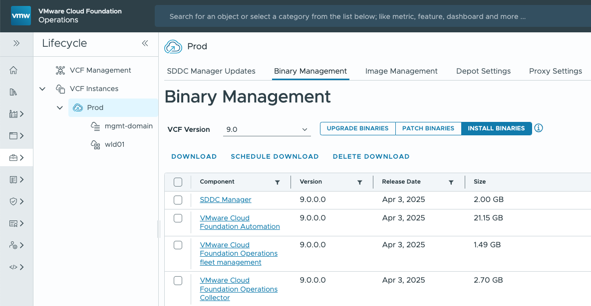
Consistent Binary Download Workflows
Configure depot and download necessary binaries for all VCF components
Download all upgrade, patch, and install binaries for VCF infrastructure and VCF management components
Configure online or offline depots, with proxy support if required
Proxy also accommodates authentication where required
Notes:
Key Message:
VCF 9 brings consistency to the software binary management process – supporting an online or offline depot for all components: infrastructure and management
Talk Track:
In the Fleet Management → Lifecycle section of VCF Operations there are now consistent binary management capabilities for both VCF infrastructure and VCF management components. This is a very welcome enhancement that simplifies the process of downloading software binaries for patching and upgrading as well as for new deployments of components and workload domains.
Downloading from the online depot is the fastest and easiest path, but many customers have security policies or architectural requirements that must be accommodated by an offline depot. The VCF Download Tool can be used to create an offline depot for all components and is also desirable for sites that have multiple VCF instances.
For customer environments that require proxy server support, this is available – with and without password authentication.
Notes:
Be aware of the subtle shift in terminology from “bundles” in VCF 5.x and earlier to component binaries
Resources:
Refer to the VMware Cloud Foundation Deployment Guide for further information https://techdocs.broadcom.com/us/en/vmware-cis/vcf.html

Slide 63
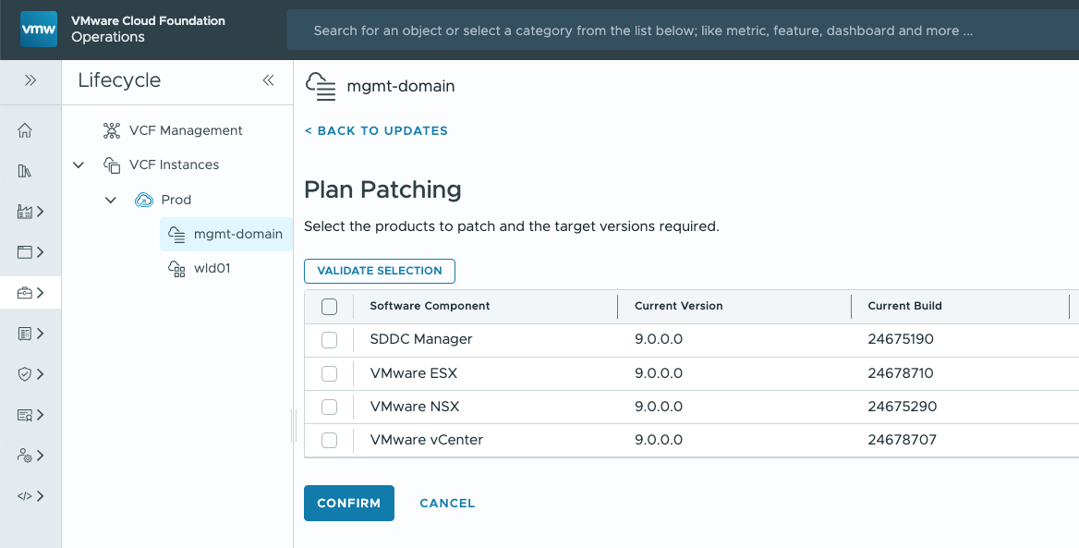
Centralized Fleet Lifecycle Management
One interface to patch, upgrade, and deploy VCF components
VCF Operations UI drives lifecycle management via appliances:
VCF Instances → SDDC Manager
VCF Management → Fleet Management
Familiar prechecks & upgrade/patch planning workflows
Flexible connectivity scenarios
Online and offline depots
Proxy server with authentication
Notes:
Key Message: VMware Cloud Foundation 9: Simplified Management & Lifecycle Control
Talk Track:
With VCF 9, we introduce a streamlined approach to managing your private cloud infrastructure. Let's take a closer look at the key components:
VCF Instances: These remain familiar to VCF 5.x users, with a user-friendly interface within the VCF Operations (Ops) console. Here, you'll focus on the foundational infrastructure components like NSX, vCenter, and ESX. VCF Instances lifecycle management also features the well-known pre-check functionality, ensuring your environment is ready for upgrades or updates.
VCF Management: This new section acts as a central hub for lifecycle management, with the new Fleet Management appliance replacing the Aria Suite LCM. Here, you can deploy new components like VCF Automation, Identity Broker, Operations for Logs, and more. This empowers you to build and manage your VCF environment in a centralized and efficient way.
Flexibility and Control: VCF 9 delivers enhanced control over your deployment and updates. You can leverage online and offline depot support, along with binary downloads and proxy + authentication capabilities. Additionally, you can utilize asynchronous patches to seamlessly apply updates to a released bill of materials (BOM). Thanks to live patching, certain updates can be applied without requiring maintenance mode for minimal impact to your environment. This allows for a flexible and granular approach to managing your VCF infrastructure.
Notes: Aria Suite Lifecycle (formerly vRSLCM) must remain online to manage components such as VIDM that are not directly upgradable to VCF 9.
Resources: Refer to the VMware Cloud Foundation Operations Guide for further information https://techdocs.broadcom.com/us/en/vmware-cis/vcf.html

Slide 64


Patch vSphere Clusters Faster and Less Disruptively
Live Patch even more of ESX
Live Patch vmkernel, user-space and NSX components
ESX service restarts required (non-disruptive)
Fast-Suspend-Resume remediates VMs
No Evacuation, VMs stay running
ESX
vmkernel
user-space
nsx
vmx
Notes:
Presenter Note: [This slide contains animation]
Key Message:
Live Patch is extended to more of the ESX image, including vmkernel and NSX components. Increasing the frequency that patches can leverage live patch.
Talk Track:
Live Patch for ESX was introduced with vSphere 8.0 Update 3 and is has now been extended to more of the ESX image, including vmkernel and NSX components. Increasing the frequency that patches can leverage live patch.
NSX components, now part of the base ESX image, can be patched using the live patch process without hosts entering maintenance mode and needing VMs to evacuate the hosts.
Vmkernel, user-space and vmx (virtual machine execution) components can also leverage live patch. ESX services (for example hostd) might require a restart during a live patch which can cause ESX hosts to briefly disconnect from vCenter. This is expected behaviour and does not impact the running virtual machines. vSphere Lifecycle Manager reports what services or daemons will be restarted as part of the live patch remediation.
If the vmx (virtual machine execution) environment is being live patches, running VMs will perform a Fast-Suspend-Resume (FSR). Live patch is compatible with vSAN clusters. vSAN witness nodes are not compatible with live patch and will undergo full reboots when patching.
Update releases (for example ESX 9 Update 1) are expected to require a full reboot as the entire ESX system is being updated.
Hosts using TPM and/or DPU devices are not compatible with live patching.
Notes:
1. Host enters partial maintenance mode
2. New mount revision loaded
3. New mount revision patched
4. VMs fast-suspend-resume to consume patched mount revision
Some virtual machines are not compatible with FSR. VMs configured with vSphere Fault Tolerance, VMs using Direct Path I/O and vSphere Pods cannot use FSR and need to be manually remediated. Manual remediation can either be done by migrating the virtual machine or by power cycling the virtual machine.
Virtual machines that do not support FSR include VMs configured for vSphere Fault Tolerance, VMs configured with VM DirectPath I/O devices, vSphere Pods (container pods).
These VMs must be manually migrated using vSphere vMotion or power cycled to pick up a new patched vmx instance.
Resources:

Slide 65
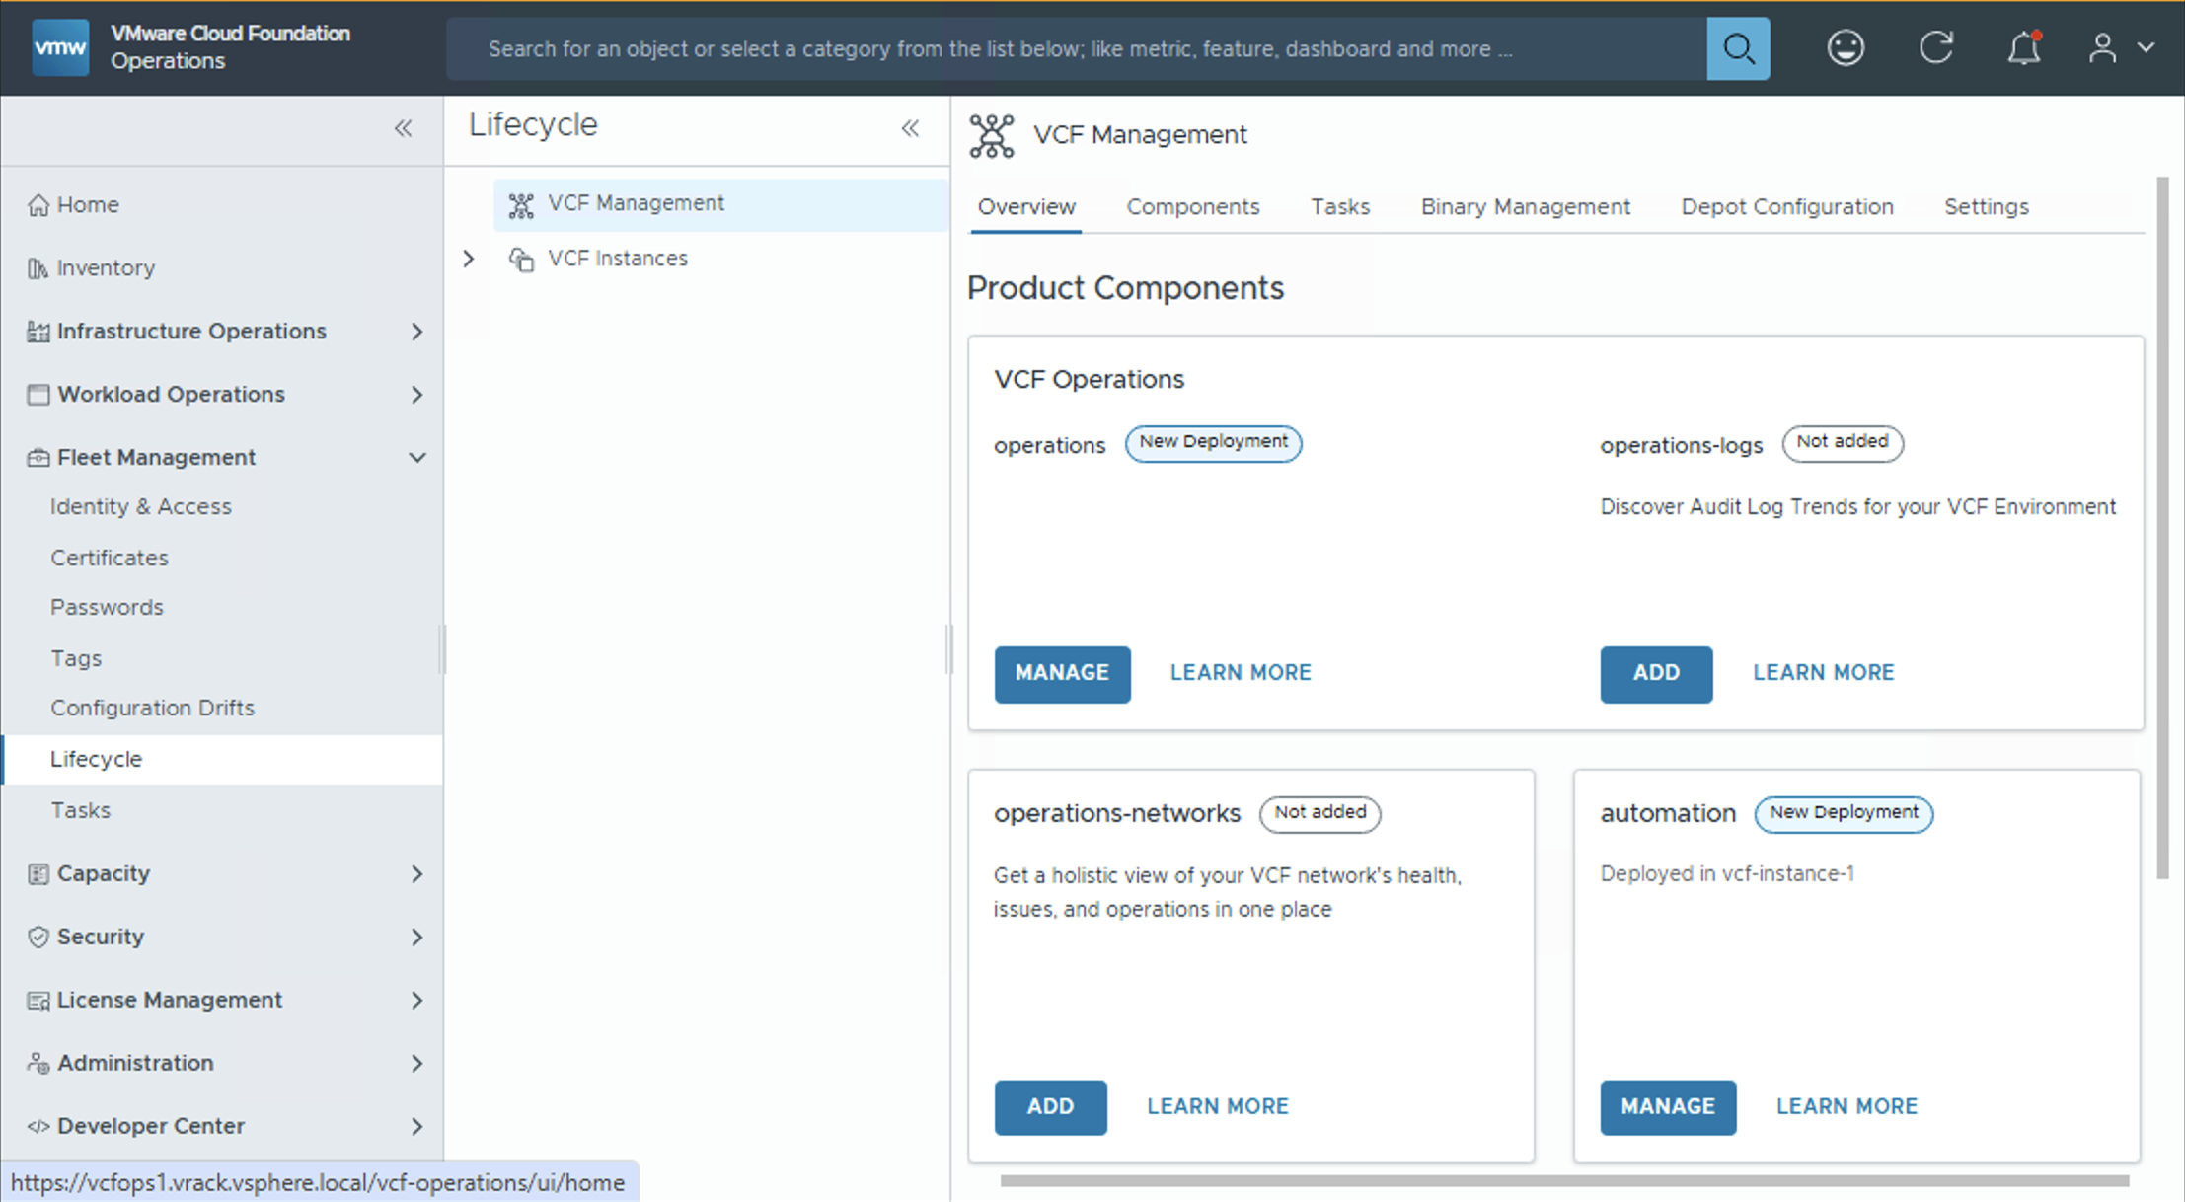
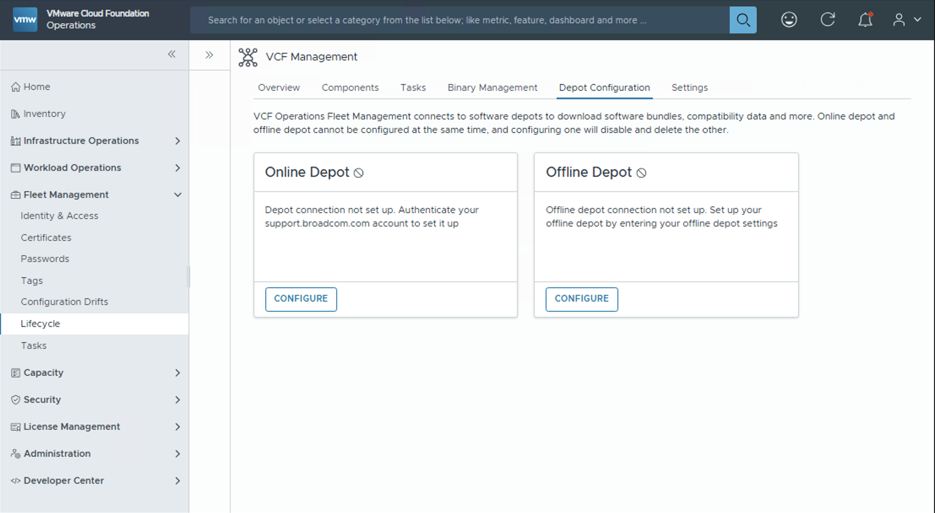
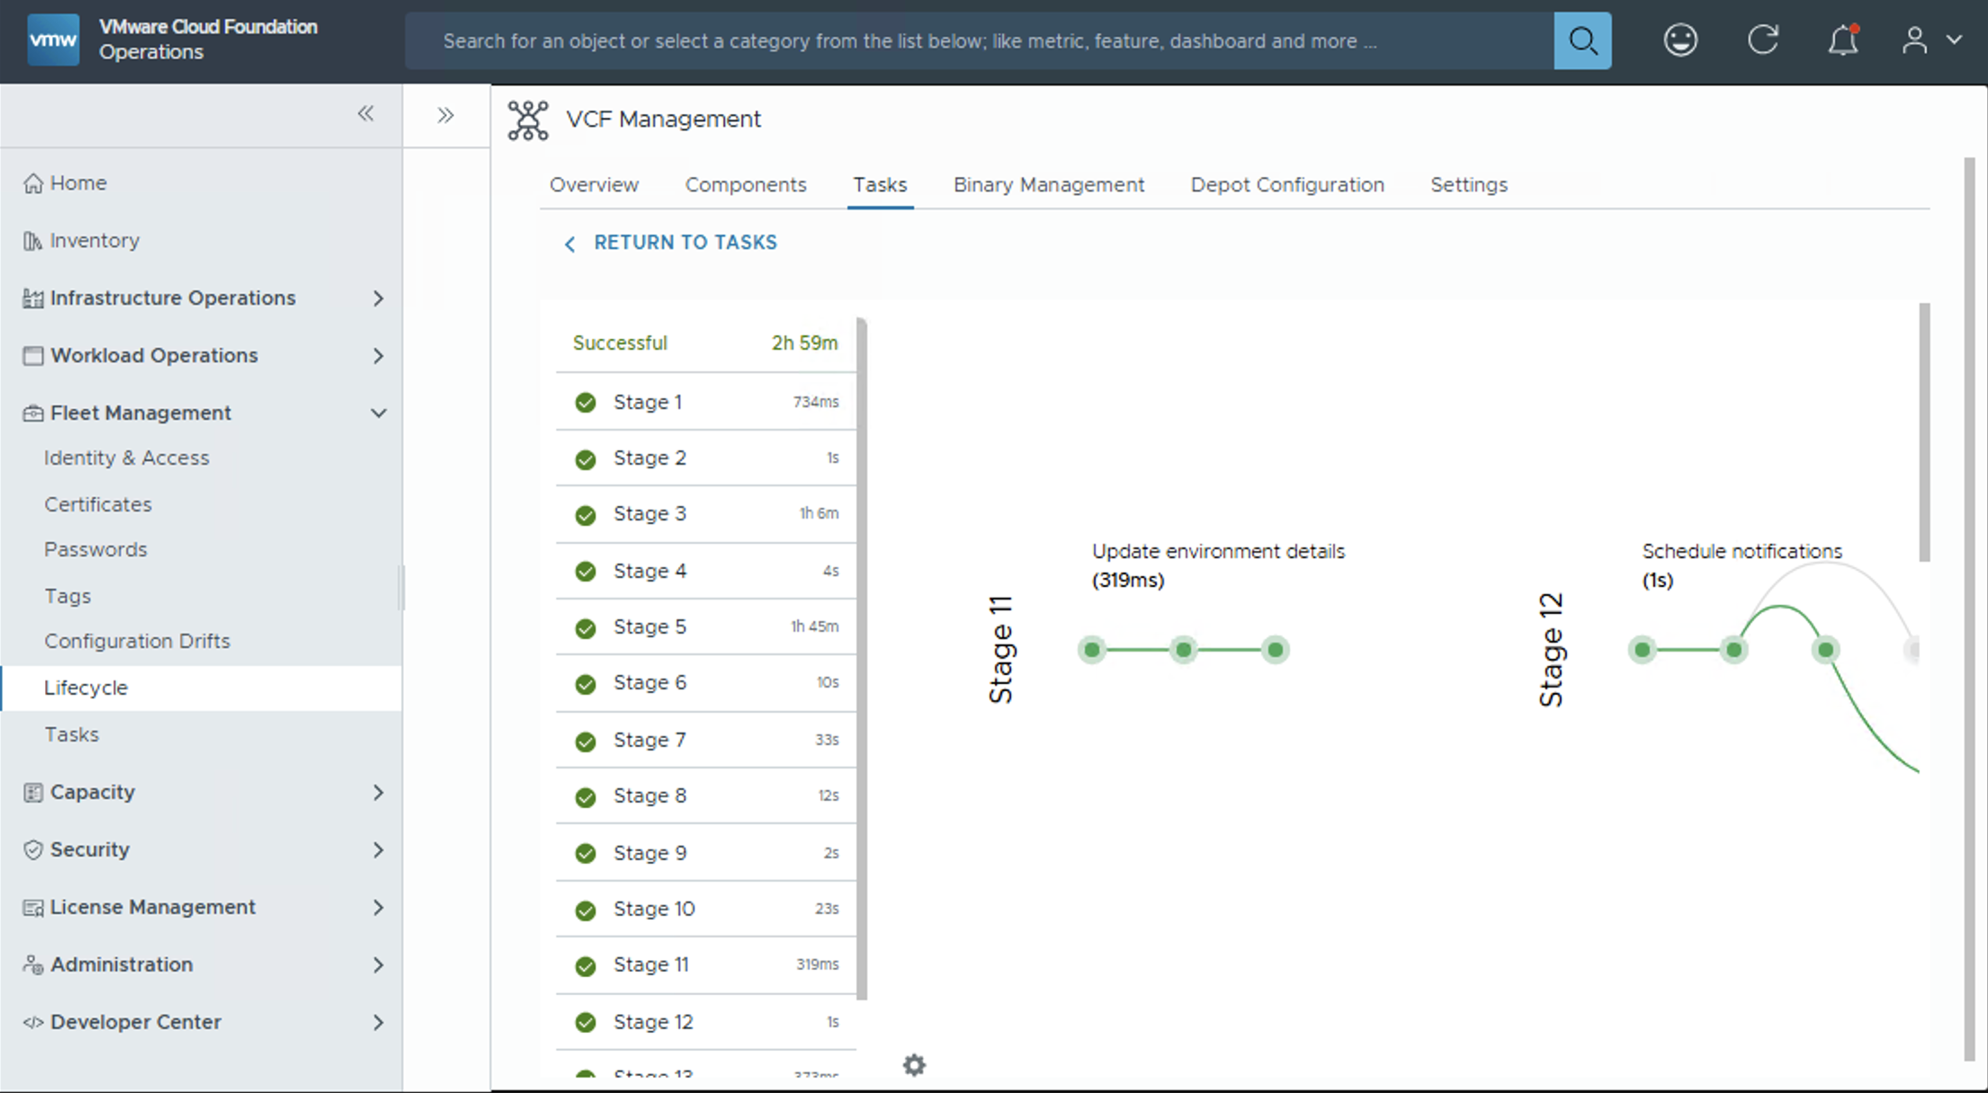
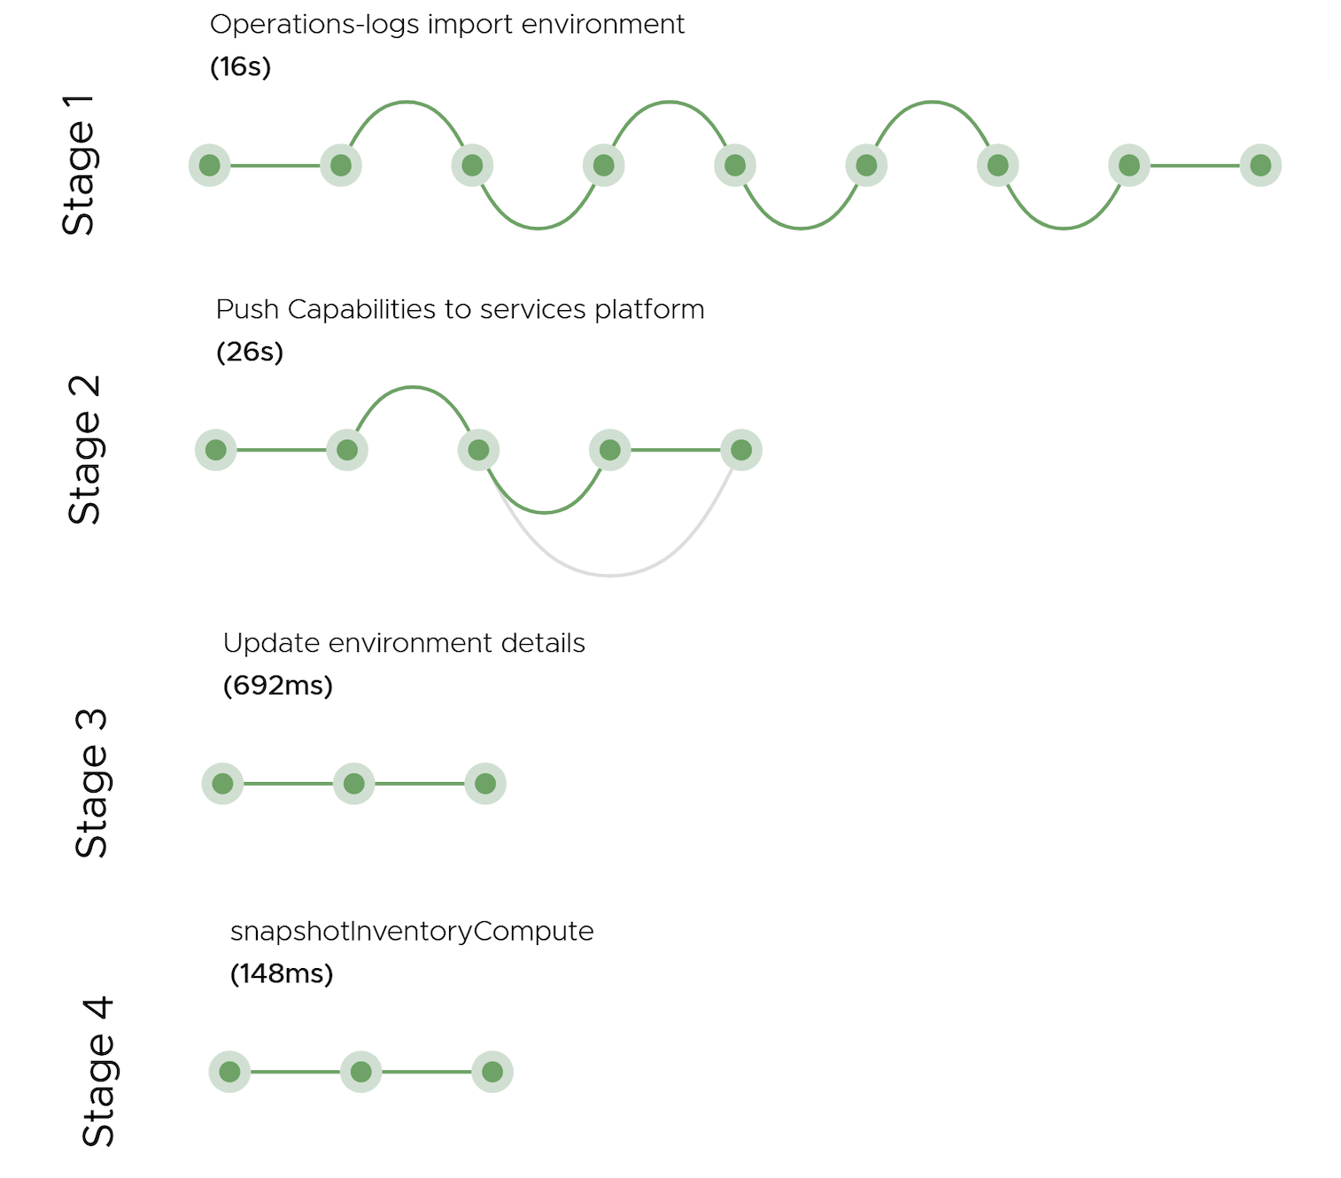
Simplified Lifecyle for VCF Management Components
VCF Operations Fleet Management
Enable and manage components from the Overview pane
Available for VCF Automation, VCF Identity Broker and VCF Operations Fleet Management
“Plan Upgrades” efficiently
Integrations and lifecycle of management components converged into VCF Operations
VCF Depot integration for binaries
Online, Air-Gapped and Dark-Sites
Backup & Restore
Notes:
Presenter Note: This slide contains animation
Key Message:
Suite Lifecycle convergence into VCF Operations console through the VCF Ops Fleet management appliance.
Talk Track: The VCF Operations fleet management serves as a lifecycle manager for management components, facilitating Day-2 operations such as upgrades, certificate and password management, patching, scaling (up and out), snapshot management, marketplace integration and Git integration management.
Fleet Management provides lifecycle capabilities for:
Operations
Operations for Networks
Operations for Logs
Automation
Identity Broker
The Overview page provides a single pane view of all the features which are enabled.
<click 1>
There are two types of depot configurations:
Online Depot:
If fleet management is connected to the internet, then:
Generate Unique ID from Broadcom Support Portal
Save the configuration after accepting certificate
The connection between FL and the depot is established
Binaries of Install, patch and Upgrade will now be available for downloads
Offline Depot:
Download bundles using OBTU and expose it to fleet management via a web server. This is an air-gapped scenario.
Download bundles on OBTU & transfer them over to fleet management to map them locally. This is a dark site scenario.
Once the Depot is configured, fleet management will download the manifest as needed and then display all available and applicable binaries for installs, upgrades or patches.
<click 2>
The Tasks tab displays all tasks executed by fleet management. Each task can have multiple statuses and you can track the progress and manage every deployments from this page.
It also provides Backup and Restore mechanism for Automation, Identity Broker and Fleet Management itself.
Notes:
Resources: Refer to the VMware Cloud Foundation Operations Guide for further information https://techdocs.broadcom.com/us/en/vmware-cis/vcf.html

Slide 66
Nondisruptive Upgrades to VCF 9
Move up to the latest version without migration or conversion
VCF 5.x & Aria Suite
VCF 9
Key Benefits
Aria Ops 8
VCF Ops 9
In-place upgrade from 5.x to 9
No need to procure additional hardware to migrate
Take advantage of latest capabilities, including vLCM images
VCF Management
Aria Suite Lifecycle
Fleet Management
5.x
9.0
Technical Value
SDDC Manager
Upgrade to VCF Operations 9 & deploy Fleet Management
SDDC Manager 5.x → 9.0
VCF Ops upgrades remaining infrastructure components
VCF Infrastructure Components
vSphere 8.x. NSX 4.x
vSphere 9 NSX 9
Notes:
Key Message: VCF Upgrade Journey From 5.x to 9
Talk Track:
VCF 5.x can be upgraded to VCF 9 without a "forklift upgrade". No complex migration or conversion steps are required, so you can move directly to VCF 9 without any additional hardware investments. This allows you to unlock the full potential of VCF 9's new features and capabilities right away. The upgrade process is straightforward and involves a series of well-defined steps:
Step 1: Update Aria Suite Lifecycle: First, update Aria Suite Lifecycle to version 8.18 Patch 2. This version is the key to unlocking the VCF 9 upgrade.
It does two important things:
Enables upgrade of Aria Operations 8.18.x to VCF Operations 9: This smoothly transitions your management layer to the latest version, setting the stage for a more streamlined experience.
Deploys the Fleet Management Appliance: This is a new management appliance for the VCF 9 environment. This appliance manages and orchestrates all your VCF management components.
Step 2: SDDC Manager Upgrade: Once VCF Operations is up to speed, upgrade SDDC Manager from version 5 to 9. This upgrade is completed through the familiar SDDC Manager interface, making it a simple and straightforward process.
Step 3: The VCF Infrastructure Component Update: This final stage involves a slight shift in management approach. In VCF 9, we move from SDDC Manager to the new VCF Ops interface for managing your VCF infrastructure components (vCenter, ESX, and NSX). This modern interface offers a more efficient and streamlined management experience.
This is a smooth, well-defined path to bring VCF up to date with the latest advancements. By taking advantage of this upgrade journey, you can unlock the full potential of VCF 9 and elevate your cloud infrastructure to new heights.
Notes:
Keep in mind that migration at this scale has numerous moving parts, this is a simplified overview to introduce the required workflow. Certain other elements will be expanded upon in other technical collateral.
Aria Suite Lifecycle (or vRSLCM) remains as-is until it is no longer needed. For example, it may be required for managing a VIDM deployment, which is not upgradable to VCF 9.
The new VCF 9 licensing model is all new and must be applied after the upgrade is finished. The deployment will be in evaluation mode after the upgrade.
Resources: Refer to the VMware Cloud Foundation Operations Guide for further information https://techdocs.broadcom.com/us/en/vmware-cis/vcf.html

Slide 67
Single Sign-On for Administrator Access Across VCF
New modern identity broker simplifies configuration
All new design with two modes:
Embedded
External appliance cluster (supports multiple VCF instances)
Automatic configuration
vCenter, NSX, Ops, Automation
Supports modern and directory-based identity providers
SAML 2, OIDC, or AD/LDAP
Privileges are set for each VCF component according to user/group
No connector needed, since VIDB is inside the firewall
Management Domain
VCF Automation
VCF Operations
Workload Domain
NSX Manager
vCenter Server
NSX Manager
vCenter Server
VIDB
VCF Ops for Networks
VCF HCX
VCF Ops for Logs
OpenID Connect Clients
Notes:
Key Message: VCF 9: Enhanced Identity and Access Management
Talk Track:
VCF 9 introduces a significant upgrade to identity and access management, bringing enhanced security and streamlined administration to your private cloud environment.
This new VIDB single sign-on service replaces the previous vIDM solution and is built upon modern identity provider technology. VIDB can be deployed in two distinct modes:
Embedded: Running directly on the management domain vCenter Server, offering out-of-the-box simplicity.
External Appliance Cluster: Provides scalability and flexibility for larger deployments, where a single VIDB instance can support multiple VCF environments.
VIDB leverages the intuitive VCF Operations interface for easy setup. For the external appliance mode, deployment is managed through the VCF lifecycle management workflow. Once configured, VIDB seamlessly integrates with key VCF components:
vCenter Server
NSX Manager
VCF Operations
VCF Automation
This enables centralized identity management and automatic single sign-on across your critical cloud infrastructure.
VIDB supports a wide range of industry-standard modern identity providers, offering flexibility and compatibility with your existing security solutions:
SAML 2.0 and OIDC: For modern cloud-based identity providers like Okta, Ping Identity, Microsoft Entra ID, or any SAML 2.0 provider.
AD/LDAP: For traditional directory-based authentication.
This empowers administrators with granular control over user privileges, enabling role-based access for different VCF components based on user or group membership.
VIDB’s simplified architecture no longer requires individual component to be configured separately with an identity provider, streamlining administration and reducing potential vulnerabilities. Plus, it is deployed inside the firewall, enabling direct communication with identity providers and eliminating the need for external connectors.
Notes: vIDM is not directly upgradeable to VIDB.
Resources: Refer to the VMware Cloud Foundation Design Guide for further information https://techdocs.broadcom.com/us/en/vmware-cis/vcf.html

Slide 68
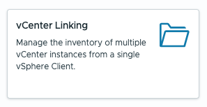
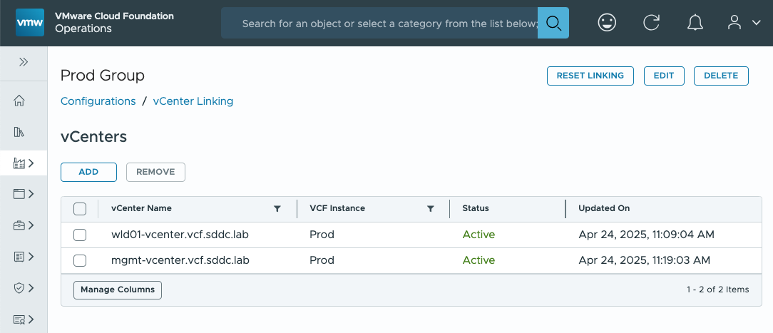
Connect to Multiple vCenter Servers in a Single vSphere Client
New vCenter Linking is the successor to Enhanced Linked Mode (ELM)
Infrastructure Operations → Configurations
Create a single pane of glass for vSphere management: Combine VCF Single Sign-On with vCenter Linking
Replaces Enhanced Link Mode, which is no longer supported in VCF 9
Reduces friction for vSphere administrators as they access and manage multiple workload domains
Notes:
Key Message: VCF 9 features a single pane of glass view for multiple vCenter Server instances
Talk Track:
Once VCF Single Sign-On is configured, take the benefit one step further and view multiple vCenter Servers from different workload domains in a single instance of the vSphere Client.
Enhanced Linked Mode must be broken and disabled before enabling VCF SSO, so vCenter Linking is the successor to that previous architecture.
Notes:
Resources:

Slide 69
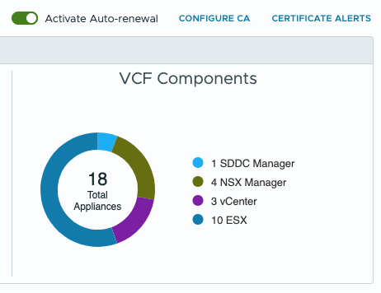
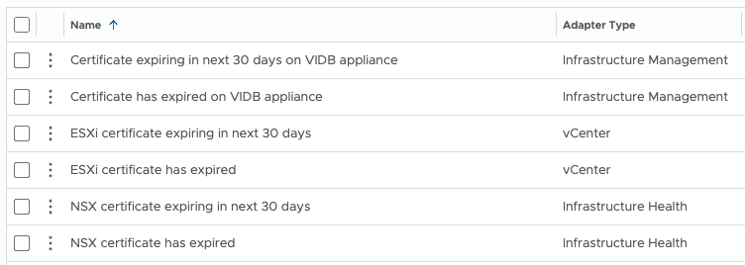
Centralized Certificate Management
Non-disruptive certificate updates for VCF infrastructure and management components
One interface to manage certificates for VCF Infrastructure & Management components
Supports Microsoft, OpenSSL, or external certificate authorities
Automatic renewal
VCF Operations alerts configured out of the box
Manage VMware ESX host certs
New non-disruptive (NDC) architecture delivers fast and reliable certificate updates
Notes:
Key Message:
VMware Cloud Foundation 9 Delivers A Powerful New Approach to Certificate Management
Talk Track:
In VMware Cloud Foundation 9, we're excited to introduce a completely revamped certificate management experience, bringing both the infrastructure and management components under one umbrella. Administrators now have greater flexibility in their certificate management approach, with the ability to leverage existing Microsoft Active Directory Certificate Services CAs, utilize the open-source OpenSSL for certificate generation, or even generate certificate requests for use with external CAs.
One of the key enhancements in VCF 9 is the automatic certificate renewal functionality when using integrated CAs. This streamlines the process, ensuring certificates are automatically renewed and replaced for compatible components, eliminating the need for manual intervention. The new certificate management infrastructure also integrates with VCF Operations alerts, providing timely notifications about expiring certificates and upcoming renewals, enabling proactive management and minimizing potential disruptions.
For organizations with high compliance requirements, VCF 9 also introduces the ability to issue signed certificates to VMware ESX hosts. This ensures that your virtualized environment is compliant with the most stringent security standards, further bolstering your overall security posture.
Overall, VCF 9's certificate management capabilities represent a significant step forward in managing and securing your cloud infrastructure. This new approach delivers enhanced flexibility, increased automation, and improved compliance, ultimately making your cloud environment more secure and efficient.
Notes:
Resources:
Refer to the VMware Cloud Foundation Operations Guide for further information https://techdocs.broadcom.com/us/en/vmware-cis/vcf.html

Slide 70
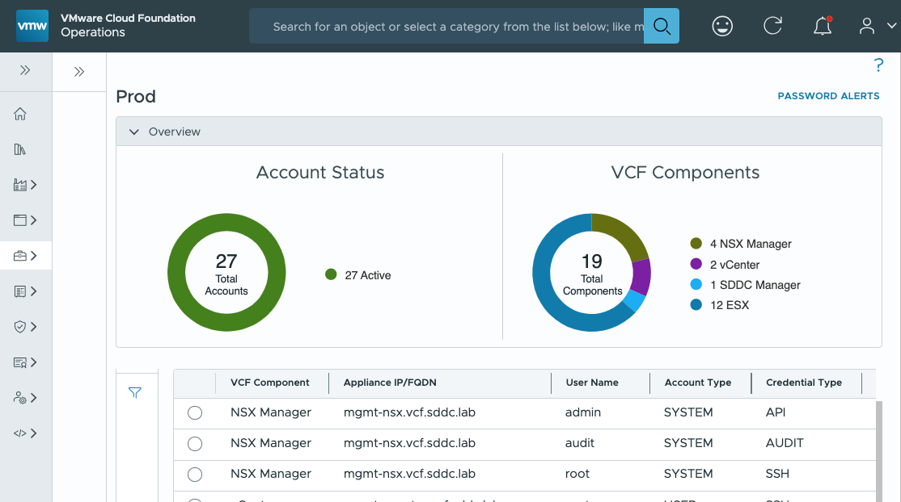
Centralized Password Management
Simplified password management across infrastructure and management components
Manage the key “break glass” admin accounts for VCF components
Passwords can be reset in the case they are forgotten
Remediation is used to sync a password that was changed directly on a component
VCF Operations alerts to warn of upcoming password expiration
No longer a need to rotate service accounts – managed internally
Notes:
Key Message: Streamlined Password Management for Enhanced Security and Efficiency
Talk Track:
VMware Cloud Foundation 9 introduces a centralized and unified password management experience, simplifying and securing your VCF environment.
The new VCF Operations interface brings centralized control: Manage passwords for both infrastructure and management components from a single location.
Eliminate Password Rotations: Service accounts for inter-component communication are automatically provisioned and managed to eliminate the need for manual password management, reducing administrative overhead.
The password management user experienced has been simplified to two operations:
Update Password: Easily reset forgotten passwords through the user interface.
Remediate Password: Synchronize passwords that were changed outside of VCF, ensuring alignment with current configurations.
Integration with VCF Operations also brings another benefit: Administrators will receive timely alerts when passwords are approaching expiration, minimizing security risks and downtime.
Notes:
Resources:
Refer to the VMware Cloud Foundation Operations Guide for further information https://techdocs.broadcom.com/us/en/vmware-cis/vcf.html

Slide 71
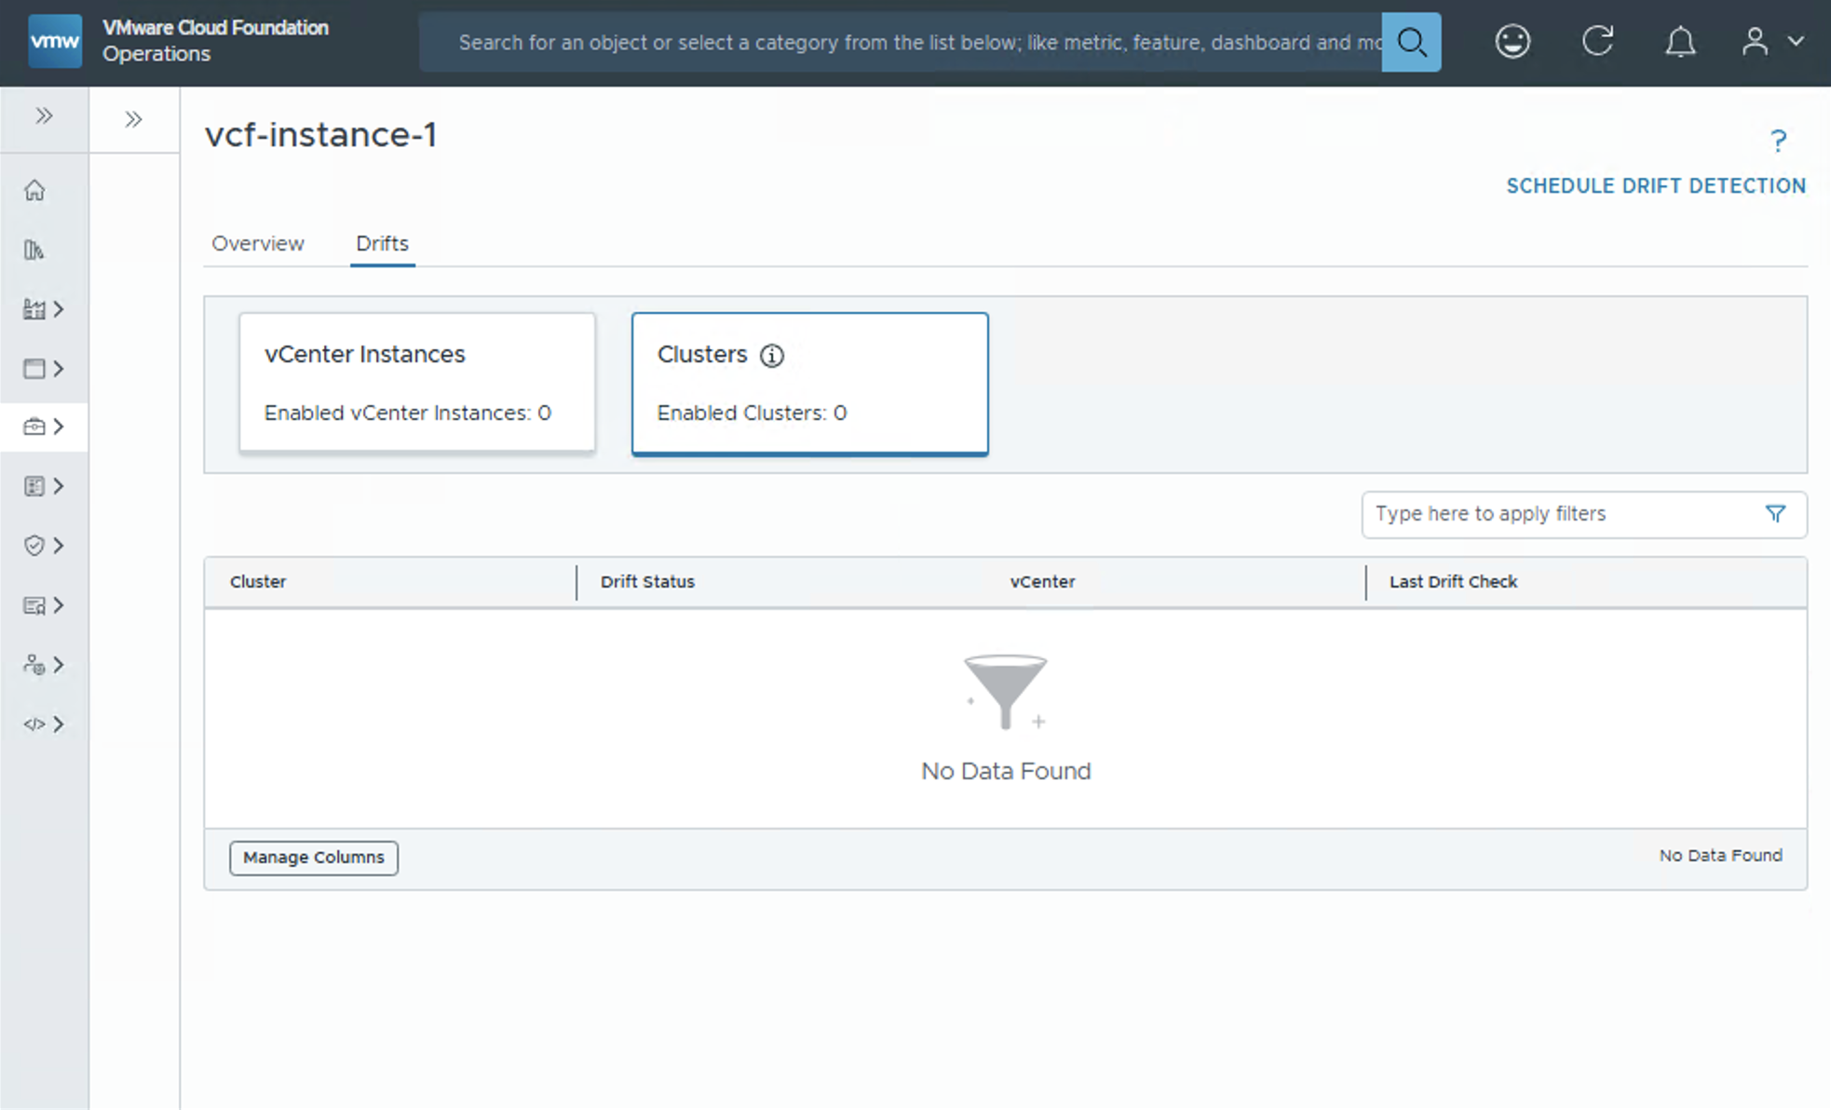
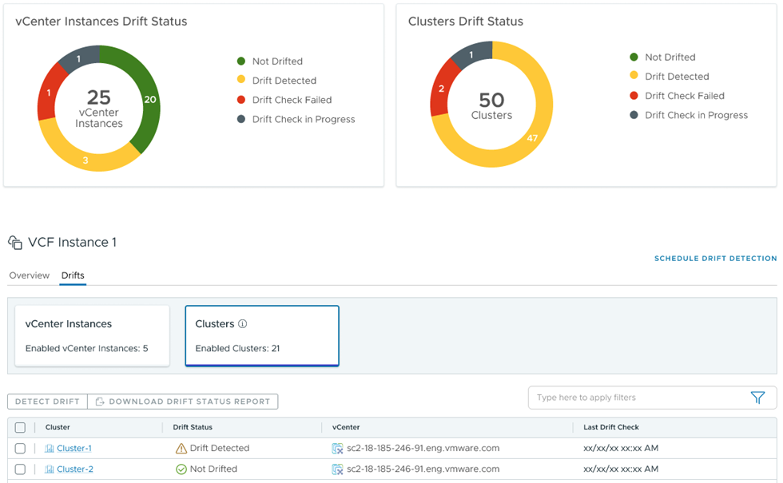
Easily Monitor and Address Configuration Differences
Configuration Drift Management and Assessment
Centrally monitor configuration drift across clusters and vCenters
Deliver smooth operations with consistency and compliance
Reduce risk of security breaches
Ensure environments run smoothly
Automate Drift Detection
Schedule Configuration Drift Reports & automate drift detection
Create and edit Configuration Drift templates
Control template versioning with Git-Integration
Notes:
Key Message:
VCF allows you to monitor configuration drifts in your environment over time in a central location and allows you to compare those changes a standardized template that you define, based on your company standards. It helps to prevent misconfiguration from going unnoticed, reduces the risk of security breaches, and keeps the environment running smoothly.
Talk Track:
When it comes to Configuration Management, Admins face the challenge of enforcing global and regional standards as they struggle to manage configuration drifts across hosts, clusters, VCs, and SDDCs. The process is manual, tedious, prone to error, hard-to-track, and often requires them to use multiple technologies and interfaces.
Unified Configuration Management within VCF alleviates these challenges by preventing misconfiguration from going unnoticed, reducing the risk of security breaches, and keeping their environment running smoothly with the following enhancements and capabilities:
Schedule Drift Detection: Ability to use the VCF Operations console to schedule a Drift Detection job based on the vCenters scoped in a Policy with activated Templates. You can perform an on-demand job, schedule a single job in the future, or a repeatable Drift Detection job. You can see a list of active jobs and historical Drift Detection jobs in the Automation/Orchestration service. The drift status of each vCenter will be stored by the VCF Operations console.
Download the Drift Status Report: Ability to select one or more vCenters with the associated templates and download a PDF report containing the Template drift status of each vCenter within the Configuration Drift Management retention period.
Git Repo Integration: The VCF Operations console retains, displays, and uses one local copy of a Template. In order to perform advanced Template functions like versioning, you can connect the Configuration Template service with a third-party Git-based repository. On successful connection, the VCF Operations console automatically creates a merge request when a Configuration Template is created or modified in the VCF Operations console. The connected Git repository becomes the primary owner of the Templates when the connection is established. Hence, although Templates can be edited and created in the VCF Operations console, you must pull any merged requests from the Git repository.
vSphere Configuration Profile-Enabled Cluster Status: For clusters activated with vSphere Configuration Profiles (VCP), the Configuration Drifts service lists and displays the VCP Drift status of all activated clusters in an aggregated view based on global VCF instances, specific VCF instances, or specific Workload domains.
Edit Configuration Templates: Ability to edit Configuration templates. The Edit template capability allows you to remove and add vCenter Schema Configuration items to an existing Template. Additionally, you can edit values of existing or new vCenter Schema Configuration items. The VCF Operations console validates the edited values before changes are saved.
Notes:
Resources:

Slide 72

Manage, Identify and Organize Resources
Unified Tag Management
Create, edit, delete categories and tags from a single pane of glass
Import brownfield categories and tags from vCenters and evaluate conflicts
Push categories and tags to vCenters
Pushed tags are persisted across vCenters after vMotion
Centralized consistent behavior across services to create and manage tags
Identify and eliminate duplicate tags across vCenters
Notes:
Key Message:
Customers, the ability to manage tags end to end for all objects, without having to switch consoles.
Talk Track:
Tags can help you manage, identify, organize, search for, and filter resources. Prior to VCF 9, there were multiple different tagging/grouping solutions across vSphere, NSX, vROps, vRA which created some challenges, including Tag Duplication, Tag Loss (if VMs were moved across vCenters), and Tag Inconsistency
Now that these solutions are now unified as VMware Cloud Foundation (VCF), VCF 9 address these challenges by providing customers a Unified E2E workflow to create, manage, assign tags, resolve conflicts without the need for them to manage tags in multiple locations.
With VCF 9, customers can:
Create, edit, delete categories and tags from a single pane of glass
Import brownfield categories and tags from vCenters and evaluate conflicts
Push categories and tags to vCenters
Pushed tags are persisted across vCenters after vMotion
And, as a result of these new capabilities, customers will be able to
Ensure consistent behavior across services to create and manage tags
Easily identify and eliminate duplicate tags across vCenter server
Notes:
Resources:
Refer to the VMware Cloud Foundation Operations Guide for further information https://techdocs.broadcom.com/us/en/vmware-cis/vcf.html

Slide 73
Modernize Infrastructure Private Cloud Operations
Lifecycle Management
Notes:
Key Message:
Talk Track:
Let's take a look at fleet management in VCF Operations.
Unified Operations Experience
Centralized Fleet Lifecycle Management
Non-disruptive Upgrades
Single Sign-on for Administrator Access
Centralized Certificate Management
Centralized Password Management
Configuration Drift Management and Assessment
Unified Tag Management
VCF Download Tool for Disconnected Sites
Notes:
References:

Slide 74
Execute Lifecycle Management Tasks from a Single Console
VCF Operations consolidates patching and updating for all components
VCF 5.x & Aria Suite
VCF 9
Key Benefits
Management Appliance
VCF 9 Components
Aria Ops 8
VCF Ops 9
Lifecycle management tasks are consolidated into a single UI
Enhances existing workflows that are proven and reliable
VCF Management
VCF Operations
VCF ID Broker
Fleet Management
VCF Management
Aria Suite Lifecycle
Fleet Management
VCF Automation
Ops for Logs, Networks
5.x
9.0
Technical Value
SDDC Manager
VCF Instances
vCenter Server
VMware ESX
Workflows are still orchestrated by applicable management appliances
Single interface reduces context switching for administrators
SDDC Manager
VMware NSX
SDDC Manager
VCF Infrastructure Components
vSphere 8.x. NSX 4.x
vSphere 9 NSX 9
Notes:
Key Message: Going deeper into the management architecture of VCF 9: two appliances perform lifecycle management tasks
Talk Track:
VCF Operations 9 brings a new consolidated interface for administrators to perform lifecycle management activities. Infrastructure components, including vSphere and NSX, are found in the new “VCF Instances” section, which communicates behind the scenes to SDDC Manager for orchestrating the patching and upgrades. Similarly, patching and deploying the management components is orchestrated by the new Fleet Management appliance.
Notes: Although the SDDC Manager interface is deprecated in VCF 9, the appliance is still very essential to lifecycle management. (I.e., do not shut it down)
Resources:

Slide 75

Cloud Foundation Software Binaries
Lifecycle management operations upgrade, install, or patch with binaries
Binaries, previously called bundles, provide software for updating existing infrastructure
They are also needed when deploying new workload domains or management components
To download binaries, customers must have a token obtained from the Broadcom Support Portal
Notes:
Key Message:
Binaries are used to upgrade Cloud Foundation components: Management and Infrastructure
Talk Track:
Cloud Foundation automatically downloads required software binaries for updating, patching, and deploying VCF components.
These bundles align to a specific software bill of materials (BOM) which is validated and tested and then released to the online depot download – giving the confidence and peace of mind in knowing that an upgrade will be predictable.
Components include SDDC Manager (and internal services), vCenter Server, ESX, vSAN and NSX, and VCF management components.
Notes:
VCF 9 now features downloading for both the infrastructure and the management components – this is a nice enhancement.
Resources:

Slide 76
Software Update Download Options
Different approaches depending on connectivity and security policies
Direct download from the Online Depot
Download and import to a disconnected VCF deployment
Create local offline depot for multiple VCF instances
Default configuration, obtain a download token from the Broadcom Support Portal (See KB 390098)
Install the VCF Download Tool on a system with Internet access – download and upload to VCF in two phases
Deploy an internal web server and use VCFDT to mirror the online depot locally. Can be used with multiple VCF instances
Online Depot
Offline Depot
VCF Download Tool
VCF 9
VCF 9
VCF 9
VCF 9
Notes:
Presenter Note: This slide contains animation
Key Message:
VCF lifecycle management operations require software binaries that are normally downloaded from the online depot.
Some sites do not allow direct connection to the online depot. In these instances, an administrator has another two (2) options to choose from.
Talk Track:
In order to update VCF infrastructure, or deploy new workload domains, software binaries are required. Many admins configure their VCF deployments to download software from the online depot by connecting to the Broadcom Support Portal.
There are VCF deployments that cannot access the online depot on the Internet for technical or policy reasons. This prevents VCF from downloading new software binaries that are needed for updates and new deployments of infrastructure.
New in VCF 9 is the VCF Download Tool (VCFDT), successor to the Offline Bundle Transfer Utility (OBTU) CLI. SDDC Manager has a configuration option that enables downloading from a local web server instead of the online depot. A customer managed Windows or Linux server with adequate storage can be configured as an “offline depot” and is comprised of a customer-managed web server (for example Apache) that acts as a local mirror of the online depot.
Another use case for this new capability is to improve scalability when there are multiple instances of VCF deployed. Binaries can be downloaded from the depot just once, saving bandwidth.
Here is how it works:
<click>
To use the online depot, admins simply enter their Broadcom Support Portal download token in SDDC Manager and click to download desired binaries.
<click>
The VCF Download Tool requires a server or portable system that can download bundles and then connect to the internal network. From there, they can sync the binaries to SDDC Manager and import them.
<click>
An offline depot combines those two approaches and creates a local mirror of the online depot that SDDC Manager can connect to on the internal network. This permits use of the GUI, just click to download.
Notes:
The VCFDT is downloaded as a tar.gz file from Broadcom Support Portal. The same file also includes the older Offline Bundle Transfer Utility (OBTU) for use with older 5.x environments.
Resources:
KB article on download tokens:
https://knowledge.broadcom.com/external/article/390098
For a demo of the OBTU:
https://youtu.be/w2vXXz0PkBk?si=OozkReStBta4BqjA
For further detail on how to configure an Offline depot for VCF:
https://www.youtube.com/watch?v=iPqZtgAI7P8

Slide 77

SDDC Manager Context-Aware Prechecks
Automatically check for conditions that may prevent successful updates
Prechecks can be run at any time
Choose General Readiness or target a specific BOM version
Errors should be remediated before continuing with an update
Notes:
Key Message:
Prechecks for VCF Instances are now accessed in the new VCF Operations interface
Update Prechecks can be run for a Target Version of a VMware Cloud Foundation release.
A General Update Readiness precheck can be run at anytime without the need to complete the update.
Talk Track:
The inbuilt workflows within VCF Operations uses SDDC Manager behind the scenes to perform lifecycle management operations. The updates are thoroughy tested to ensure a deployment is updated to the desired VMware Cloud Foundation version in the correct order, starting with the management domain components.
Administrators can choose to run a precheck against a specific VCF release or they can run a “General Update Readiness” precheck.
Notes:
Prechecks for a specific “Target Version” will run prechecks related to the components between the source and target VMware Cloud Foundation releases. Administrators select to run a precheck against the desired target version they wish to update to. This reduces the risk of running into issues during the actual update.
A “General Update Readiness” precheck can be run by an Administrator at any time allowing them to plan and assess upgrade readiness without the need to trigger an upgrade. A General Update Readiness precheck can be run against an entire workload domain or the custom option can be chosen.
Selecting the “Entire Workload Domain” option will run prechecks against all installed BOM components, clusters and edges configured.
Selecting the “Custom selection” option allows Administrators to run a precheck for a specific component.
For example: A precheck can be run at a per cluster-level. This is useful for large workload domains configured with multiple clusters. It allows administrators to reduce planned maintenance windows by updating components of domain separately.
A General Update Readiness precheck can be run as a health check on a given SDDC component on a periodic basis.
Resources:
For further information on Lifecycle Management Prechecks please download the VMware Cloud Foundation Lifecycle Management Documentation
https://docs.vmware.com/en/VMware-Cloud-Foundation/index.html

Slide 78

Upgrade or Patch Domains from VCF Operations
Graphical workflows for all infrastructure updates
….
All upgrade and patch bundles now available in SDDC Manager
No need to patch via CLI
Patches can be applied during upgrades workflows, reducing administrative effort
New workload domains and clusters deploy with patches already applied
Notes:
Key Message:
VCF 9 uses VCF Operations UI with graphical workflows for upgrades and async patches.
Talk Track:
VCF Operations is the centralized graphical interface that accommodates all types of VCF infrastructure updates, including patches. Administrators can apply a patch to one or more components of a workload domain, and these patches are downloaded from the online depot just like other install and upgrade patches. When a new BOM is released, an upgrade can be applied which also applies patches at the same time (if a newer async patch has been been released for that target BOM). This saves time by eliminating the need to go through a second time to apply patches after upgrading.
Notes:
Prior to VCF 5.2, customers would use SDDC Manager to upgrade workload domains to higher releases of a VCF BOM, but they had to use a CLI tool to apply patches to components that needed updating.
In certain cases, the difference between Plan Upgrade and Plan Patching may be nuanced – be aware that there is some potential redundancy in the interfaces. See the following slides for more details on these two.
Resources: For further information on updating and patching workload domains in SDDC Manager please download the VMware Cloud Foundation Lifecycle Management Documentation:
https://docs.vmware.com/en/VMware-Cloud-Foundation/index.html

Slide 79
Patch Individual Components using SDDC Manager
The Async Patch Tool is no longer needed
Updates that are not part of the standard VCF BOM are called “async patches”
VCF Operations provides an easy-to-use graphical interface
Multiple components can be patched at once
Selection is validated to ensure the configurations is supported
Notes:
Key Message:
VCF Operations Lifecycle handles patching and updating – the Async Patch Tool CLI is no longer needed.
Talk Track:
Between major VCF BOM releases, it may be necessary to update one or more of the individual components to address reliability or security issues. These updates are known as “async patches” because they are delivered separately from the BOM. Previously, customers desiring to update their workload domains would need to use the Async Patch Tool, which is a CLI utility.
Starting with VCF 5.2, and continuing in VCF 9, async patches can be deployed directly inside of the familiar graphical environment. Customers can select available patches in a drop-down menu, which is automatically updated when VCF receives updated bundle data, either through the online depot or through offline equivalents.
Notes:
The Async Patch Tool CLI could only apply a single async patch at a time. These graphical workflows within SDDC Manager allow Administrators to patch their VCF deployments in much less time.
Resources:
For further information on updating and patching a VCF instance please download the VMware Cloud Foundation Lifecycle Management Documentation:
https://docs.vmware.com/en/VMware-Cloud-Foundation/index.html
KB of available async patches:
https://knowledge.broadcom.com/external/article?legacyId=88287

Slide 80

VCF 9 Requires vLCM Images for ESXi Clusters
The legacy baselines have been long deprecated and must be migrated to images now
ESXi host software is now managed exclusively by vLCM images at the cluster level
Administrators can customize images according to hardware vendor and required drivers
Older VCF deployments may be configured with legacy vLCM baselines (VUM) – those must be migrated
Notes:
Key Message: The legacy “Update Manager” baselines have been deprecated and will not be supported in VCF 9
Talk Track:
Managing ESXi host software as a single image applied at the cluster level is much more efficient than the previous Update Manager baseline approach. VCF has supported vLCM images for the past several releases and baselines have been deprecated and are no longer available in VCF 9.
Notes: This requires administrators to use a PowerCLI script available for download from KB article xx.
Resources:

Slide 81








vSphere Lifecycle Manager (vLCM) Images
Using qualified hardware
Uses desired-state model for host lifecycle operations
Monitors compliance drift and remediates
Built to manage hosts at cluster level
Hypervisor
Drivers
Firmware
Broadcom.com
Vendor
Desired State
vSphere Lifecycle Manager (vLCM)
Vendor Plugins
1
2
3
4
Drift
Base Image
ESX/vSAN
Vendor Add-on
Drivers
Firmware and Drivers Add-on
BIOS I/O Controllers Storage Devices
NICs
BMC
Desired Image
Apply image across cluster
Managed by SDDC Manager
Remediate Drift
vSphere
vSAN
Notes:
Presenter note – this slide contains animation
Key Message:
Leverage a single tool to update Hardware and Software, when using qualified hardware.
Talk Track:
As of VCF 9, all domains must use vLCM Images
Using vSphere Lifecycle Manager Images allows for customers to configure their hosts for desired state software updates.
When using qualified hardware and a Hardware Management System, vLCM Images has the ability to unify not only your ESX Image, but also your BIOS/Firmware/Drivers through a single update process. vLCM Images reduce the overall overhead of system maintenance within a HCI environment.
All clusters configured with vLCM Images under that workload domain need be running on qualified hardware, however you can use different vendors on a per cluster basis. The image itself is assigned at the cluster level.
To begin configuration, a cluster image is first created using your chosen vendor plugins and then imported to SDDC Manager. Once the workload domain has been created a vendor Hardware Management System can be registered.
<click 1>
A compliance check is then run which identifies any drift in the environment from the desired state. The drift is then scheduled for remediation to patch your hardware and software to match your desired state.
Notes:
- Desired state Images are created natively using any WLD vCenter or external vCenter. Images will be based on downloaded ESX bundles.
- An empty cluster can be used in the management domain to create the image. SDDC Manager then allows you to query empty clusters in the management domain that have vLCM Images to allows you to import them easily.
vLCM Desired State Images contain base images, vendor add-ons, firmware and drivers.
Once created, images can be applied to any cluster in a vLCM based WLD at the time of cluster creation or at the time of an upgrade. (Hosts are updated at the cluster-level and NOT at a host-level).
A key benefit to using vLCM Images is that VCF does compatibility checks before applying an image.
Hardware must be homogenous per cluster, however WLDs can have multiple clusters of different hardware.
During creation or upgrade of a cluster, the user must select the image that needs to be applied to that cluster.
Resources:
https://techdocs.broadcom.com/us/en/vmware-cis/vsphere/vsphere/8-0/managing-host-and-cluster-lifecycle-8-0.html

Slide 82

VCF Download Tool for Disconnected Sites
Command-line utility supports new, enhanced offline depot and binary transfer scenarios
New binary download tool
Supports VCF 9+
Integrates infrastructure bundles and UMDS host patches
Essential for disconnected sites
Initial VCF installation
Ongoing lifecycle management
VCF 5.x and below continue to use the original OBTU tool
Notes:
Key Message: New VMware Cloud Foundation Download Tool (VDT) supports disconnected sites
Talk Track:
There are many customers that are not willing or able to allow VCF to directly connect to the Broadcom software depot in order to download software binaries for install, upgrade, and patching.
In these scenarios, admins of disconnected sites can create their own private offline depot with the new VDT. This tool is the successor to the Offline Bundle Transfer Utility (OBTU), and the two tools will coexist, with VDT being for VCF 9+ and OBTU for VCF 5.x and below. Offline depots help provide control and consistency as well as scale to environments with many instances of VCF deployed.
In addition to generating a mirror of the online depot, VDT can also be used to import bundles directly into SDDC Manager, without the need to create an additional internal web server to host the offline depot.
Notes:
Resources:

Slide 83
Modernize Infrastructure Private Cloud Operations
VCF OPERATIONS
Notes:
Key Message:
Talk Track:
Notes:
Resources:

Slide 84
Private Cloud Operations
VCF Operations
VCF Fleet
VCF Operations
VCF Automation
VCF Fleet Management
VCF Health & Diagnostics
(formerly Aria Skyline)
VCF Operations
Identity & Access
Integrated Log Operations
VMware Cloud Foundation Instance
Certificate Management
Integrated Network Operations
vCenter Server
NSX Manager
Password Management
Integrated Storage Operations
Tag Management
Core Infrastructure
Integrated Troubleshooting & Observability
Configuration Drift
Security Operations
Lifecycle Management
.
Additional VCF Instances
Notes:
Presenter Note: This slide contains animation
Key Message: From VCF 9 private cloud operations and management is performed using the VCF Operations Console.
VCF Operations provides Administrators with a unified and feature rich operations experience for fleet management which spans identity and access management, certificate management, password management, tag management, configuration drift and lifecycle management.
Talk Track:
Lets now take a closer look at closer look VCF Operations, formerly known as VMware Aria Operations.
Notes:
Resources:

Slide 85

Know When There is a Problem and Solve it Quickly
VCF Operations – Performance Management & Troubleshooting
Overview: Lower Mean Time to Resolution
Meet your SLA/SLOs
Provide visibility to both IT & LOB stakeholders
Reduce costly downtime
Fix problems using alerts, metrics and network flows
Highlights events, property changes and anomalous metrics
Ties-in logs for root cause analysis
Intuitive AI driven troubleshooting
Notes:
Key Message:
Continuous Performance monitoring is all about ensuring your VCF objects have access to the resources they need to run properly across their lifecycle.​
Achieve faster time to resolution of issues to realize better performance at lower costs with AI-driven troubleshooting and remediation.
Talk Track:
The ability to troubleshoot and remediate issues lies at the heart of infrastructure and application performance management of your VCF environment.​
When an alert is triggered on an object, you can use VCF Operations’ Troubleshooting Workbench and its AI-based analytics to perform advanced troubleshooting tasks. ​
VCF Operations narrows down the potential sources of an issue by correlating similar metrics or objects to check for trends or patterns.​ It looks for potential evidence of a problem such as events for metrics that have breached usual behavior parameters, major configuration changes, or metrics that have shown a drastic change within a selected scope and time.​
It then ties into VCF Operations for Logs, VMware’s log management solution, for “last mile” root cause analysis to determine the specific source.​ At that point, VCF Operations provides guided recommendations on how to fix the issue.​ It also provides you the option to have the system automatically apply the recommended fix should a similar issue reoccur in the future.​
With VCF Operations issues can be resolved faster, reducing the MTTR, ensuring your SLAs with the business are met.​
Plus, since transparency and communication are critical to IT’s relationship with the business, VCF Operations can notify important stakeholders via alert notifications and reports of any issues that pop up.​
Notes: Resources:

Slide 86


Maximize Your Infrastructure Utilization
VCF Operations – Capacity Management
Optimize resource utilization
Prevent unnecessary spending
Improve Performance
Scalability and Flexibility
Assess current state and current capacity
Set capacity thresholds and risk levels
View most constrained resources, predict shortfalls and plan future capacity
Reclaim and right-size resources and see the impact on savings
Notes:
Key Message:
VCF Capacity Management tools help ensure that your organization's infrastructure has sufficient resources (such as computing power, storage, and memory capacity) to meet current and future demands.
Talk Track:
Capacity management in IT involves ensuring that an organization's infrastructure has sufficient resources (such as computing power, storage, and memory capacity) to meet current and future demands. And to effectively perform Capacity Management, you need a combination of accurate data analysis, strategic planning, and automation tools to help you monitor and adjust capacity in real-time.
And this is where VCF shines. With it, you can:
- Set capacity thresholds and risk levels
- Assess the current state of your environment’s current capacity and predict shortfalls in the future.
- See most constrained resources
- Identify resources that can be reclaimed and rightsized
- Forecast the performance (and financial) impact of adding and removing workloads or infrastructure (e.g., new servers) to and from you’re your environment with What-If Scenario/Workload Planning Tools.
These capabilities provide the following benefits:
- Ensures that hardware, software, and infrastructure are used efficiently, reduce waste and avoid over-provisioning
- Prevent unnecessary spending on IT resources by aligning capacity with actual demand and identifying opportunities for consolidation or decommissioning.
- Help maintain system performance and availability by proactively addressing capacity constraints before they impact users.
- Forecast future capacity needs, making it easier to scale services up or down as demand changes.
Notes: Resources:

Slide 87



Reduce Costs and Run a More Efficient Cloud
VCF Operations – FinOps
Track, forecast, and optimize resources
Drive cost transparency and accountability
Run IT like a business. Make informed financial decisions before committing
View TCO, potential savings opportunities, and realized savings
Customize OOTB Cost/Pricing Dashboards
View operational costs with Showback
Chargeback - Generate tenant bills
Perform What-If Cost Analysis
Notes:
Key Message:
The FinOps capabilities within VCF integrates financial management with operational processes. With it, Organizations can track, forecast, and optimize their spending on IT resources and services efficiently and effectively.
Talk Track:
The FinOps capabilities within VCF integrates financial management with operational processes. With it, Organizations can track, forecast, and optimize their spending on IT resources and services efficiently and effectively with a variety of tools including:
VCF’s Cost Overview page (shown here) allows you to see the total cost of ownership, potential savings, and realized savings for your environment in a single location.
Highly customizable OOTB costing and pricing dashboards with interactive widgets that allow you to drill down into more financial detail for reporting purposes.
Showback and Chargeback Tools that allow you to see what your spending vs what you’re charging your tenants.
And planning tools that allow you to perform What-If Analysis to see the financial impact of scaling your infrastructure (such as additional VMs or Clusters), before making a final decision.
Notes: Resources:

Slide 88

Network Monitoring and Troubleshooting
VCF Operations – Integrated Network Operations
Comprehensive view of entire VCF network
Accelerated troubleshooting
Visibility to traffic issues through flow insights
Overview of VCF network inventory
Monitor health of network components
Traffic summary and analyze flows
Application insights
Notes:
Key Message:
VCF Operations Console now provides integrated network operations, giving a complete network view with real-time health monitoring, traffic analysis, and application insights.
Talk Track:
This slide shows how Integrated Network Operations enhances visibility across your VCF environment.
With the new capabilities, you get a complete overview of your network inventory, helping you monitor the health of your components in real time.
You also gain quick access to a traffic summary and flow analysis, making it easier to detect and troubleshoot issues.
Additionally, application insights allow you to understand how network health impacts workloads.
The dashboard centralizes all this information, providing a one-stop view that makes troubleshooting faster and network management more effective.”
Key Benefits:
Comprehensive visibility: Get a full view of the entire VCF network from a single dashboard.
Proactive troubleshooting: Quickly identify and resolve traffic and health issues with real-time flow insights.
Operational efficiency: Reduce the time needed to monitor, analyze, and maintain network health.
Notes: Resources:

Slide 89

Integrated Storage Operations
Storage monitoring and troubleshooting
Storage visibility and insights in a across VCF Infrastructure
Storage Ops Dashboard includes:
Alerts
Inventory
Configuration
Performance & Cost
Troubleshoot performance issues using Diagnostics
Benchmark and Optimize vSAN clusters
Notes:
Key Message:
VMware Cloud Foundation Operations streamlines storage management by consolidating key insights into a unified view, enabling proactive optimization, efficient resource allocation, and minimized downtime.
Talk Track:
VMware Cloud Foundation Operations centralizes storage management, providing a unified view of your entire storage environment. With a centralized storage inventory, you gain complete visibility, simplify capacity planning, and ensure efficient resource allocation. This eliminates the need to navigate multiple tools, streamlining operations and saving time.
Understanding storage usage is crucial, and VCF Operations excels at utilization trend analysis. By tracking consumption patterns, you can proactively optimize resource allocation, prevent bottlenecks, ensure consistent performance, and avoid potential disruptions. Additionally, vSAN Cluster Health monitoring offers real-time insights, enabling you to quickly address issues and maintain optimal storage availability, minimizing downtime and maximizing uptime.
Storage Distribution insights reveal how storage is allocated across clusters and workloads. This detailed view empowers you to manage resources efficiently and troubleshoot issues, ensuring optimal performance and resource utilization. Finally, Alert Trends allows you to analyze storage-related alert trends, facilitating proactive issue resolution and minimizing potential downtime. By consolidating these storage insights, VCF Operations simplifies management, optimizes performance, and ensures the continuous availability of your critical data.
VCF Operations also provides a new vSAN Diagnostic check option, which enables users to run live diagnostics on vSAN clusters. Admins can now run diagnostics checks on clusters facing performance issues and Ops provides insights and recommendations to improve storage performance
Notes:
Resources:

Slide 90

Simplified Log Analysis
VCF Operations - Integrated Logging Operations
Faster issue detection and resolution
Improve efficiency and save time by simplified logging workflow
Consistent log collection reduces human error
Simplified log collection from VCF components
Flexible log forwarding protocols
Granular control to start/stop log collection
Compare logs and perform analysis
Log widgets and alerts in VCF Operations
Unified Cloud Proxy for metrics and logs
Notes:
Key Message: Integrated Log Operations simplifies the collection, forwarding, and analysis of logs across all VCF components, accelerating troubleshooting while improving consistency and control.
Talk Track: Log collection is now unified across all VCF components, making it easier to detect and resolve issues quickly. Admins can use a simplified workflow to configure log collection using common protocols like TCP, UDP, or SSL. You also gain granular control to start or stop log collection per component.
Logs can be compared side by side, enabling streamlined analysis of issues across different time periods or services. Plus, log widgets and alerts are built into the VCF Operations framework, offering a consistent and centralized experience. All of this is powered by a unified cloud proxy that supports both metrics and logs, reducing complexity and improving reliability.”
Key Benefits:
Faster issue detection and resolution with centralized log access.
Improved efficiency through a simplified and automated logging workflow.
Reduced human error via consistent log collection and configuration.
Comprehensive control and flexibility with protocol and component-specific log settings.
Notes: Resources:

Slide 91

Ensure VCF is Running at Optimal Health
VCF Operations – Health and Diagnostics
Faster issue detection & resolution
Diagnostics capabilities to improve VCF health
Faster engagement with support via log assist
Single console to diagnose known issues impacting VCF software
View security risks (CVE & VMSA)
Understand impacted components with curated remediation steps
Diagnose VCF capabilities vMotion, snapshots, workload provisioning
Notes:
Key Message:
VCF’s Diagnostic Findings and VCF Health provides a single-pane-of-glass to correlate issues across your infrastructure.
Talk Track:
VCF’s Diagnostic Findings and VCF Health provides a single-pane-of-glass to correlate issues across your infrastructure.
With these tools, you can monitor the operational state of critical components, such as VCF Instances, ESX hosts, vCenters, vSAN Clusters, and NSX Instances, to ensure everything is functioning correctly, ranging from issues related to vMotion, Snapshots, NTP, DNS… the list goes on and on.
And if an issue, such as a Security Advisory Finding that requires immediate attention is identified, you can see impacted objects and get recommendations on how to remediate the issue yourself.
And, in addition to self-service remediation, you can even send Log Bundles to our support team, via VCF’s Log Assist tool, to speed discovery and drive faster resolution for issues that you can’t resolve on your own.
All in All, VCF Diagnostics and Health helps you to:
- Increase visibility & speeds discovery
- Drive faster resolution
- Improve environment stability and resiliency.
Notes Resources:

Slide 92


Monitoring Traditional Applications
VCF Operations – Workload Operations
Application auto-discovery
Agentless monitoring with management packs
Agent-based application monitoring via Telegraf agents
OS and process-level visibility
Understand application boundaries and communications
Monitor business critical application availability and performance
Know where a problem lies: infrastructure or application
Notes:
Key Message:
Continuous Performance monitoring is all about ensuring your VCF objects have access to the resources they need to run properly across their lifecycle.​
Ensure critical applications are running properly by monitoring their performance, availability and end-user experience.​
Talk Track:
The purpose of infrastructure is to serve the needs of your applications (native or containerized) which in turn serve the needs of your business.​
Hence, understanding and ensuring the health and performance of your applications running on VCF – not just the infrastructure on which they run – is critical.​
VCF Operations monitors popular and mission-critical application services like Java application, PostgreSQL, Nginx, etc.​
The first step for understanding infrastructure is to use application discovery which uses machine learning and traffic flows to map out which VMs are part of an application. This helps with defining what the application boundaries are so that users know how much traffic bandwidth is used as well as where applications are communicating with other applications.​
Native K8s and numerous applications management packs provide monitoring of Kubernetes containerized applications including the nodes, namespaces, deployments, individual containers, etc. while application management packs monitor common apps like (MSSQL, Netapp, Cisco UCS)​.
Telegraf provides in depth agent-based application monitoring with OOB 200+ apps supported with the open source telegraf agent​.
Our synthetic monitoring capability mimics the paths users might take when interacting with an application, thus helping identify issues from different end user perspectives.​
VCF Operations helps eliminate customer-impacting issues by leveraging flexible tracing and analytics using logs and metrics.​ Our ability to correlate between issues makes it much easier to identify where a problem lies – in the infrastructure or the application layer -- thus creating a more collaborative and proactive problem-solving environment among teams.​
With VMware application monitoring, you can deliver significantly faster mean time to resolution (MTTR), helping you meet and exceed your SLAs.​
Notes: Resources:

Slide 93

Monitoring Modern Applications
VCF Operations – Workload Operations
Automatically monitors Supervisor/VKS
Drill down into Kubernetes objects
Detailed metrics for further troubleshooting
Discovers Kubernetes entities nodes, namespaces and workloads
OOTB Dashboards, metrics and alerts for Kubernetes objects
Notes:
Key Message: Native Integration for Supervisor, VKS and Kubernetes objects
Talk Track:
So, what is this native integration? For those who are familiar with k8s management pack, you can consider this a spinoff of the MP. This is tailored only to monitor the supervisor and VKS, and one of the things we wanted to do is to make sure that admins don’t have to spend a lot of time setting up monitoring.
So previously in the Kubernetes management plane, for every supervisor that you wanted to monitor, you had to create this new adapter instance, feed in the credentials of the supervisor with its control pane and all these details so we are trying to reduce that learning curve for admins by ENABLING the collection for supervisors by default.
Once you do that, every time a Supervisor is created in vCenter, it will start reporting into VCF Ops, so you don’t have to do any installation or download anything from the marketplace to set this up.
So, you will see the whole Kubernetes constructs of the supervisor, the overall topology showing the Kubernetes constructs like the Namespaces, deployments, the nodes, pods and containers. and then you see the vCenter constructs because you are creating the supervisor on the VC which is a collection of vSphere clusters and it will have namespaces on top of that and then the workloads in them so all those topology mapping will be built for you.
Also, different performance KPI metrics for the supervisor like the CPU ,memory, disk, the nodes, pods and the container level metrics.
We are pushing some OOTB content for the supervisor; Additionally, new control pane metrics have been included in these dashboards as control pane forms a very important component for supervisor and VKS clusters. Some of the issues we notice where the control pane components are misbehaving and because of it the applications run into degraded state within k8s so we want to provide some insights for these critical components, they at least know, we point them in this direction that this is where things would be going wrong and continue to DEBUG further. So these dashboards provides pointers in that direction for troubleshooting issues.
Notes:
Resources:

Slide 94


End-to end Process - Plan, Schedule and Migrate Workloads at Scale
VCF Operations – Workload Migration Planning
Efficient migrations save time and cost
Automated migration and execution workflows
Granular planning to analyze network flows, create move groups and create mobility groups
Robust Large Scale Migration Execution:
Scenarios (On-prem; vSphere only)
Into/between/within VCF
From/to VPC
M&A, DC consolidation
On-demand and planned workload mobility
Notes:
Key Message: The latest update in VCF Operations for networks (version 9.0) introduces enhanced Migration Planning capabilities, allowing for a more streamlined and informed approach to migrating workloads to VCF.
Talk Track:
Let’s start by taking a look at some of the key features of the Migration Planning in this release. One of the most powerful aspects of this feature is how it allows users to define the scope of migration, either using specific applications or members of those applications. This flexibility makes it much easier to identify and manage the applications that are critical for migration while also uncovering the necessary application and network dependencies.
Another important aspect to highlight is the creation of migration waves. This concept breaks down the overall migration process into more manageable steps, enabling you to focus on smaller, defined groups of resources at a time. With migration waves, you can better plan and execute your strategy in a phased approach, minimizing risk and complexity.
Next, we have an overview of resource consumption. This feature provides insight into the usage of memory, cores, and storage, helping you to effectively plan for any resource limitations that could affect your migration. Having this data at hand ensures you’re not only making informed decisions but also optimizing resource allocation as you move through the migration.
Lastly, I want to emphasize the Commit feature. This is a key tool for creating mobility groups, which can then be committed to HCX. This capability facilitates smooth, seamless migrations by allowing users to prepare these groups in advance, ensuring they are ready for HCX at the right time.
Key Benefits:
Efficient Migration Planning: Users can easily define the migration scope based on applications and understand dependencies, ensuring no critical elements are overlooked.
Informed Decision-Making: The discovery of application and network dependencies reduces the risk of errors during migration, enhancing reliability.
Resource Awareness: The detailed overview of resource consumption ensures that users are fully aware of the infrastructure requirements before starting the migration process.
Flexibility with Migration Waves: Breaking down the migration into waves allows for phased implementation, reducing potential downtime and disruptions.
Customer Outcomes:
Customers will experience smoother, more efficient migration to VCF with a clear understanding of resource needs and dependencies.
By using migration waves, they can minimize operational risk and downtime during migrations.
The ability to commit mobility groups for HCX ensures a seamless handoff, making the process more flexible and adaptable to different infrastructure environments.
Notes:
Resources:

